Slide 1
Sustainable Consumption:
A Brief Overview of Research and Policy
Maurie J. Cohen, Director
Science, Technology, and Society Program
New Jersey Institute of Technology
University Heights
Newark, NJ 07102 USA
mcohen@njit.edu
Presentation at the College of Business Administration, Abu Dhabi University,
March 22, 2015

Slide 2

History of Sustainable Development/Consumption
Publication of Our Common Future by Brundtland Commission (1987)

Slide 3
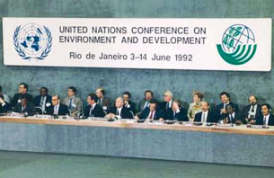
History of Sustainable Development/Consumption
United Nations Conference on Environment and Development (1992)

Slide 4
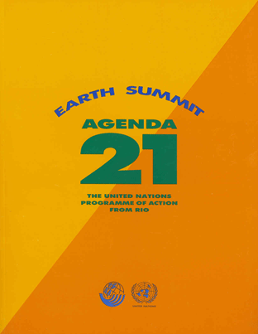
History of Sustainable Development/Consumption
Agenda 21 (1992)

Slide 5
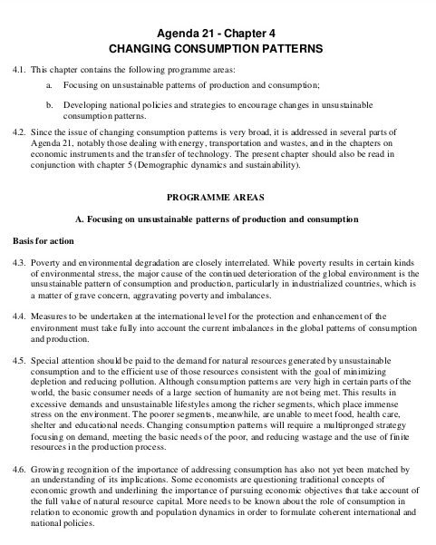
History of Sustainable Development/Consumption
Agenda 21 (1992)

Slide 6
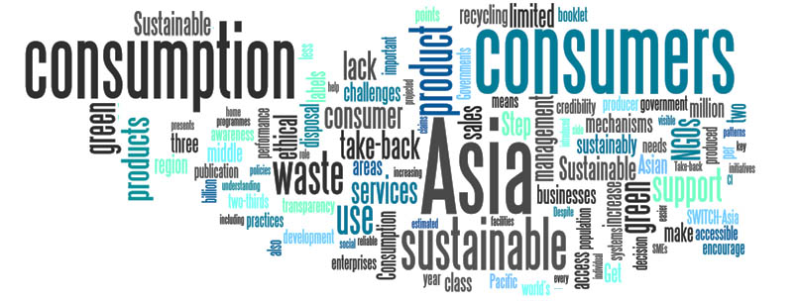
History of Sustainable Development/Consumption
Agenda 21 (1992)
“[A]ll countries should strive to promote sustainable consumption patterns.”

Slide 7
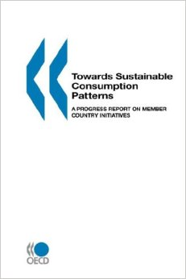

History of Sustainable Development/Consumption
Aftermath of the Rio Earth Summit (1992–2002)

Slide 8
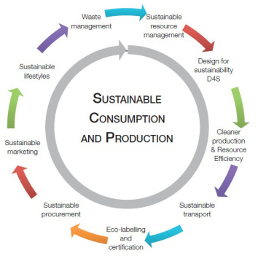
History of Sustainable Development/Consumption
Lines of Conceptual Tension: Production vs. Consumption

Slide 9
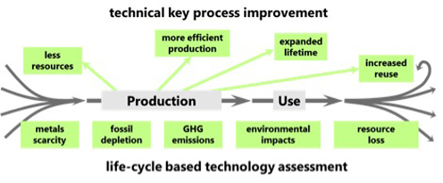
Sustainable Production
Key areas of focus: industrial ecology, life cycle analysis, clean production engineering, renewable energy deployment, energy efficiency, toxics reduction

Slide 10
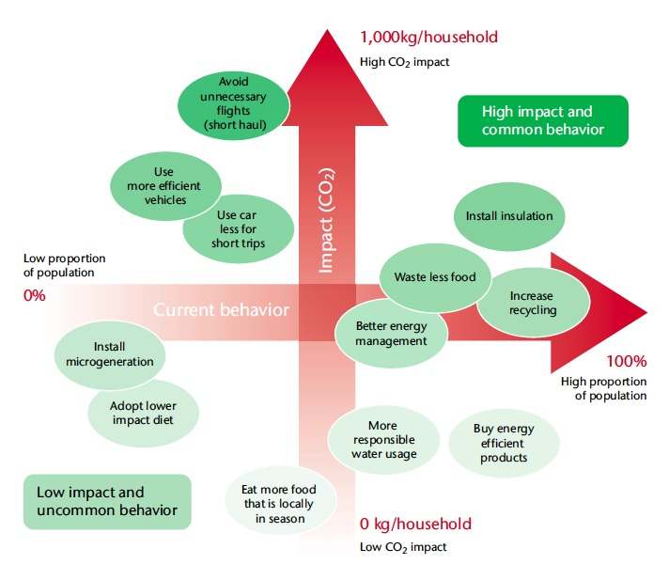
Sustainable Consumption
Key areas of focus: consumer choice (economics and psychology), materials recycling, waste reduction, localization (alternative agro-food networks)

Slide 11
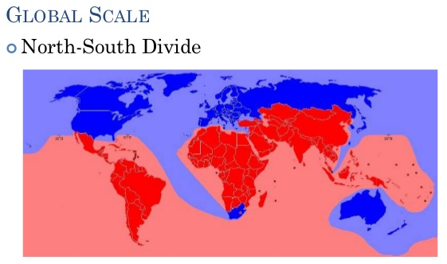
Lines of Conceptual Tension
Global North vs. Global South

Slide 12

Lines of Conceptual Tension
Global North
Production
Consumption
Global South

Slide 13
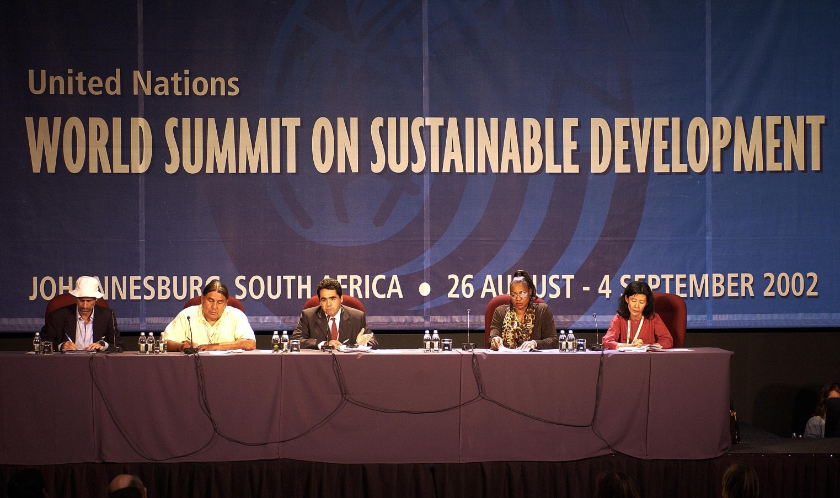
History of Sustainable Development/Consumption
World Summit on Sustainable Development (2002)

Slide 14
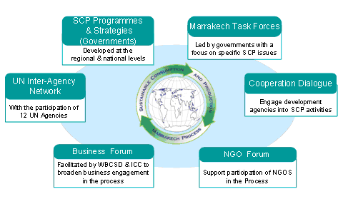
History of Sustainable Development/Consumption
Marrakech Process (2003–2013)

Slide 15

History of Sustainable Development/Consumption
Ten-Year Framework of Programmes on Sustainable Consumption and Production (2013‒Present)

Slide 16
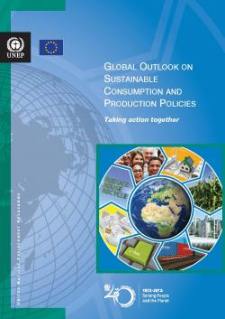
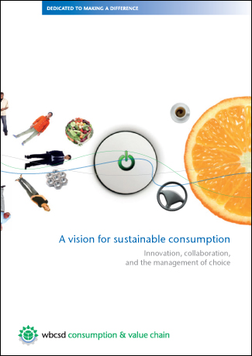
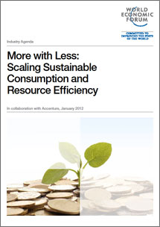
History of Sustainable Development/Consumption
Role of International Business in Sustainable Consumption

Slide 17
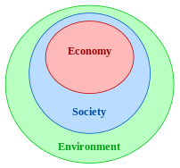
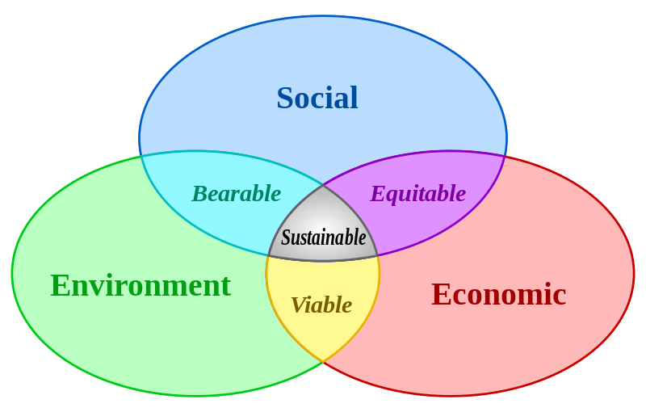
Weak vs. Strong Sustainable Consumption
Weak Sustainable Consumption
Strong Sustainable Consumption

Slide 18
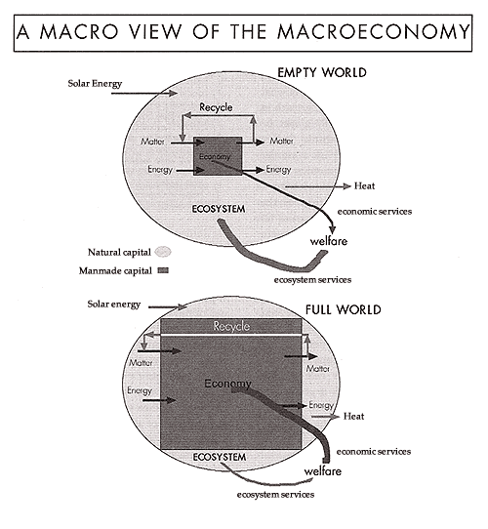
Strong Sustainable Consumption

Slide 19
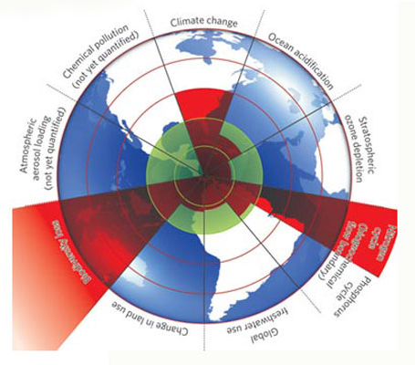
Planetary Boundaries
(Safe Operating Space for Humanity)
Climate change
Ocean acidification
Stratospheric ozone depletion
Nitrogen cycle
Phosphorus cycle
Global freshwater use
Changes in land use
Biodiversity loss
Atmospheric aerosol loading
Chemical pollution

Slide 20
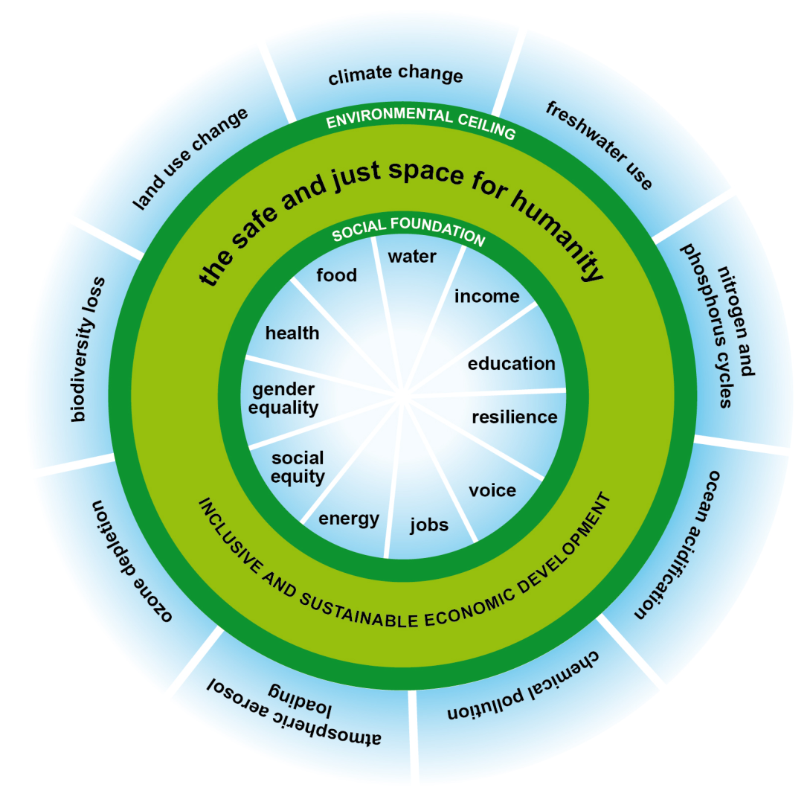
Sustainability Doughnut
(Safe and Just Space for Humanity)

Slide 21
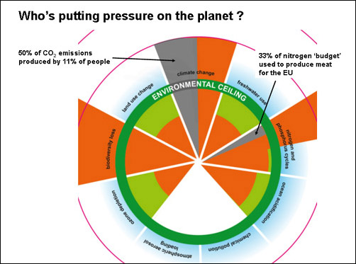
Sustainability Doughnut
(Safe and Just Space for Humanity)

Slide 22
Structure of the Field of Sustainable Consumption Research
Ecological economics
Environmental sociology
Ecological anthropology
Political science
Human geography
Industrial ecology
Marketing and consumer behavior
Business strategy
Consumer culture
Science and technology studies
Innovation studies
Architecture and design

Slide 23
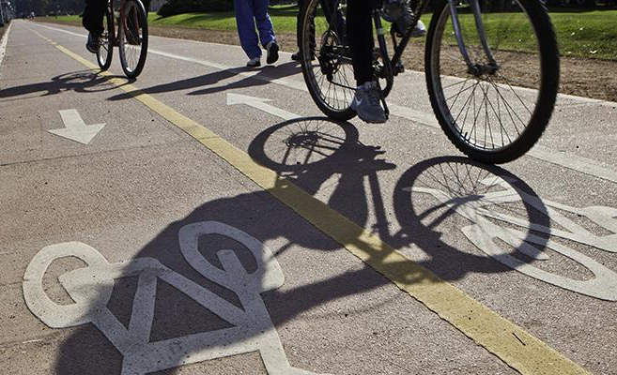
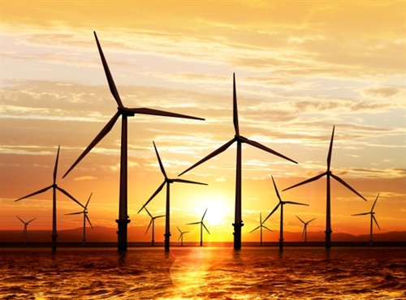
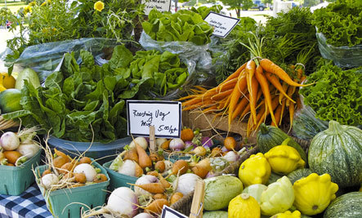
Structure of the Field of Sustainable Consumption Research
Mobility
Energy
Agro-Food Systems

Slide 24
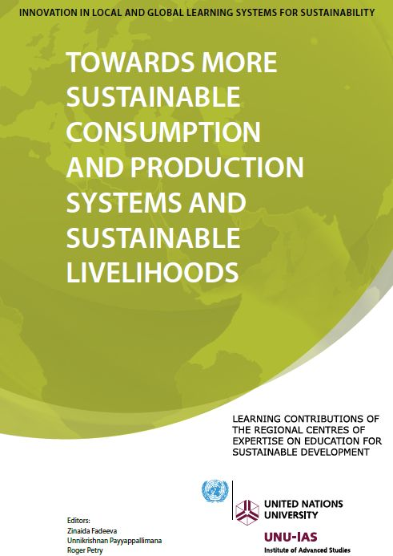
Sustainable Consumption Systems

Slide 25
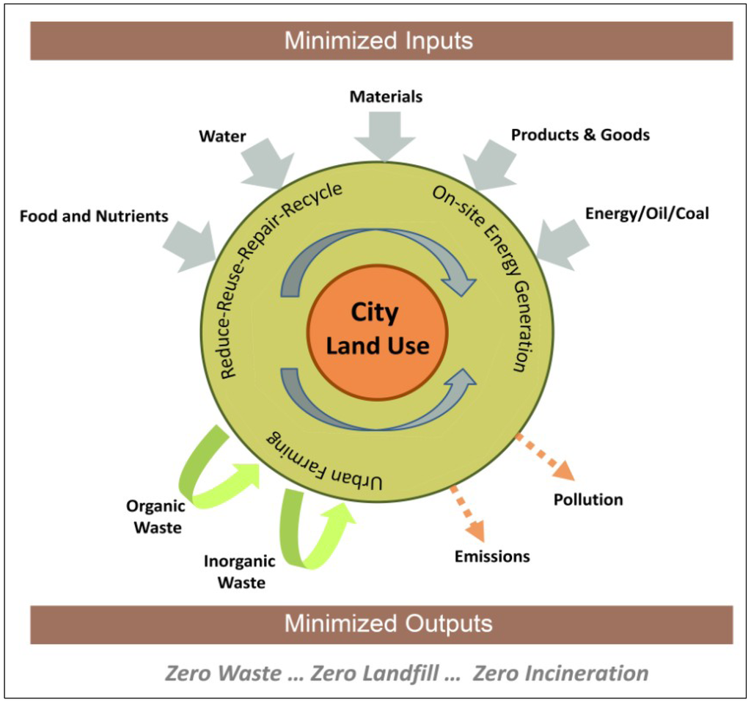
Sustainable Consumption and Cities
Land use and transportation
Urban metabolism
Materials/energy management
New modes of municipal governance
Transcending consumerist lifestyles
Alternative work practices

Slide 26
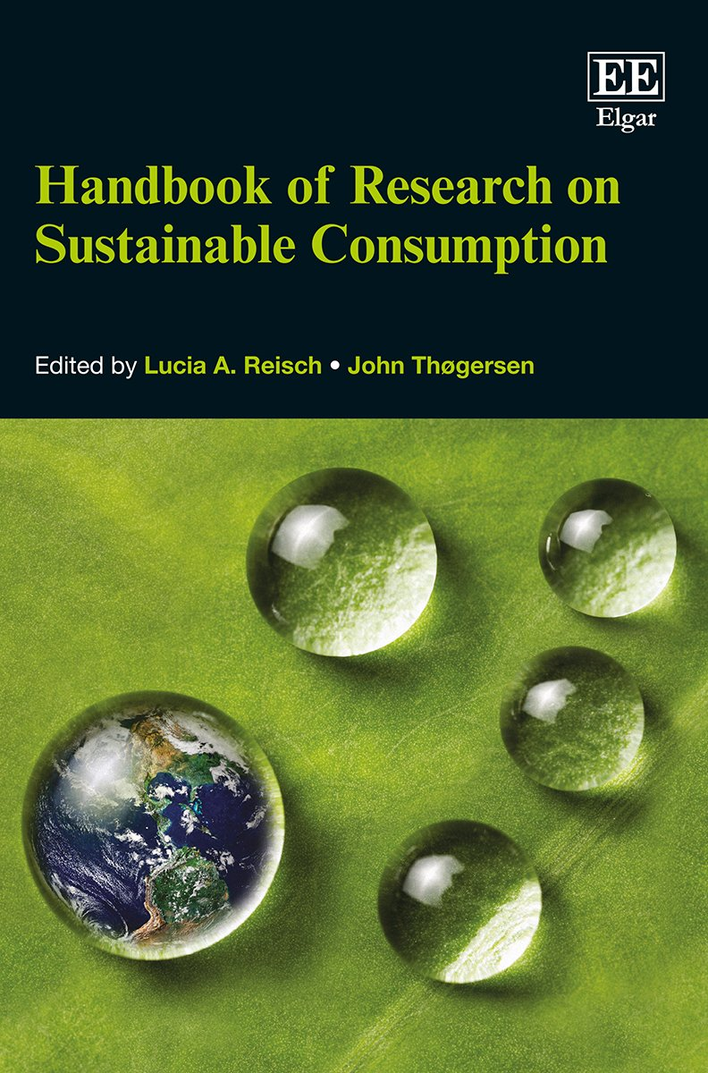
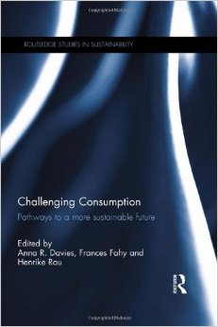

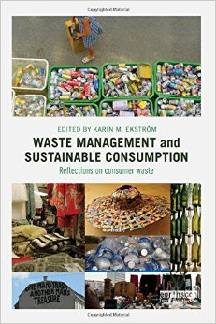
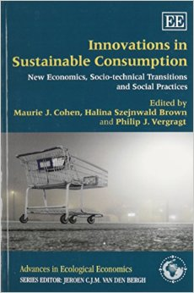
New Books on Sustainable Consumption

Slide 27
Shift Toward the Macrostructural Conditions for Sustainable Consumption
1. What are the consumption consequences of the demographic and geographic transitions that advanced industrial countries are currently experiencing?
2. Are we currently witnessing a weakening of the post-World War II consumer society in the United States and other countries? If so, what is likely to emerge as a future system of societal organization?
3. What are we to make of emergent developments regarding, for example, the so-called “sharing economy” and the “maker movement” with respect to consumerist lifestyles?
4. How can policy makers facilitate the transformation of large-scale socio-technical systems to support more sustainable patterns of consumption?

Slide 28
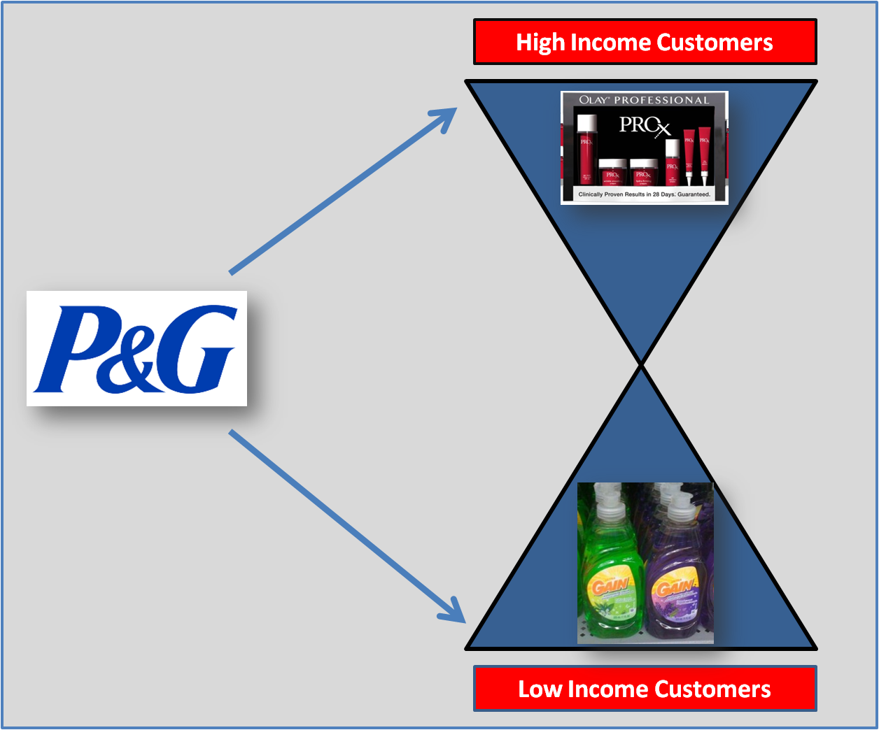
Conventional Business Response
Hourglass Society

Slide 29
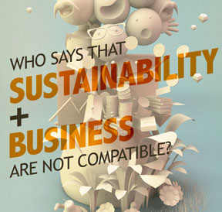
Sustainable Consumption and Business

Slide 30
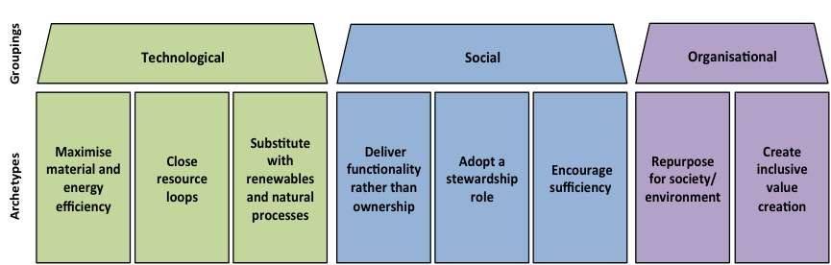
Beyond Efficiency Business Models for Sustainability
Easy
Difficult
From: http://nancybocken.com/sufficiency-based-sustainable-business-model-innovations-towards-a-typology

Slide 31
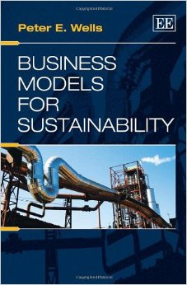
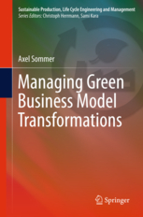
Research Community on Alternative Business Models for Sustainability (ABMfS)

Slide 32
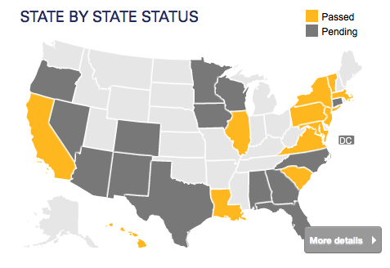
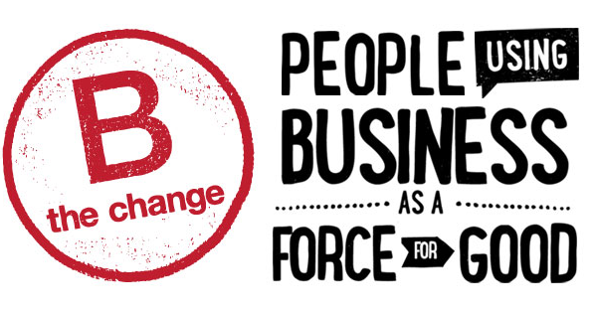
New Organizational Forms
B (Benefit) Corporations

Slide 33
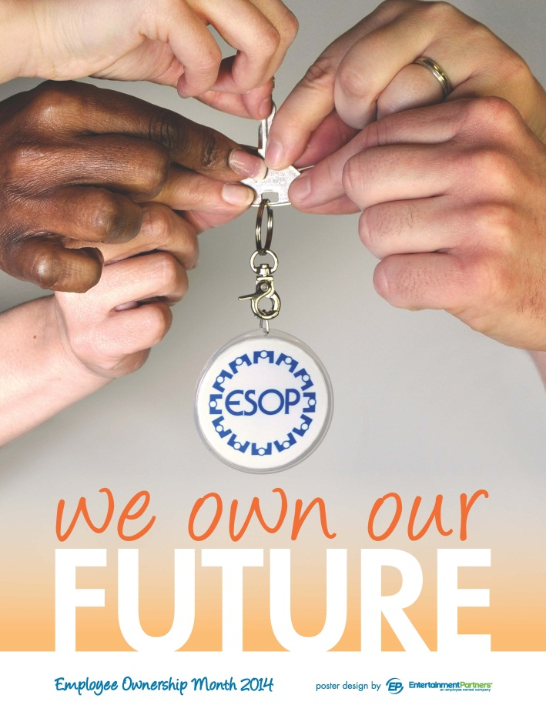
Rediscovered Organizational Forms
Employee Stock Ownership

Slide 34
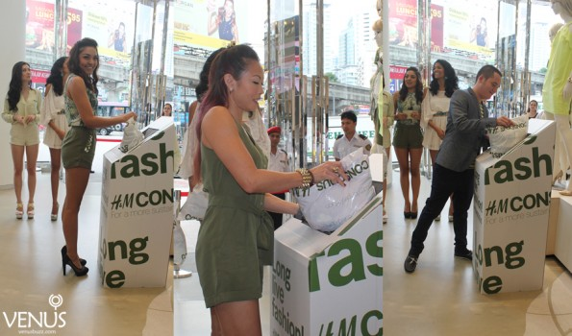
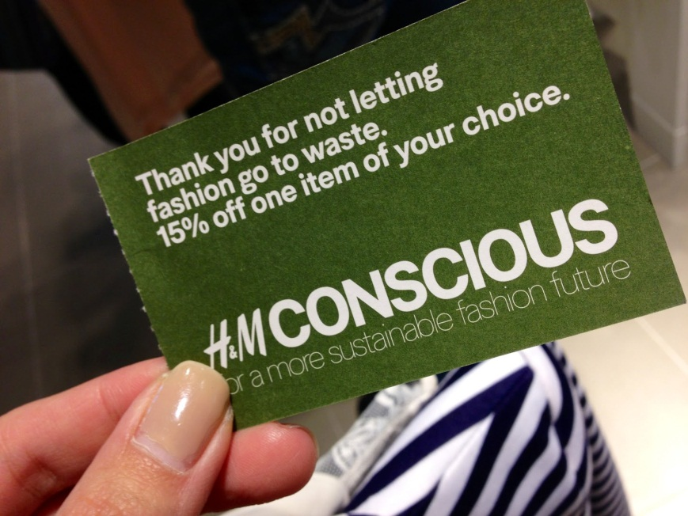
Examples of ABMfS in Practice
H&M

Slide 35
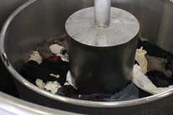
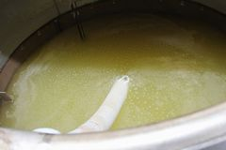
Examples of ABMfS in Practice
Used Clothing into Bioethanol

Slide 36
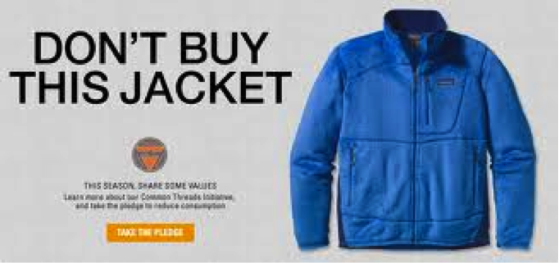
Examples of ABMfS in Practice
Patagonia

Slide 37
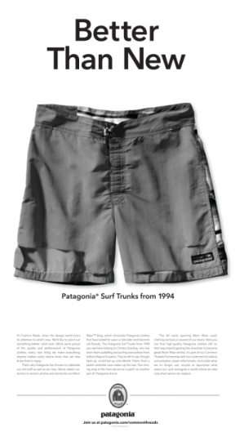

Examples of ABMfS in Practice
Patagonia

Slide 38
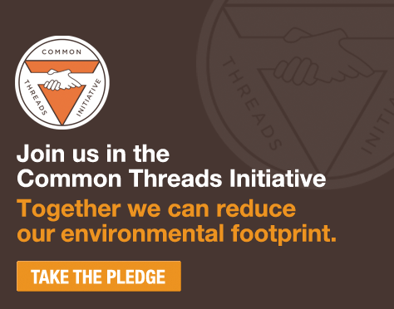
Examples of ABMfS in Practice
Patagonia

Slide 39
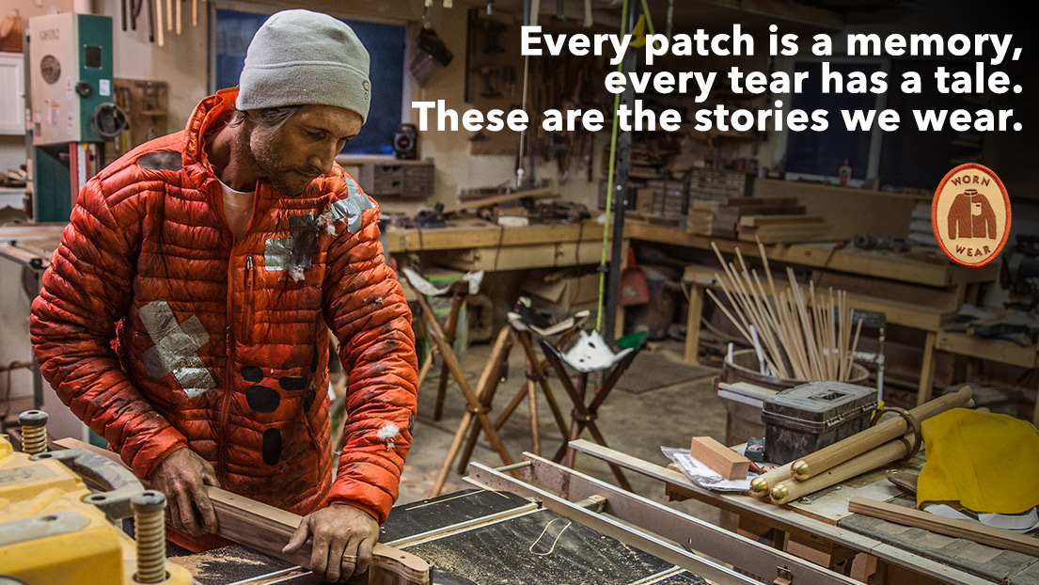
Examples of ABMfS in Practice
Patagonia

Slide 40
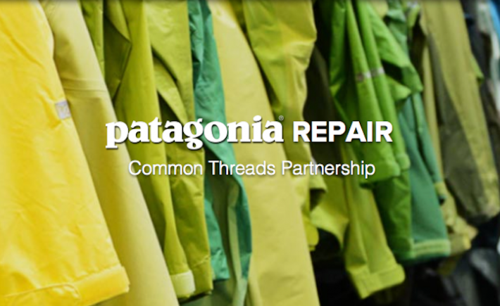
Examples of ABMfS in Practice
Patagonia

Slide 41
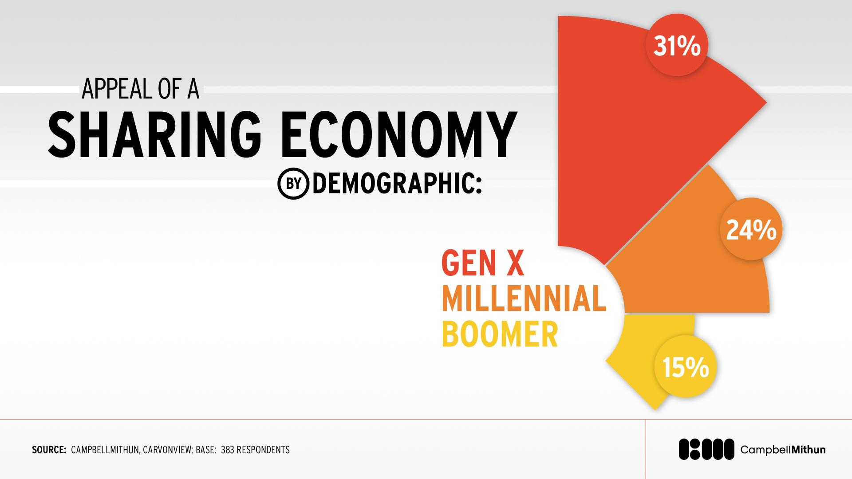
Examples of ABMfS in Practice
Shift from Ownership to Access/Sharing

Slide 42
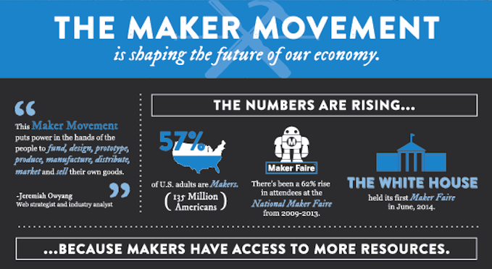
Examples of ABMfS in Practice
Maker Economy/Prosumption

Slide 43
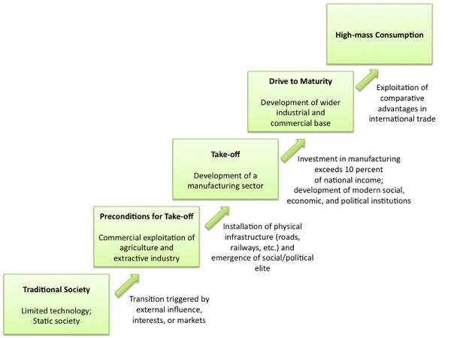
Rostow’s Stages of Growth Theory

Slide 44
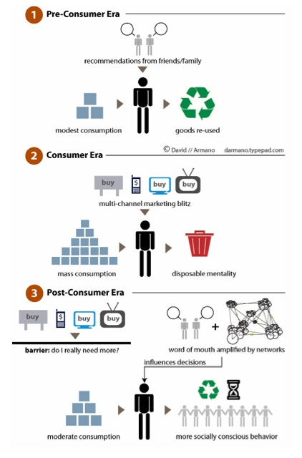
Toward Post-Consumerism?

Slide 45




Toward Post-Consumerism?

