Slide 1
Sustainable Consumption and Economic Democracy: Opportunities for Hybrid Cooperativism
Maurie J. Cohen, Director
Science, Technology, and Society Program
New Jersey Institute of Technology
Newark, NJ 07102 USA
mcohen@njit.edu
and
Associate Fellow
Tellus Institute
Boston, MA 02116 USA
Presentation at the Department of Energy and Environment, Chalmers University of Technology, Gothenburg, Sweden, 8 March, 2016

Slide 2

http://www.scorai.org
SCORAI is a knowledge network of professionals working at the interface of material consumption, human well-being, and technological and cultural change. We aim to foster a transition beyond the currently dominant consumer society.

Slide 3
Comprises 800+ academics and policy practitioners around the world
Regional sub-networks operate in North America, Europe, China, and (most recently) Israel
Each regional sub-network organizes conferences, workshops, collaborations with practitioners, publishes books and special journal issues
Operates a dynamic website and active listserv and publishes a monthly newsletter
Provides an audience for dissemination of research and organizational structure for the field (including the recently launched Routledge –SCORAI Book Series on Sustainable Consumption)

Slide 4

http://sspp.proquest.com

Slide 5
The Future of Consumer Society: Prospects for Sustainability in the New Economy (Oxford University Press, 2016)
1. “Sharing” Economy
2. Maker Movement
3. Economic Localization
4. Effects of Digital Automation on Consumption

Slide 6
Sustainable Consumption as a Field of Research and Policy Practice
Ecological Economics
Environmental Sociology
Industrial Ecology
Sustainable
Consumption
Environmental/
Consumer Psychology
Innovation
Studies

Slide 7

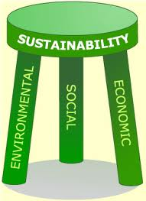

Sustainable consumption has largely been about reducing energy and material throughputs, or environmental sustainability.

Slide 8
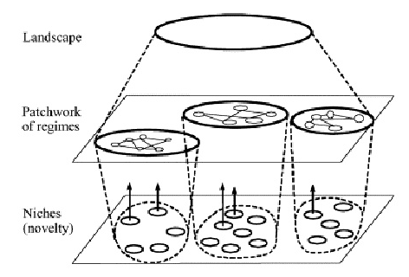
Sustainable System Change and the Multi-level Perspective

Slide 9
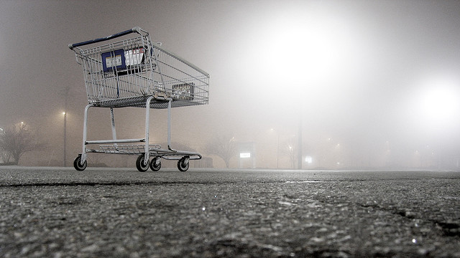
Are We Reaching the End of Consumer Society?
Demographic aging
Increasing income inequality
Decline of wage-based employment
Inadequate public investment
New preferences and cultural values
(especially among Millennials)

Slide 10
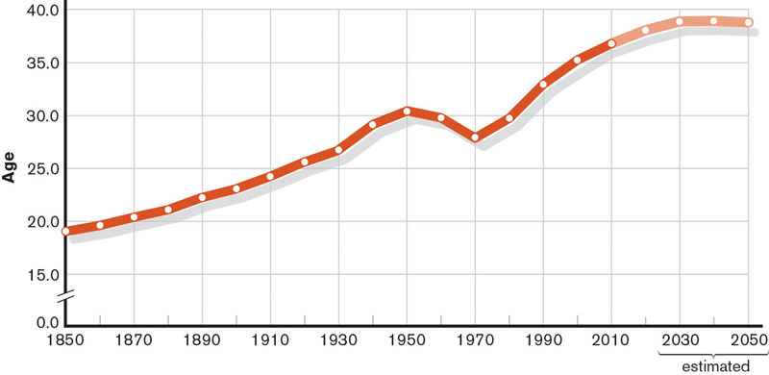
Demographic Aging
Median Age, United States, 1850–2050

Slide 11
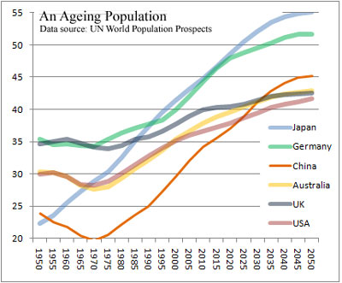
Demographic Aging

Slide 12
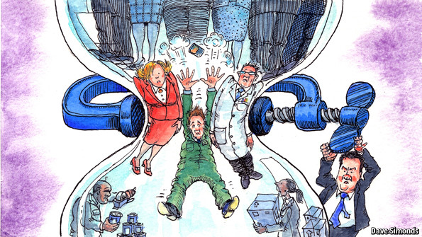
Income Inequality and the Hourglass Society
Several OECD countries are inexorably moving toward an hourglass society as the gains of economic growth are disproportionately captured by the uppermost income/wealth quintiles.

Slide 13
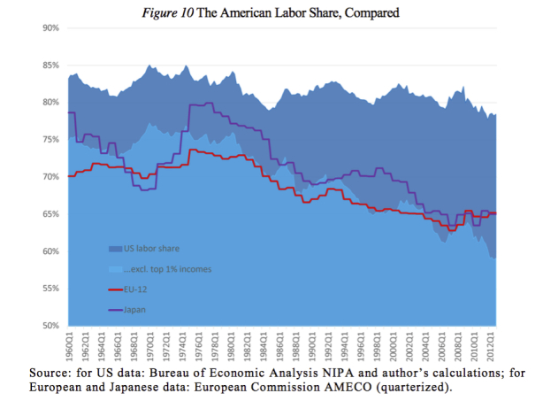
Labor Share of GDP, 1960–2012
https://anticap.wordpress.com/tag/exploitation

Slide 14
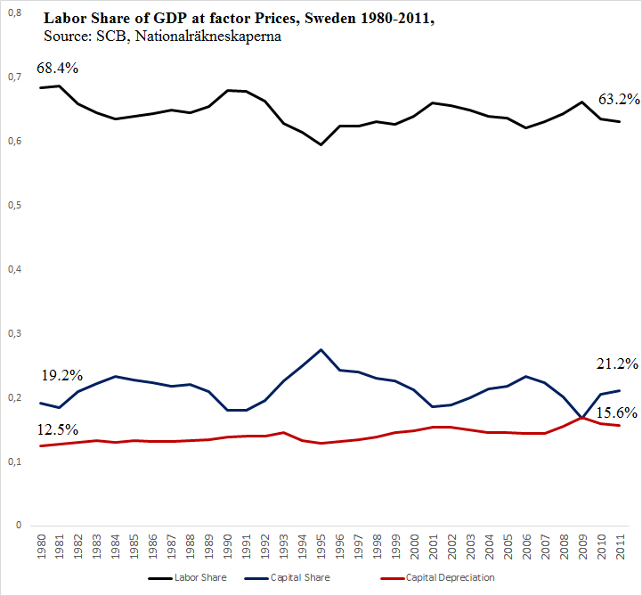
Labor Share of GDP, Sweden 1980–2011

Slide 15
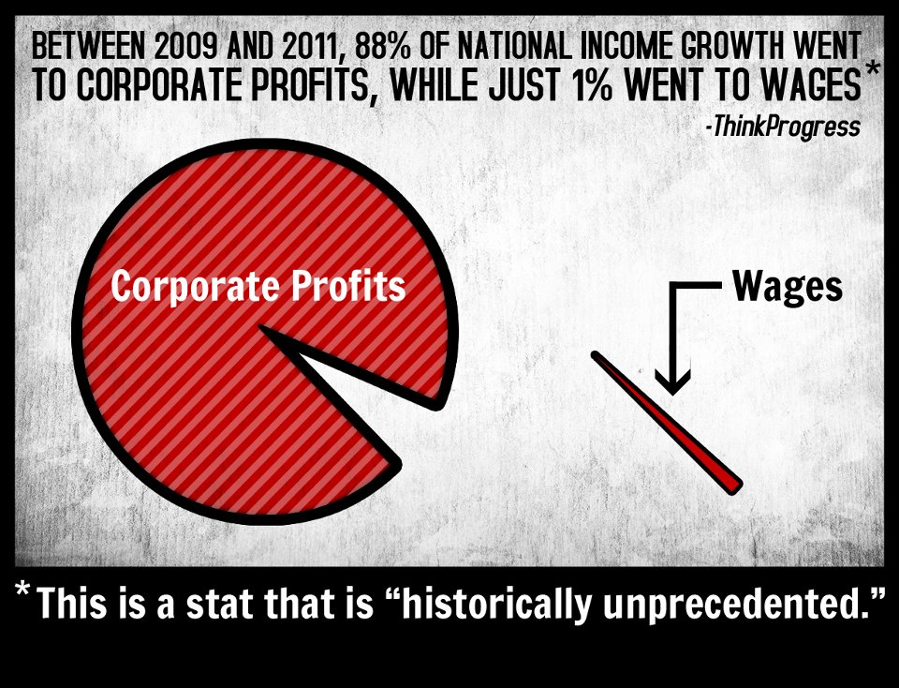
A Marxist Labor-Theory-of-Value Perspective
https://philebersole.wordpress.com/2013/02/05/the-labor-theory-of-value

Slide 16
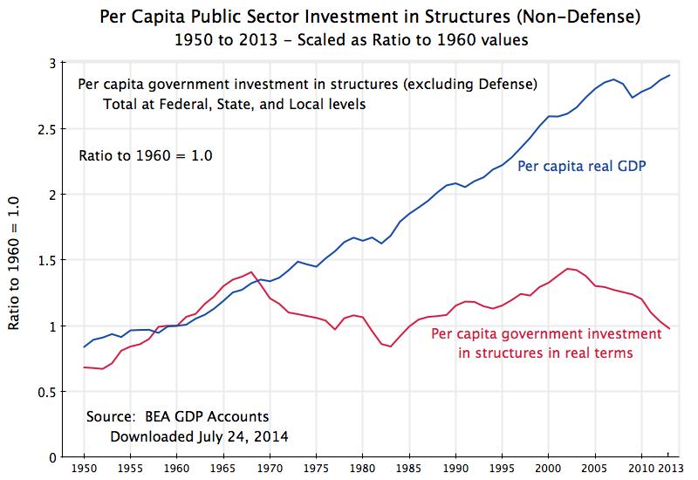
Decline in Public Investment

Slide 17
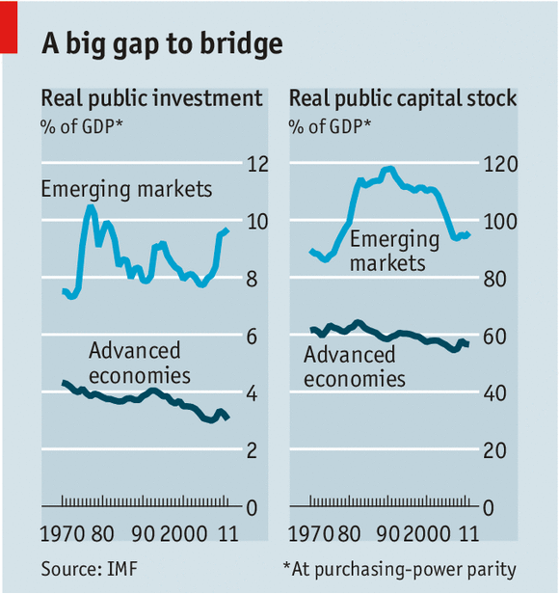
Decline in Public Investment

Slide 18
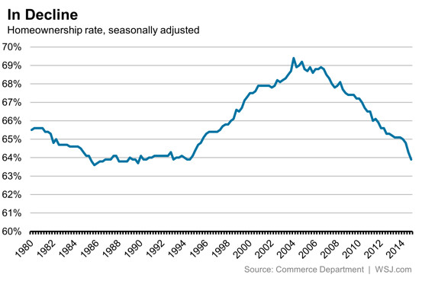
New Consumer Preferences/Capabilities

Slide 19
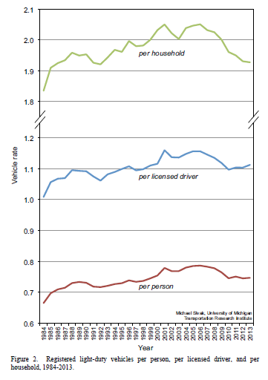
New Consumer Preferences/Capabilities
Vehicles Miles Driven Per Year, United States, 1984‒2013

Slide 20

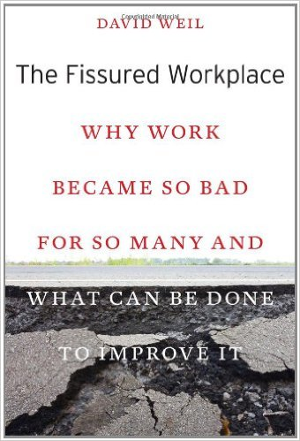
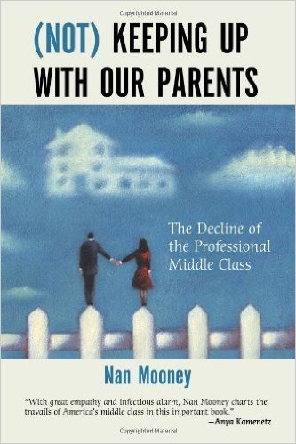
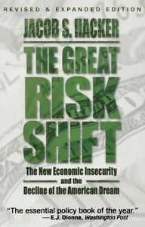
Sample of the Literature on the “New Economy”

Slide 21
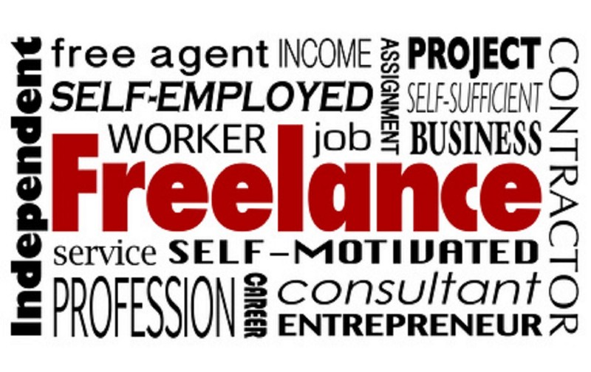
The Next Challenge for Sustainable Consumption
Against the background, how do we increase well-being on a cross-class basis in ways that simultaneously enhance economic, social, and environmental sustainability?

Slide 22
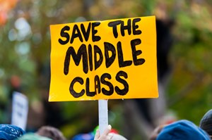
A Marxist Labor-Theory-of-Value Perspective
Can a Consumer Society Persist in the Face of a Shrinking Middle Class?

Slide 23
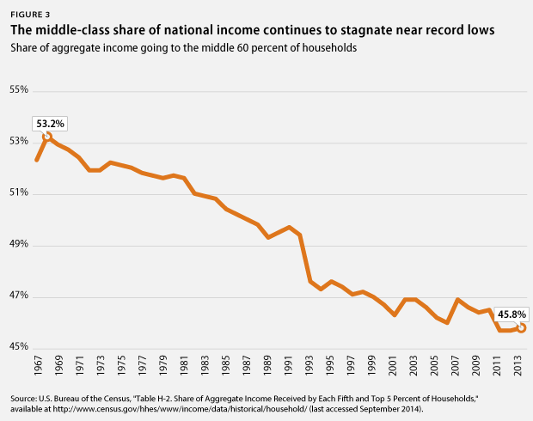
A Marxist Labor-Theory-of-Value Perspective
Can a Consumer Society Persist in the Face of a Shrinking Middle Class?

Slide 24
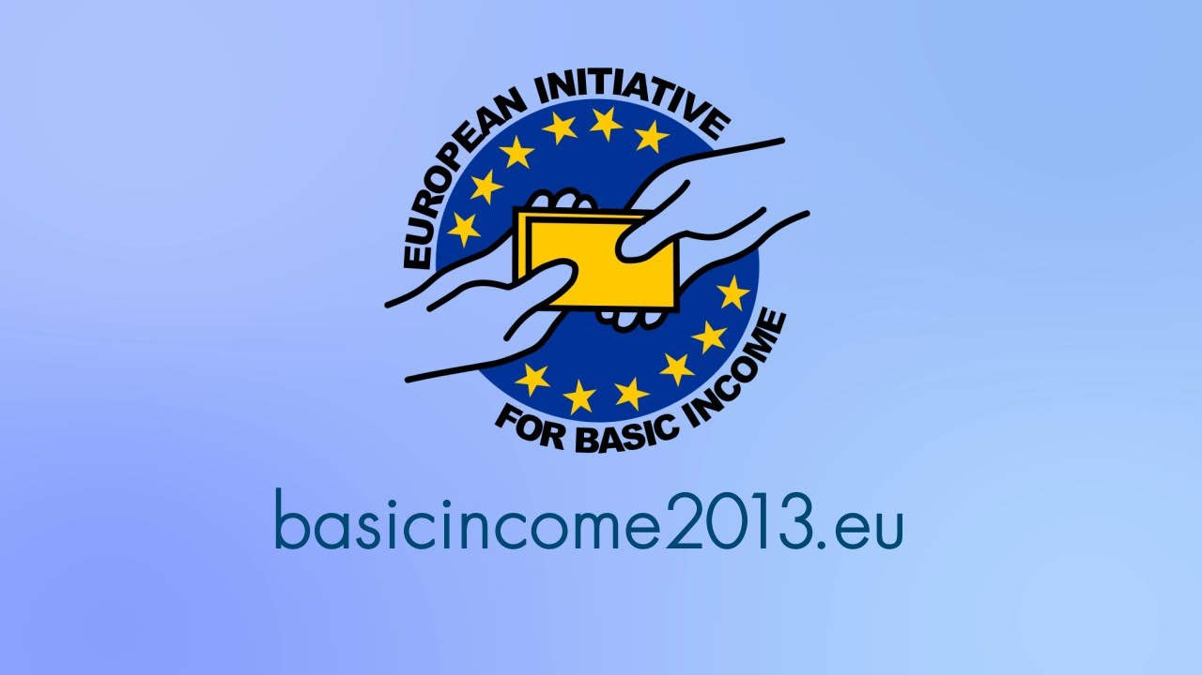
Responses Focused on Increasing Non-labor Income
1. Universal Basic Income

Slide 25
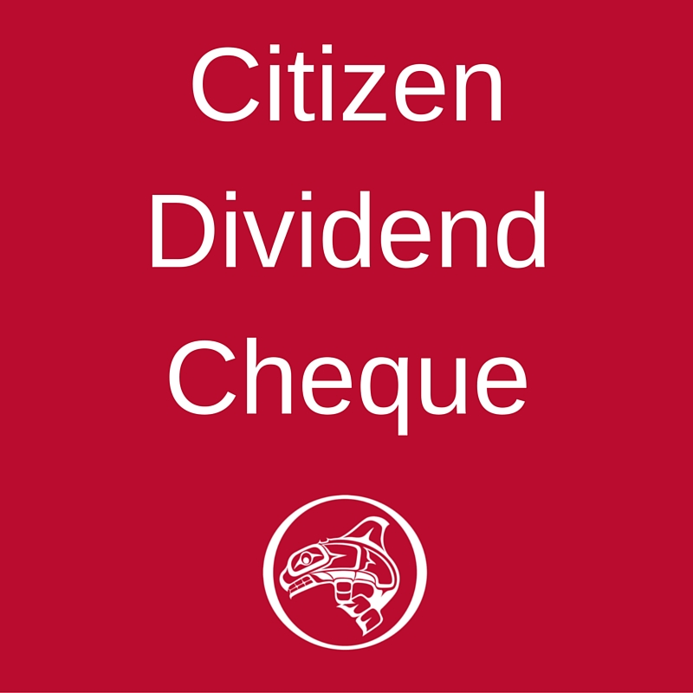
Responses Focused on Increasing Non-labor Income
2. Citizen’s Dividend

Slide 26
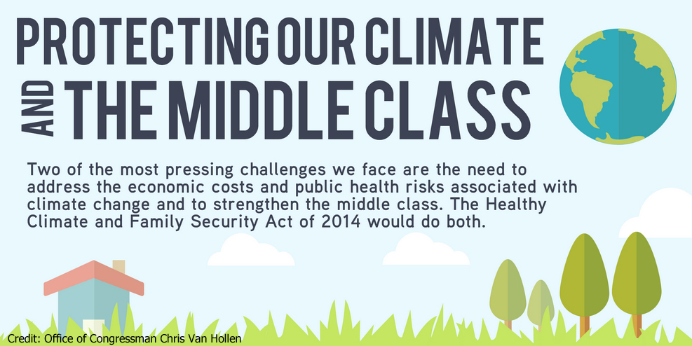
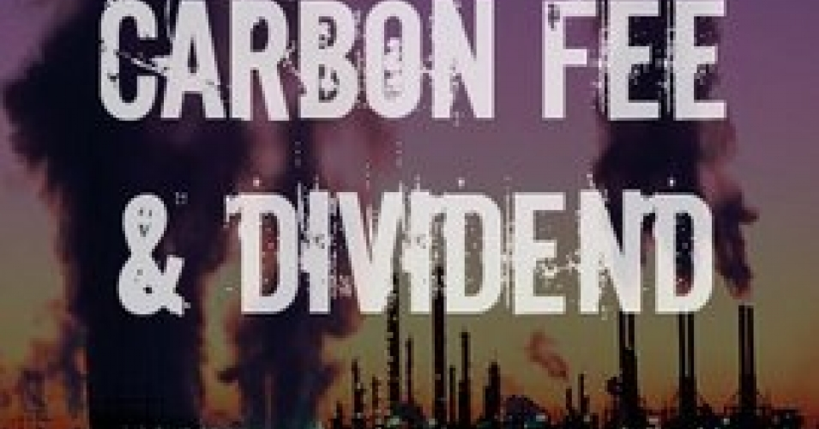
Responses Focused on Increasing Non-labor Income
Cap and Dividend (or Fee and Dividend)

Slide 27
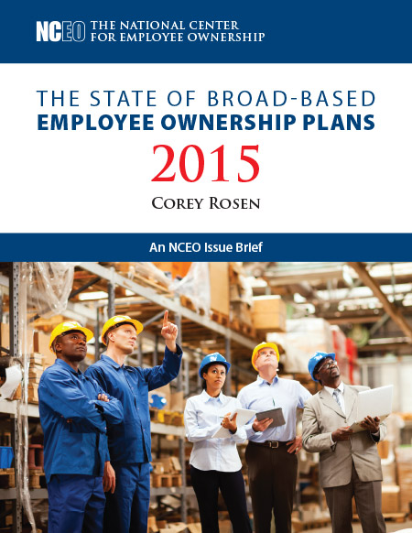
Responses Focused on Increasing Non-labor Income
3. Broad-based Stock Ownership

Slide 28
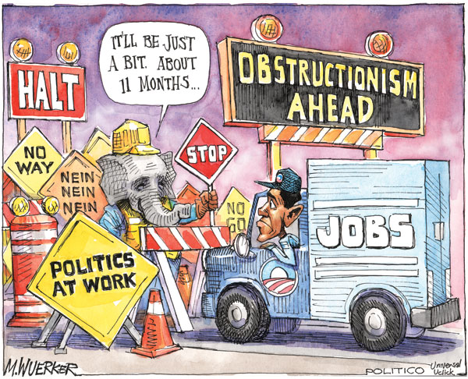

Slide 29
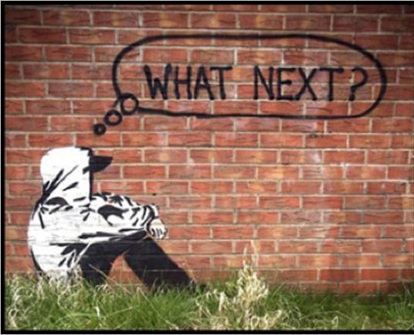
What Is to Be Done in the Short-term During an Era of Increasing Social Turbulence and Economic Precarity?

Slide 30
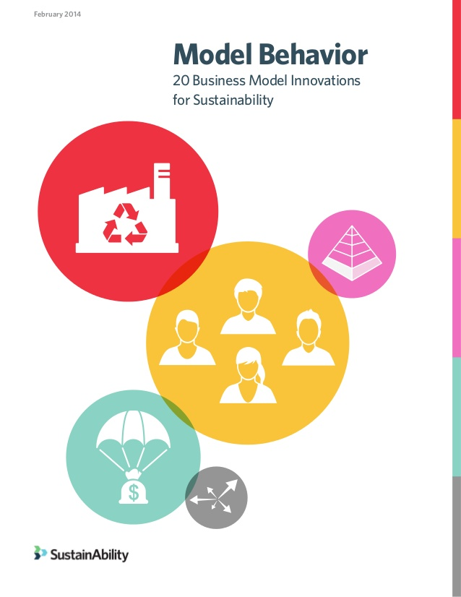
Alternative Business Models
http://www.sustainability.com/library/model-behavior#.Vrv8rPkrLcs

Slide 31
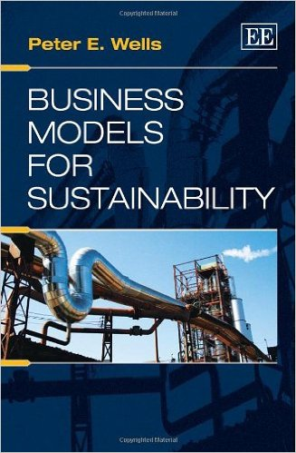
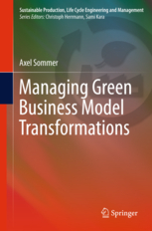
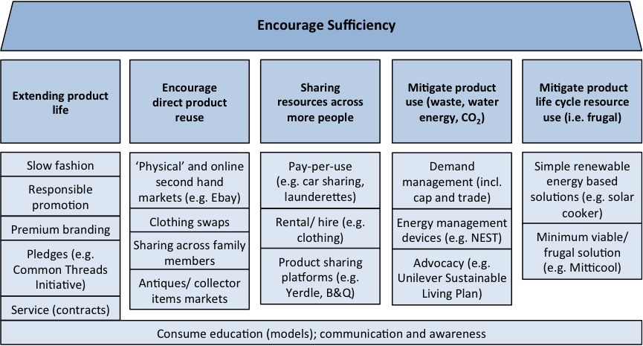
Alternative Business Models
Nancy Bocken et al, Journal of Cleaner Production

Slide 32
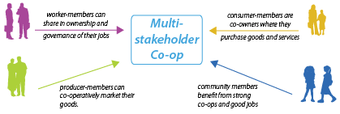
Multi-stakeholder (Hybrid) Cooperativism

Slide 33
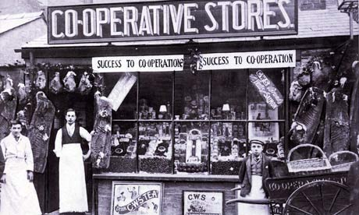
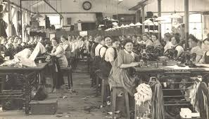
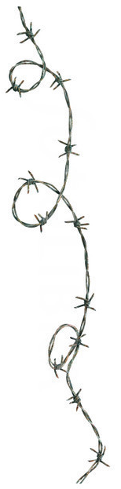
Worker and Consumer Cooperatives
Worker Cooperative
Consumer Cooperative

Slide 34
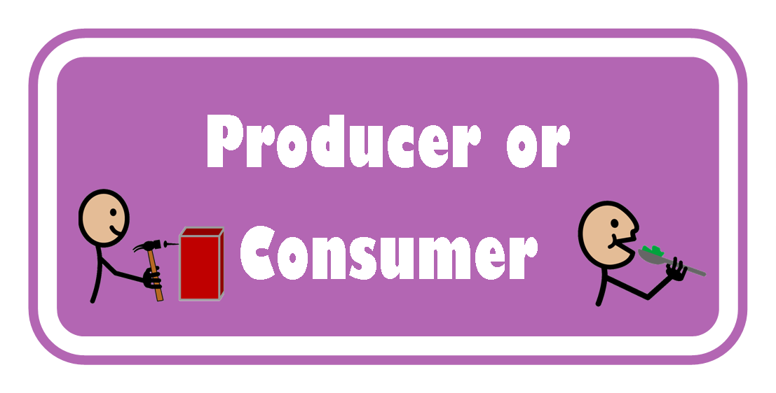
Worker and Consumer Cooperatives
It is though a figment of our reductionistic imagination to suppose that people are either workers (or producers) or consumers.

Slide 35
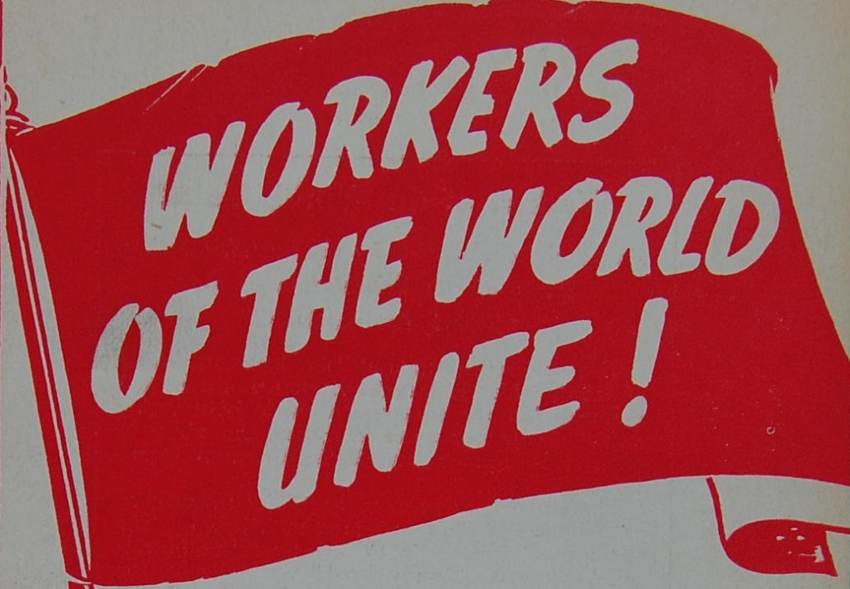
& CONSUMERS

Slide 36
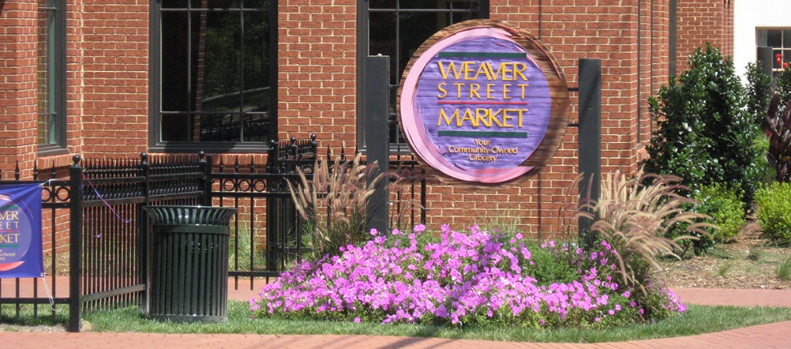

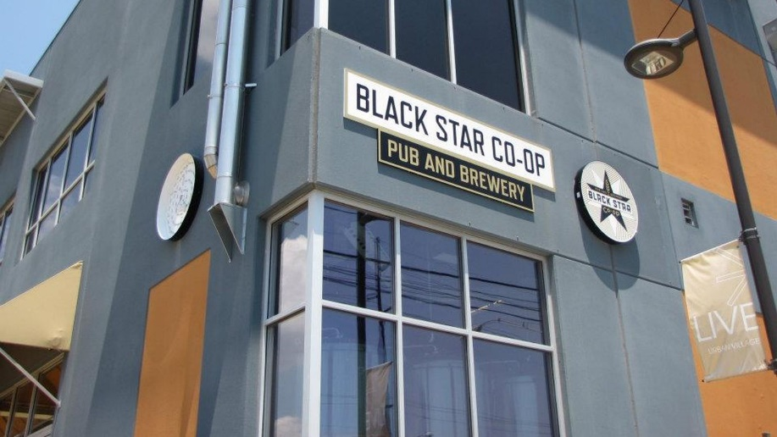
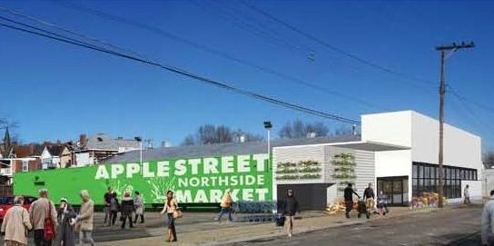
Worker-Consumer Cooperatives

Slide 37
Why Worker-Consumer Cooperatives?
Buffer economic insecurity by giving worker-consumers a financial stake in the provisioning system.
Offset vagaries of market capitalism by enabling worker-consumers to accumulate wealth through dividend disbursements and asset accumulation.
Build institutional bridges between producers and consumers and overcome the artificial divide between production and consumer (while also eliminating costs associated with retail brokerage).
Enhance social solidarity by building economically democratic institutions based on participatory organizational structures.
Modulate the tendency for overconsumption by bringing the logics of production and consumption into closer alignment.

