Slide 1
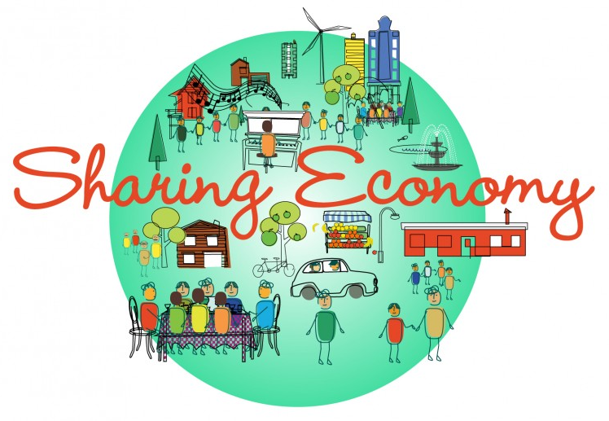
Law and Collaborative Consumption in the 21st Century
Maurie J. Cohen, Director
Program in Science, Technology, and Society
New Jersey Institute of Technology
Presentation at Sharing Economy, Sharing City: Urban Law and the New Economy, Fordham Urban Law Center, April 24, 2015

Slide 2

Transitions Beyond Consumer Society: Prospects for a Sustainable Future

Slide 3
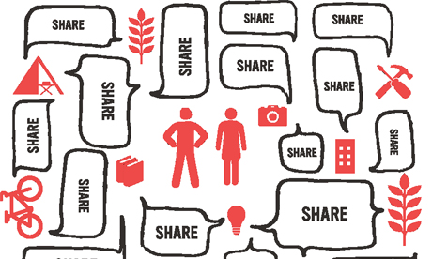
“Sharing” Economy (Collaborative Consumption)

Slide 4
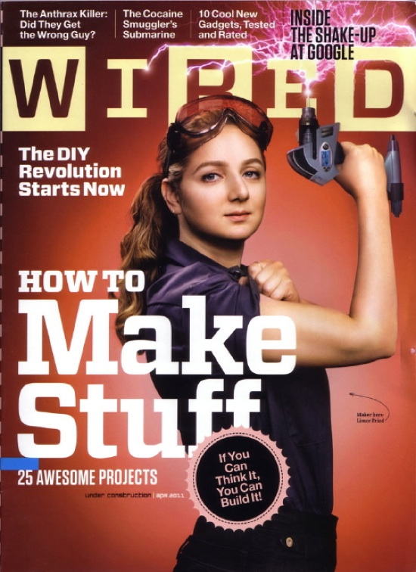
Maker Movement (Prosumption/Artisanal Crafting)

Slide 5
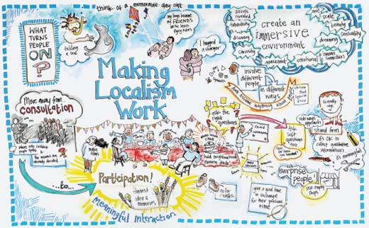
Economic Localization (Local Living Economies)

Slide 6
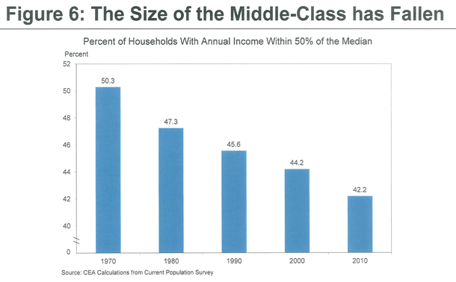
Can a Consumer Society Persist in the Face of a Shrinking Middle Class…?

Slide 7

…And What Does the Future Hold in Terms of Household Provisioning Practices?

Slide 8

“Sharing” Economy

Slide 9

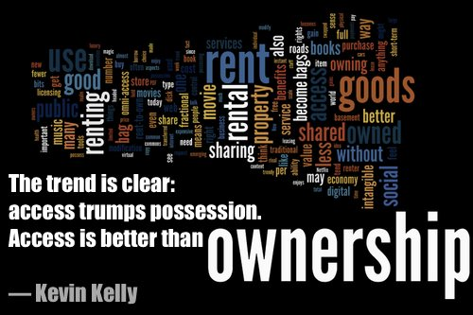
Shift From Ownership to Access (or Usership)

Slide 10

A Brief History of the “Sharing” Economy

Slide 11

A Brief History of the “Sharing” Economy

Slide 12
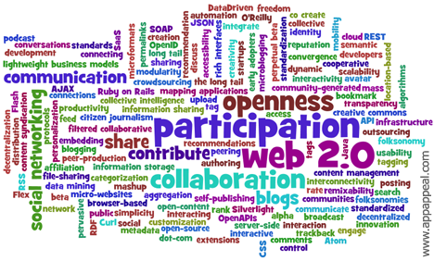
A Brief History of the “Sharing” Economy

Slide 13
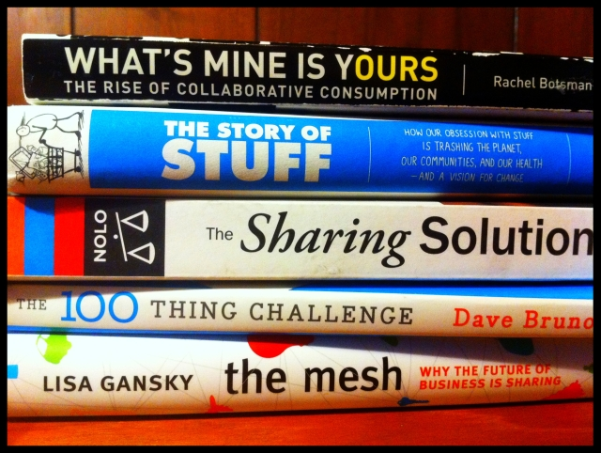
A Brief History of the “Sharing” Economy

Slide 14

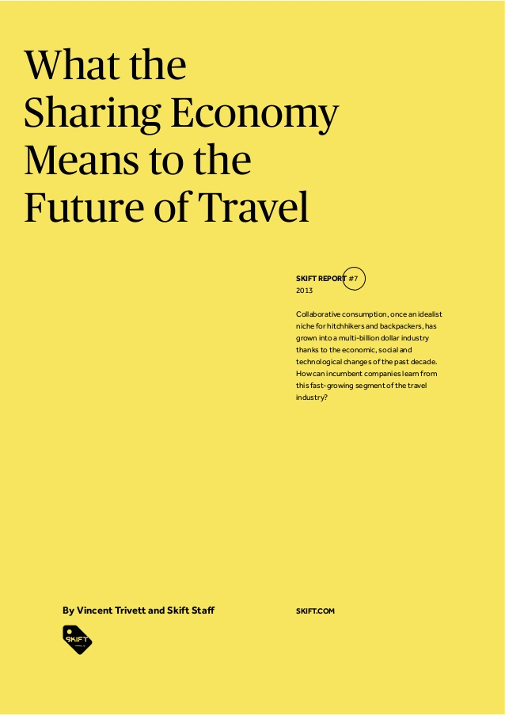
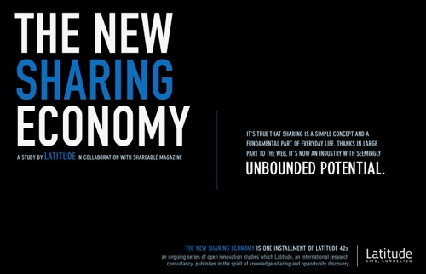
A Brief History of the “Sharing” Economy

Slide 15
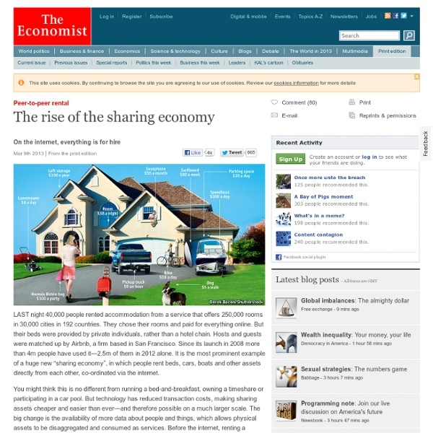
A Brief History of the “Sharing” Economy

Slide 16

A Brief History of the “Sharing” Economy

Slide 17

A Brief History of the “Sharing” Economy

Slide 18
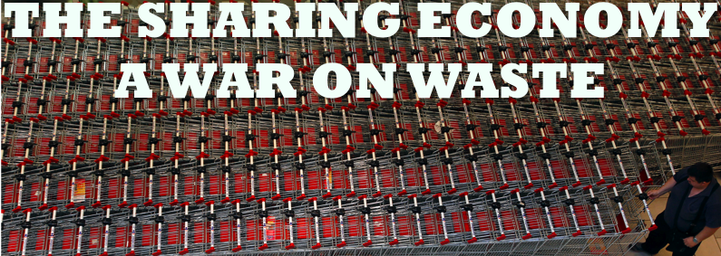
“Sharing” Has Acquired Appeal as a Sustainability Strategy

Slide 19

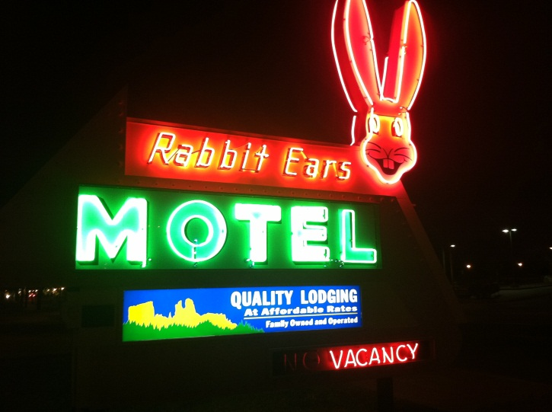
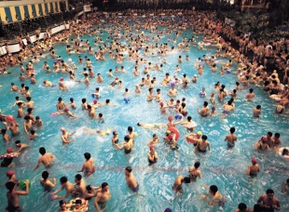
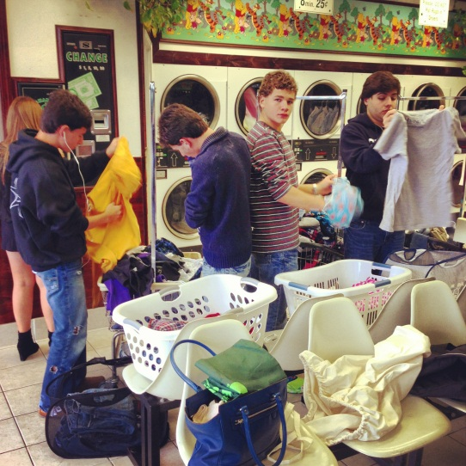
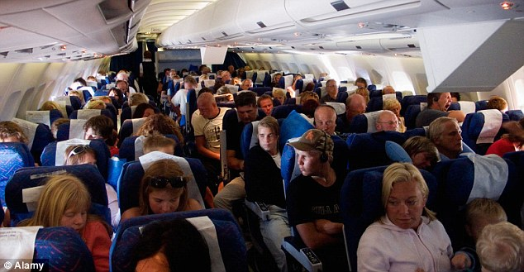
“Sharing” is Pervasive in the Normal Economy

Slide 20


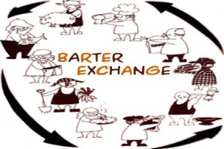

Conceptual Confusion Surrounding “Sharing”

Slide 21
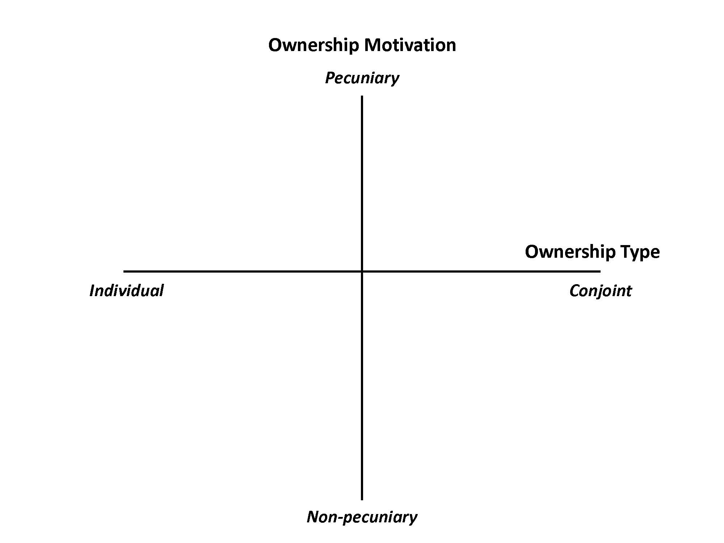
Taxonomy of the “Sharing” Economy

Slide 22
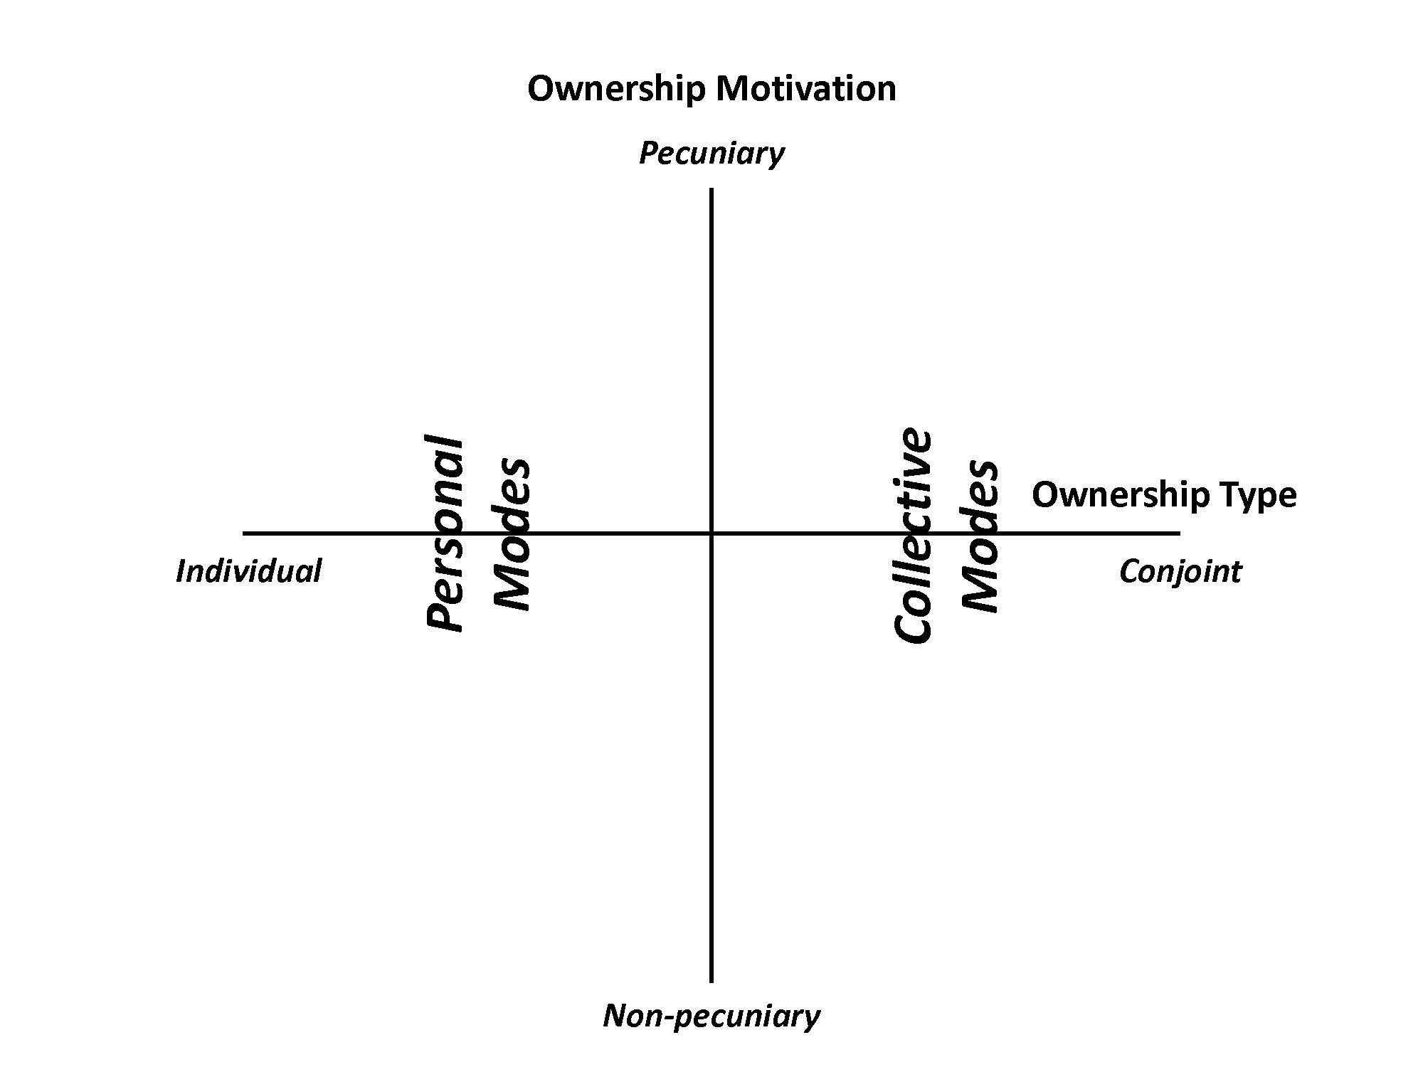
Taxonomy of the “Sharing” Economy

Slide 23
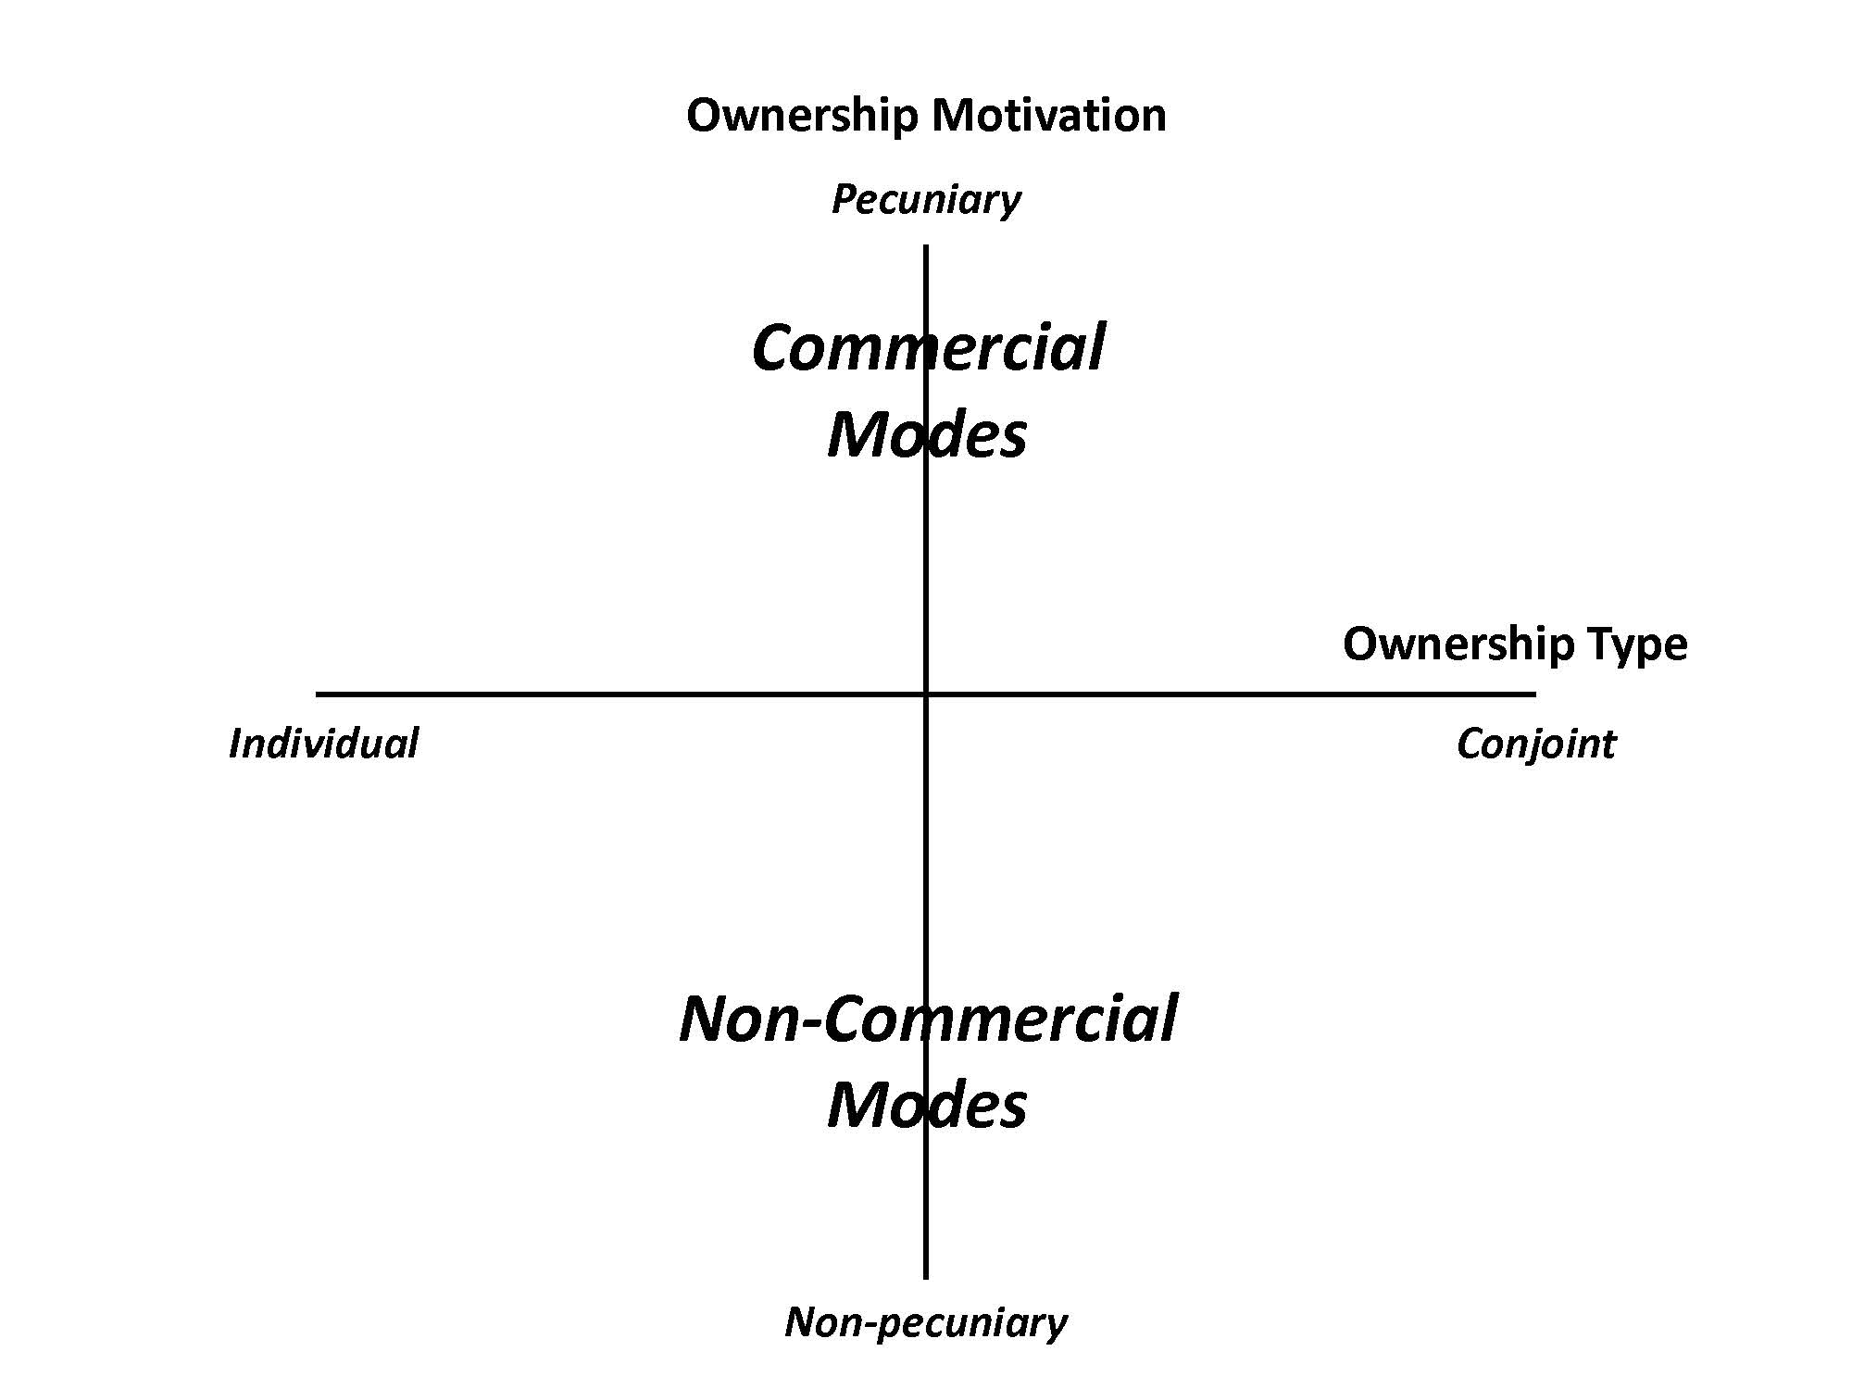
Taxonomy of the “Sharing” Economy

Slide 24

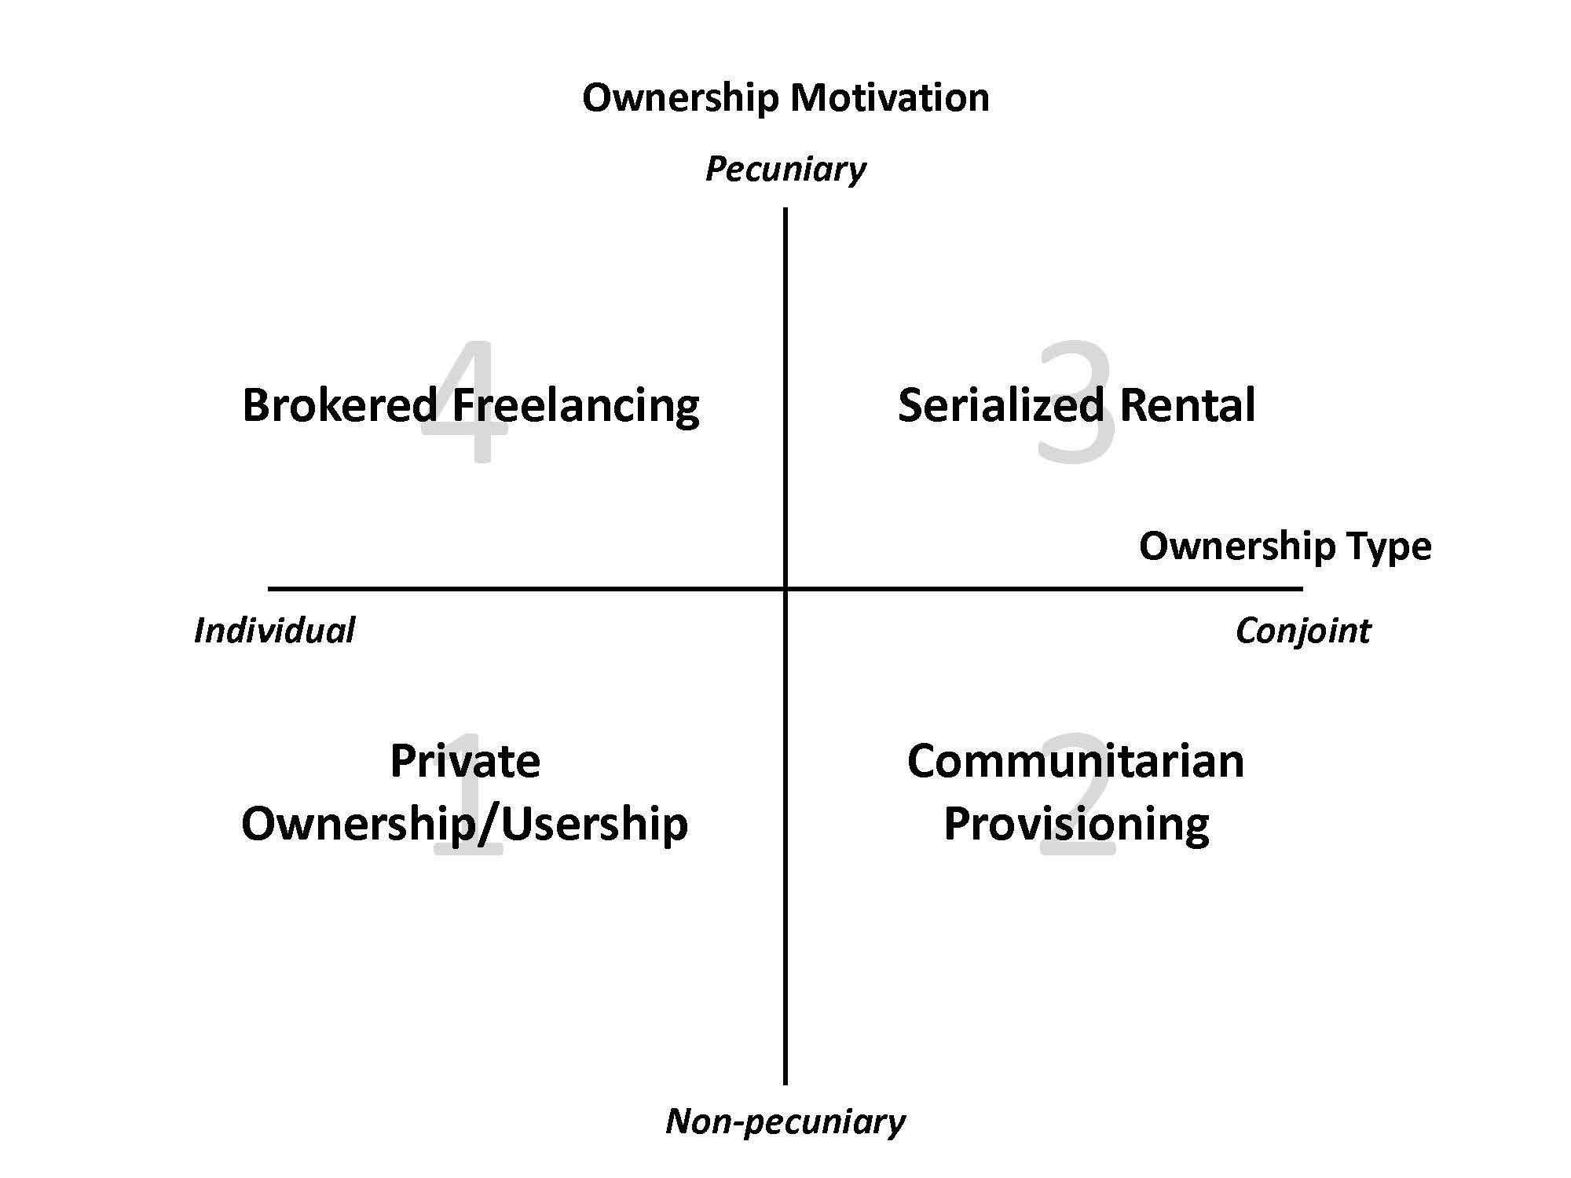
Taxonomy of the “Sharing” Economy

Slide 25

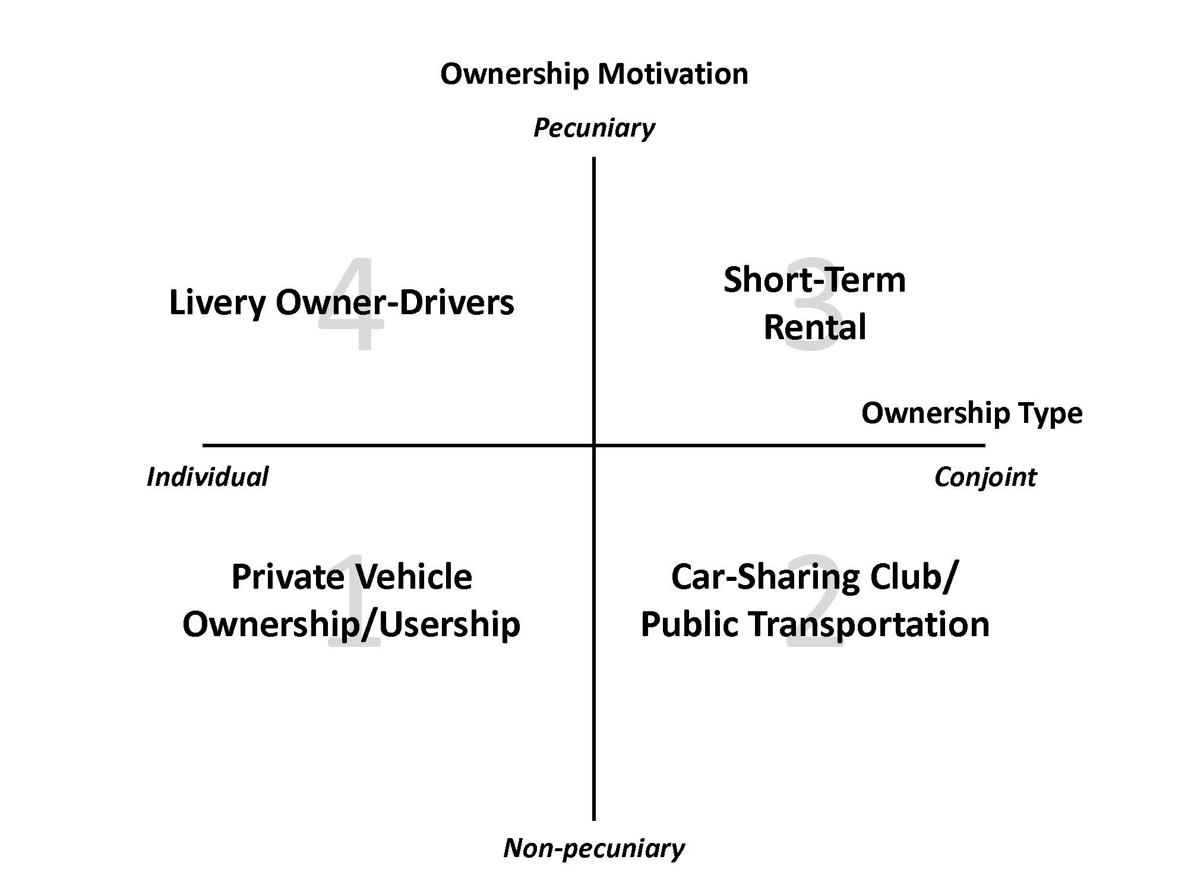


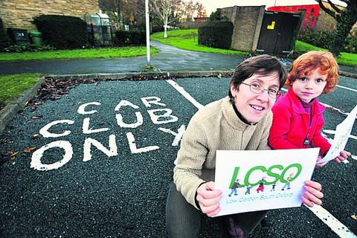

Taxonomy of the “Sharing” Economy

Slide 26
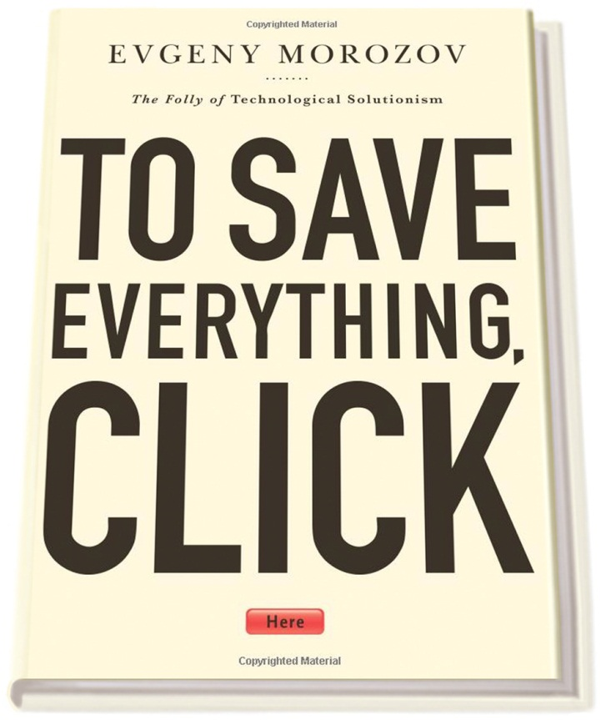

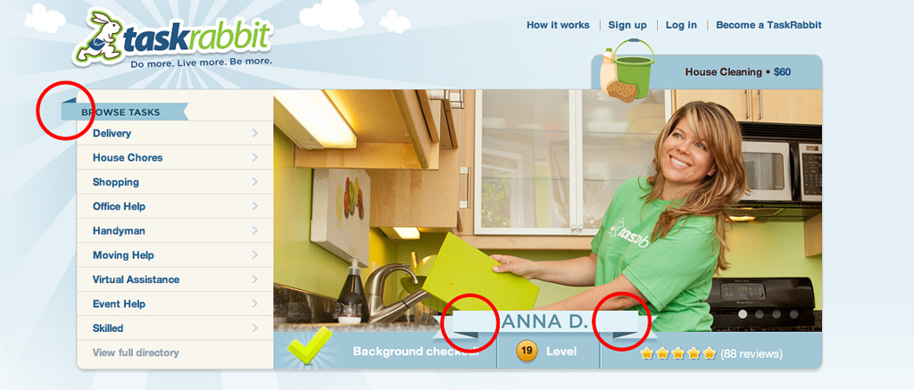
“Sharing” Economy as Neo-Liberal Solutionism?
Are service workers in the “sharing” economy empowered micro-entrepreneurs or is shared access just part of the “precariat” economy?

Slide 27
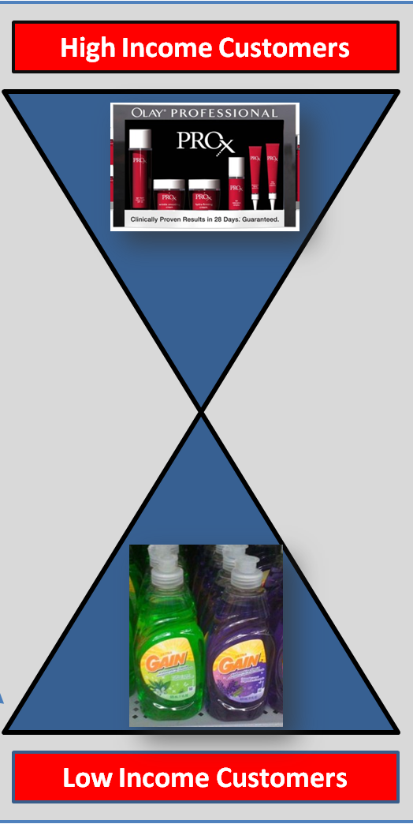
“Sharing” Economy Meets the Hourglass Society

Slide 28
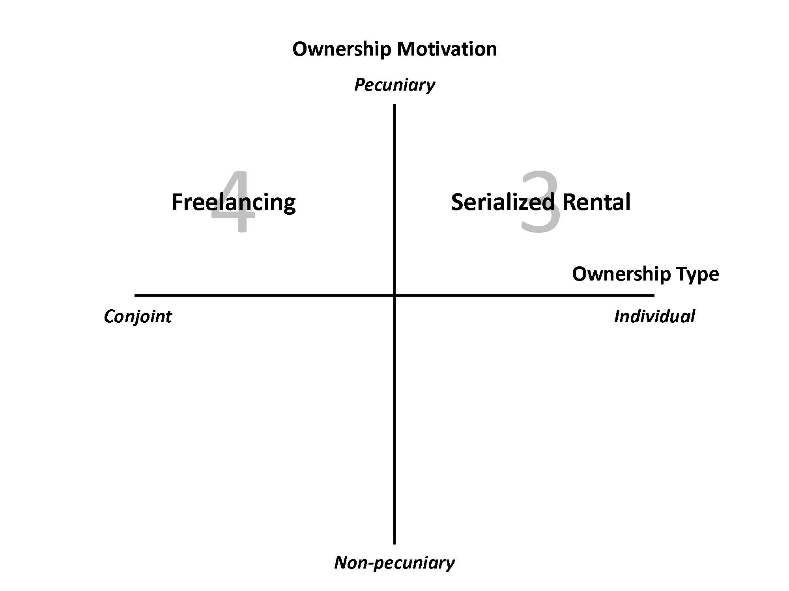
Taxonomy of the “Sharing” Economy
4
3
Brokered
Freelancing
Serialized
Rental
2
Communitarian
Provisioning

