Slide 1
Sustainable Consumption Research and Policy: Retrospect and Prospect
Maurie J. Cohen, Director
Science, Technology, and Society Program
New Jersey Institute of Technology
Newark, NJ USA
mcohen@njit.edu
and
Associate Fellow
Tellus Institute
Boston, MA USA
Meeting on Forming a Future Earth Knowledge Action Network (KAN) on Sustainable Consumption and Production, 2–3 March 2016, Research Institute for Humanity and Nature, Kyoto, Japan

Slide 2
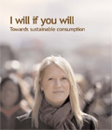
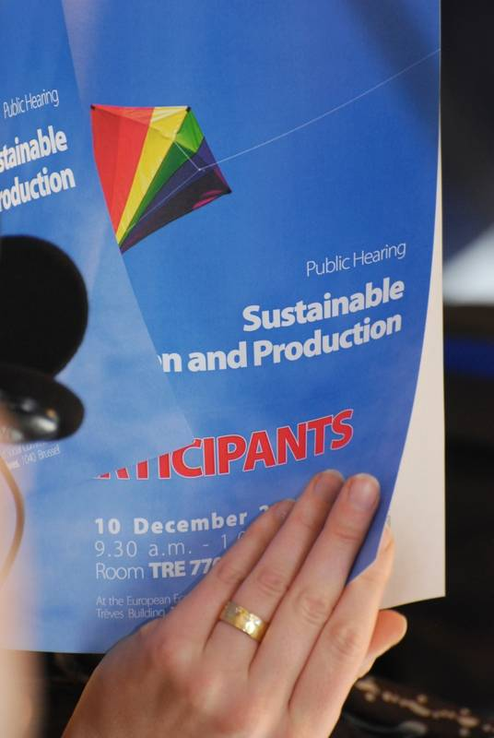

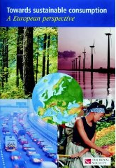
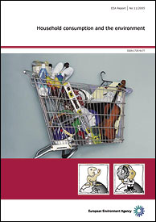

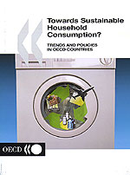
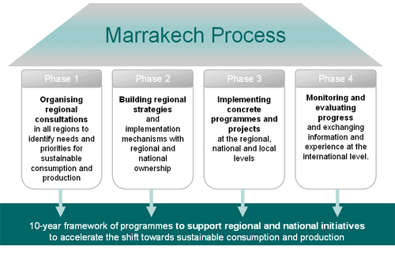
Overview of Sustainable Consumption (and Production) Policy
The last twenty years have seen the emergence of an international policy agenda organized around the notion of “sustainable consumption” (or “sustainable consumption and production”).

Slide 3
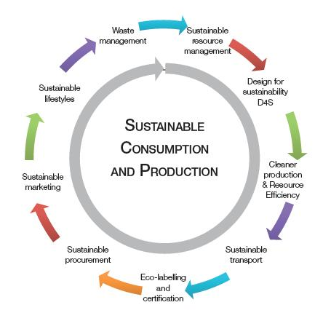
Tension Between SC and SP

Slide 4
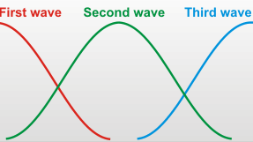
Three Waves of Sustainable Consumption Research (1995–Present)

Slide 5
Sustainable Consumption Research (~1995–2008)
Environmental/
Consumer Psychology
Industrial Ecology/Life Cycle Analysis
Sustainable
Consumption
Environmental Sociology/Politics

Slide 6
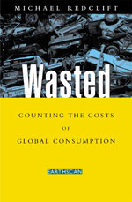
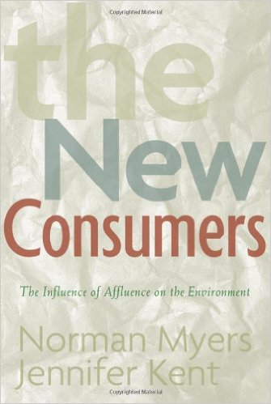
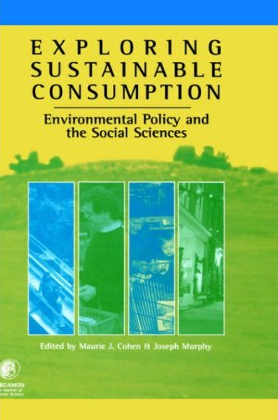
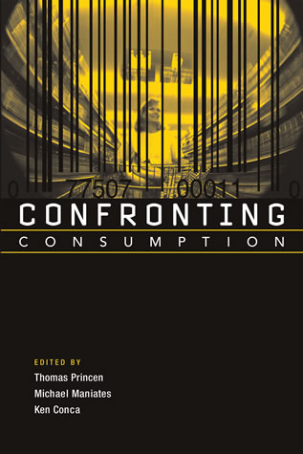
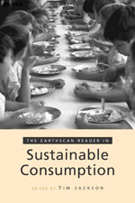
First Wave (~1995–2008): Setting the Foundations of the Field

Slide 7
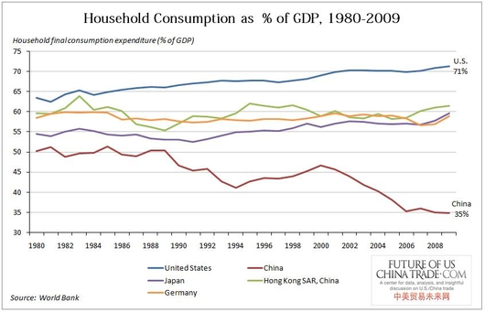
Consumption Matters
In the United States, more than 70 percent of the economy is predicated on household-level consumption.

Slide 8
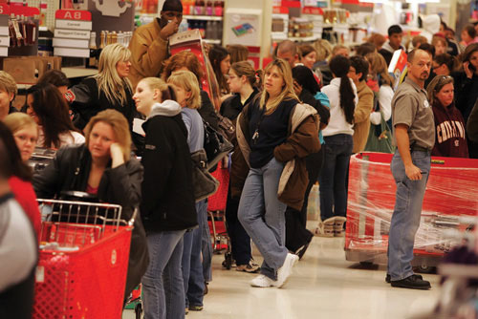
Consumption-First Approach to Sustainability
It is end-use consumers who are responsible for pulling energy and materials through the global system and hence consumption represents an important leverage point for sustainability.

Slide 9
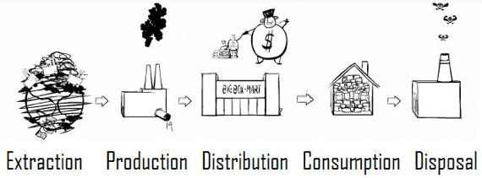
Life Cycle Perspectives
Effective sustainability policy and practice requires thinking systemically from the standpoint of product life cycles.

Slide 10
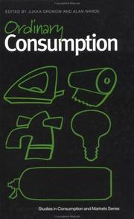
Consumption-First Approach to Sustainability
It is the multitude of ordinary consumption embedded in habituated daily practices that is most salient (e.g., energy use, transportation, food).

Slide 11
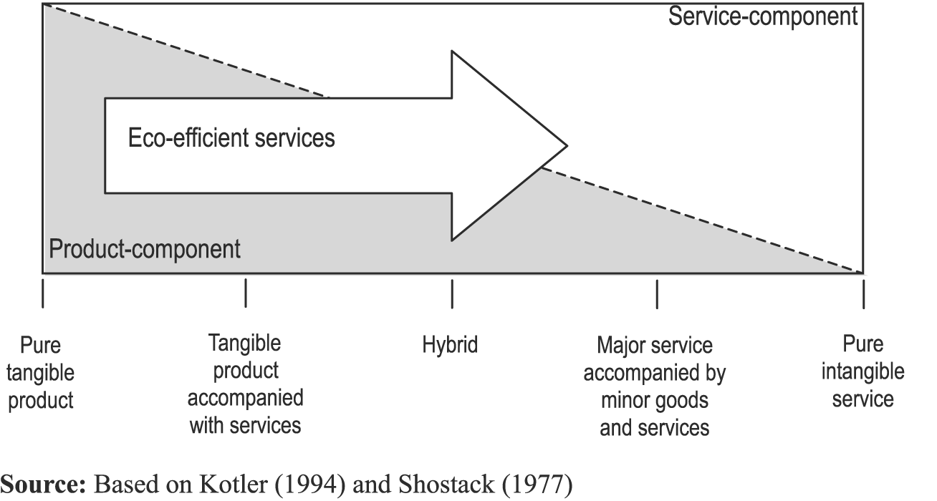
Servicization as an Alternative Business Model

Slide 12
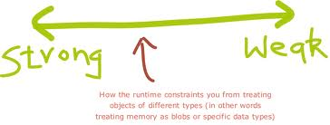
Strong vs Weak Sustainable Consumption

Slide 13
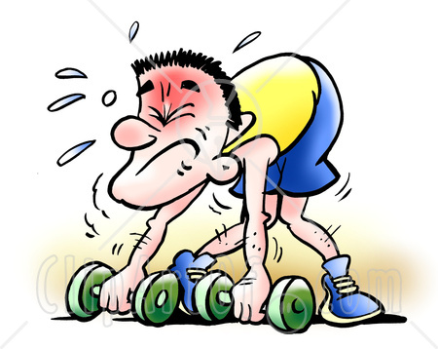
Weak Sustainable Consumption (Green Consumerism)
Consumer education
Ecological labeling
Product certification
Energy efficient products and services
Public procurement
Weak sustainable consumption primarily focuses on the quality rather than the quantity of consumption. These types of initiatives all tend to induce rebound effects and other perverse outcomes.

Slide 14
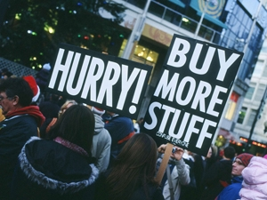
Shopping Our Way to Sustainability?

Slide 15

Toward Strong Sustainable Consumption
Proponents of strong sustainable consumption have sought to highlight the inadequacies of a singular focus on consumptive efficiency and to develop new notions predicated on an understanding of sufficiency.

Slide 16
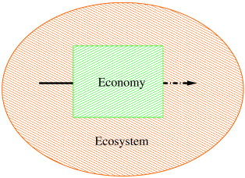
Ecological Macroeconomics

Slide 17
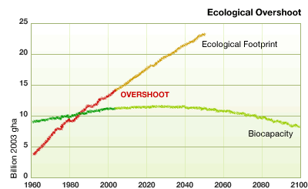
Ecological Overshoot

Slide 18
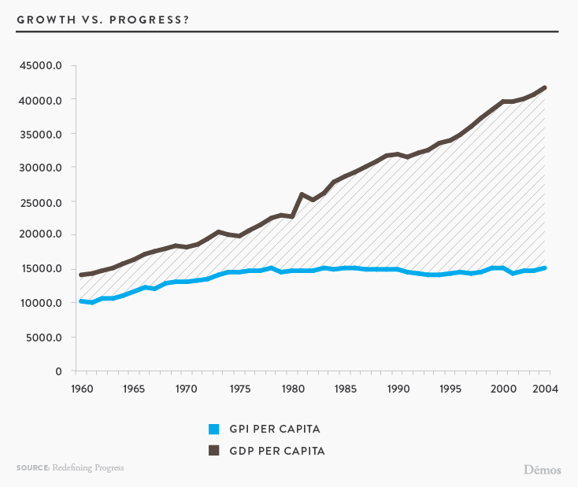
Economic Growth vs Social Progress

Slide 19
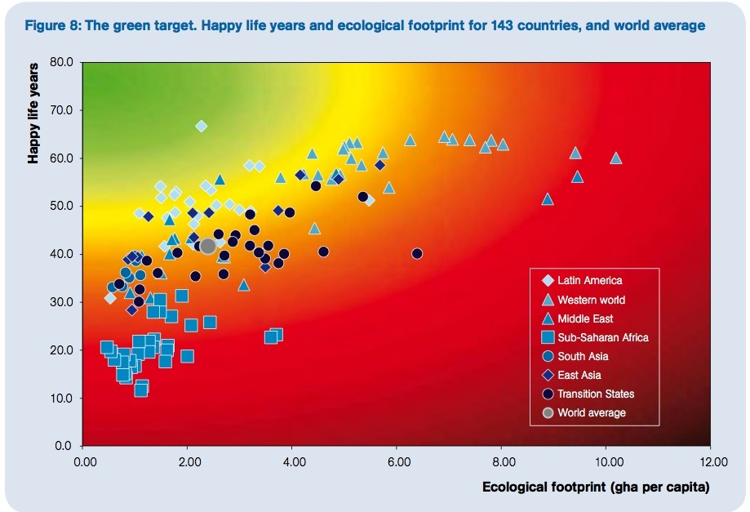
Happy Planet Index

Slide 20
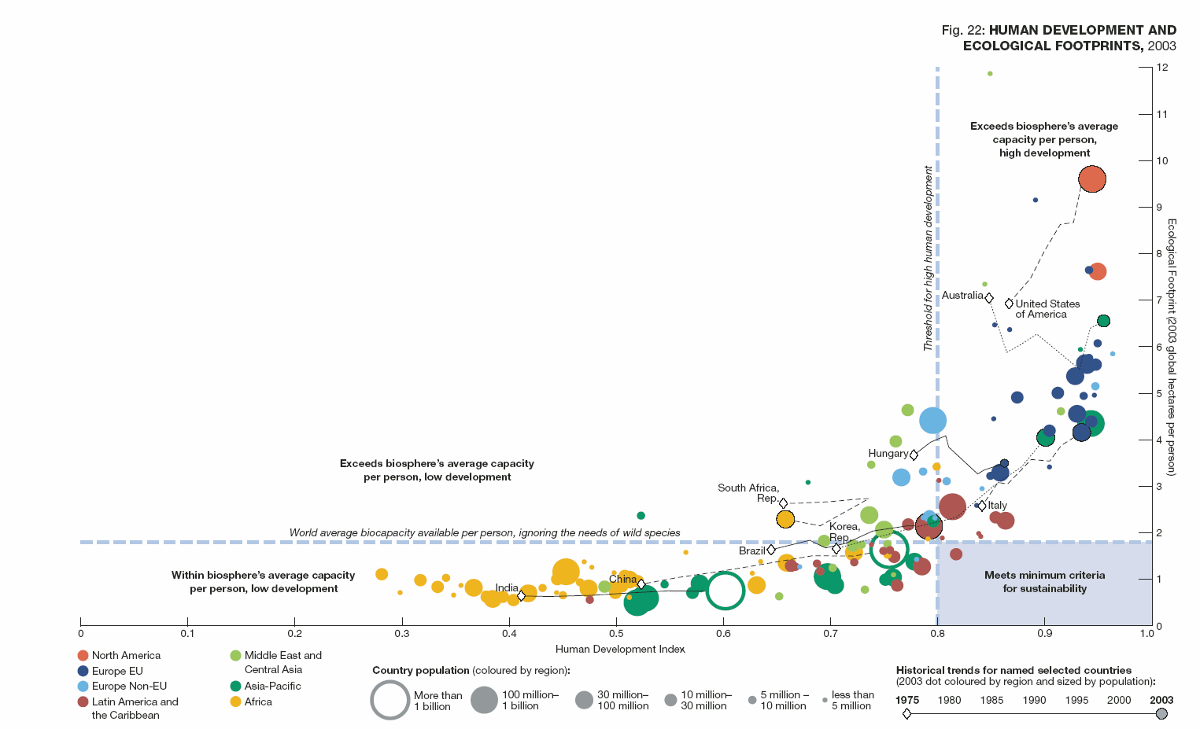

Inefficiency (and Inequity) of Global Consumer Capitalism

Slide 21
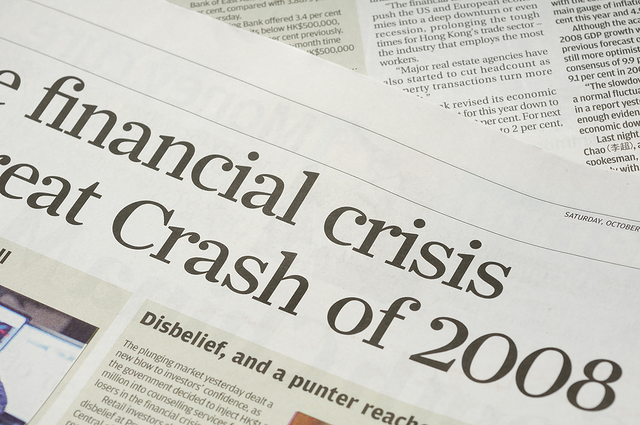
Second Wave (~2008–2015): Toward Strong Sustainable Consumption

Slide 22
Sustainable Consumption Research (~2008‒2015)
Ecological/New Economics
Consumer/
Environmental Psychology
Industrial Ecology/Life Cycle Analysis
Sustainable
Consumption
Environmental Sociology/Politics
Innovation
Studies

Slide 23
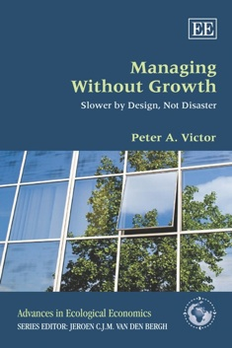

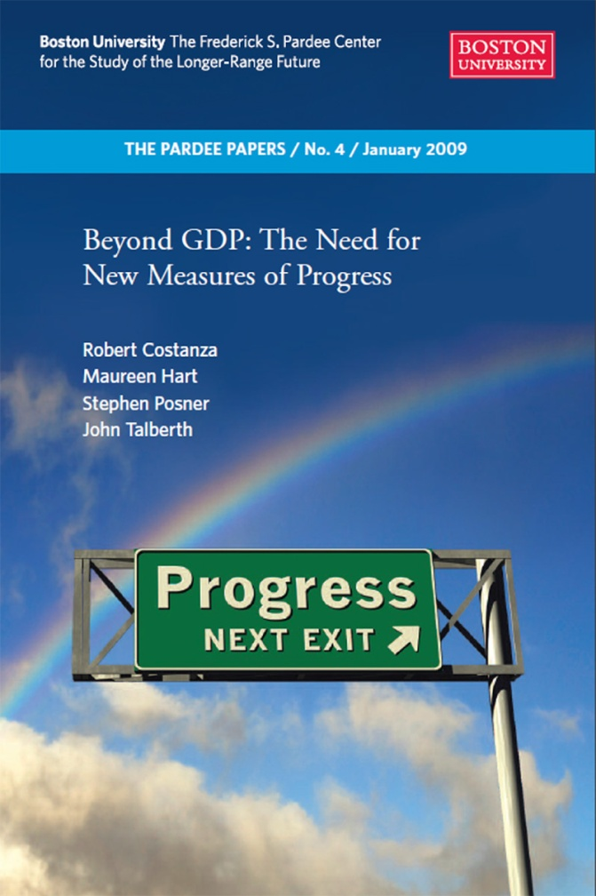
Toward Strong Sustainable Consumption

Slide 24
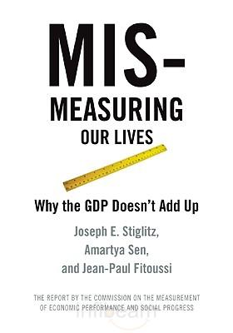

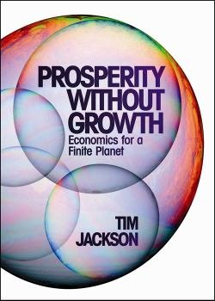
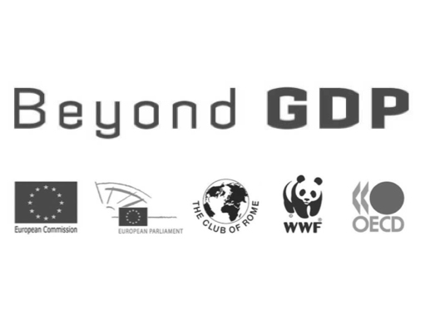
Toward Strong Sustainable Consumption

Slide 25
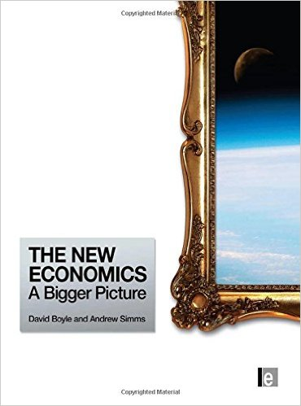
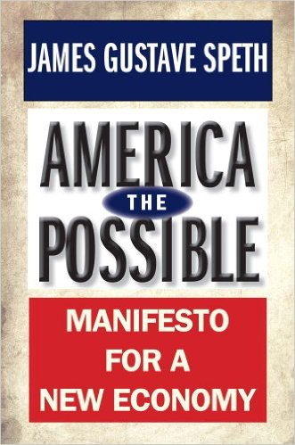
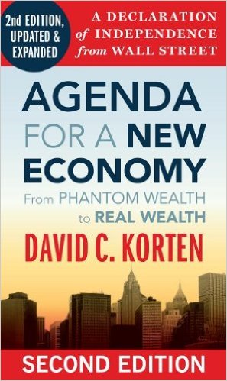
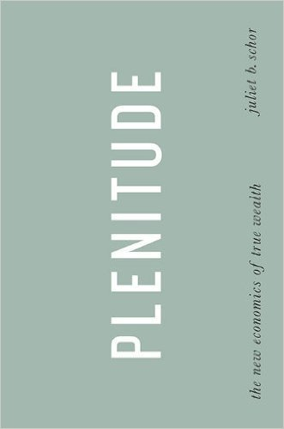
Sustainable Consumption and the “New Economics”

Slide 26
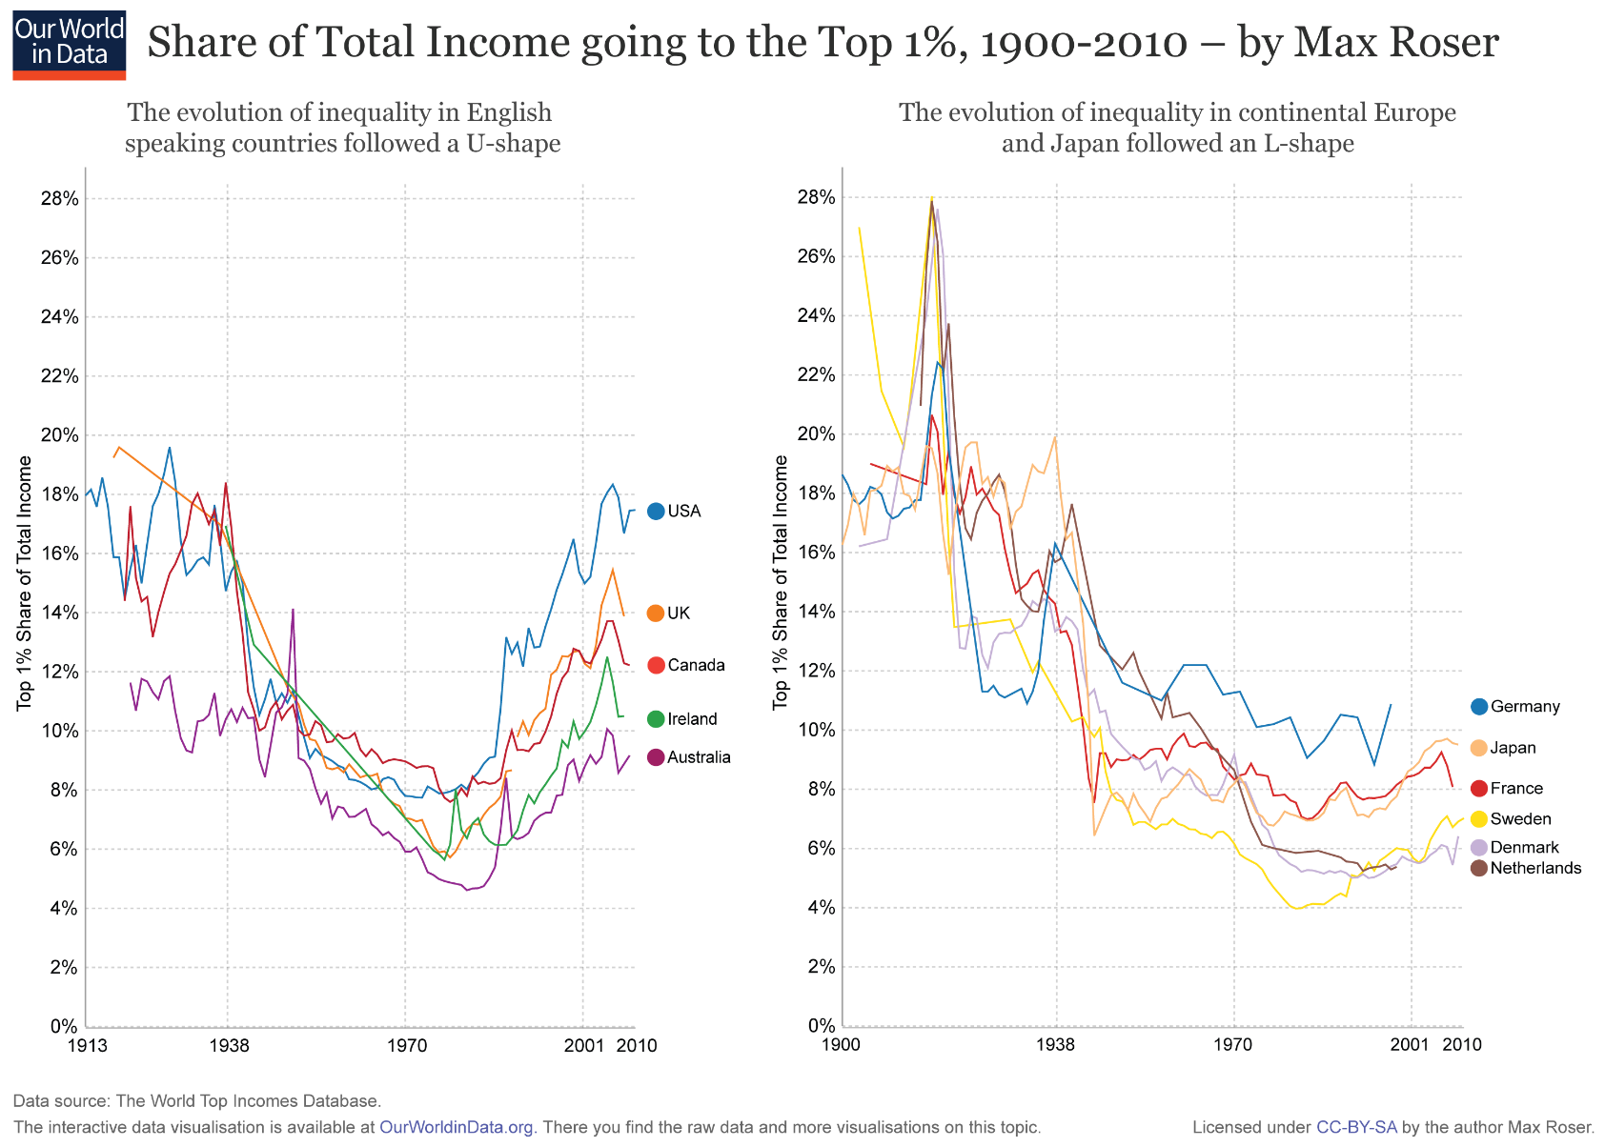
Rising Income Inequality

Slide 27
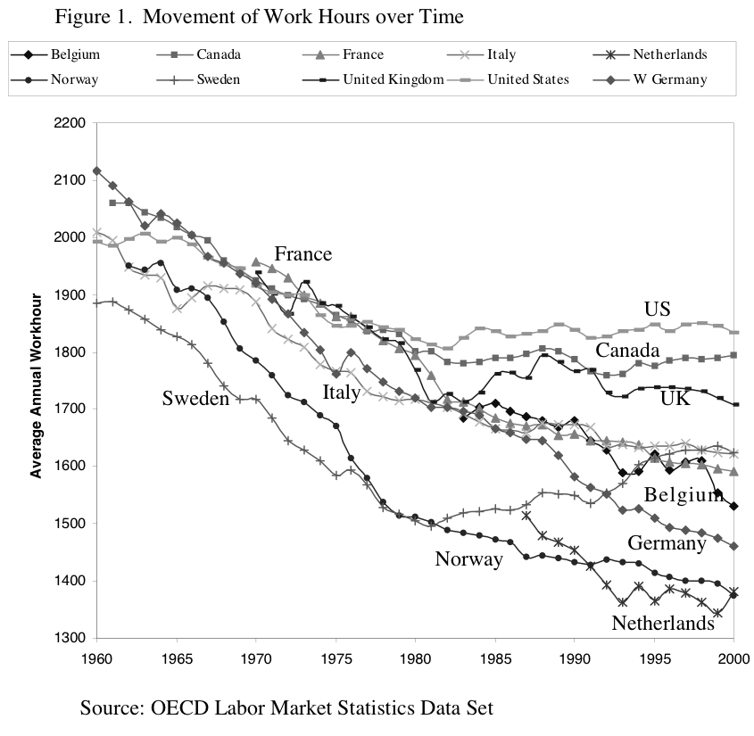
Reduction in Work Time

Slide 28
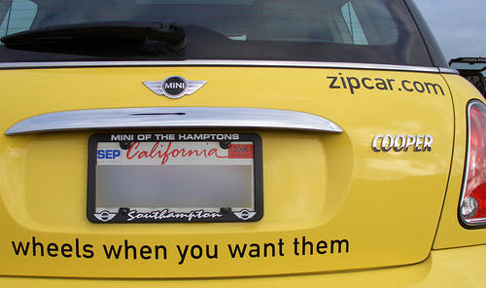
Alternative Modes of Goods Ownership

Slide 29
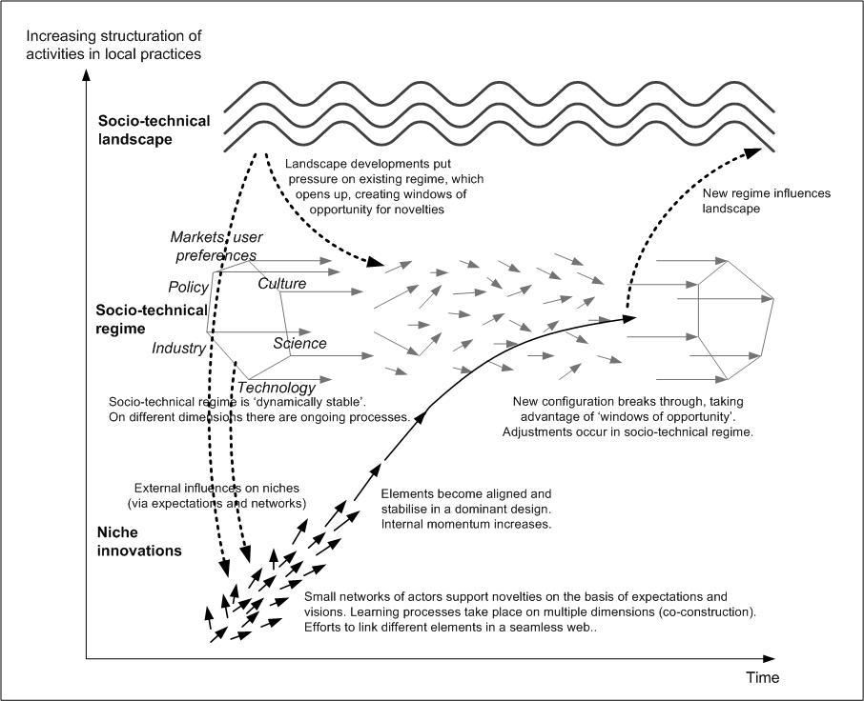
Sustainable Systems Innovation and the
Redesign of Socio-technical Systems

Slide 30

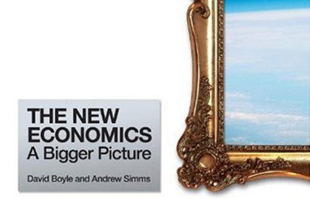
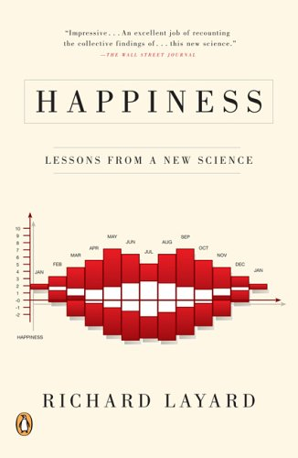
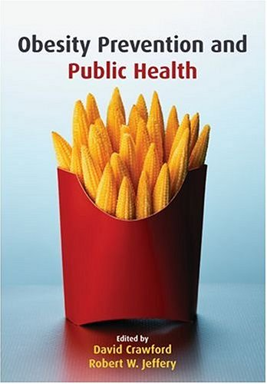
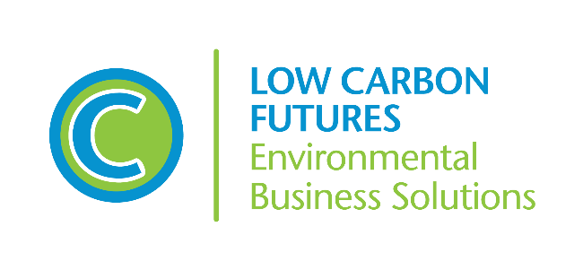
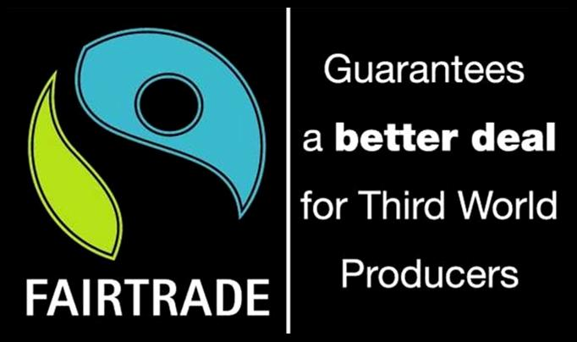
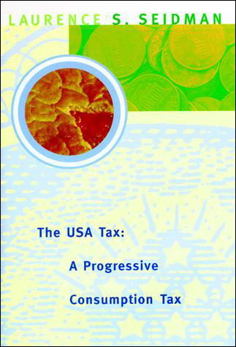

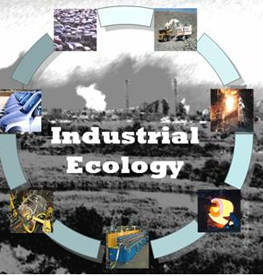
Increasing Complexity of Sustainable Consumption

Slide 31
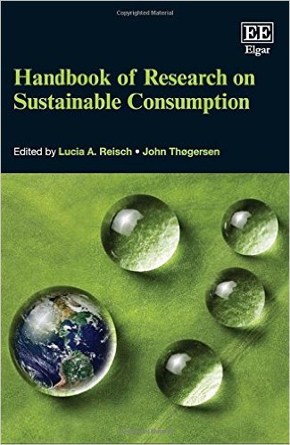
Third Wave (~2015–Present): Post-consumerism?

Slide 32
Sustainable Consumption (~2015–Present): Post-consumerism?
Degrowth/
Secular Stagnation
Sufficiency
Material Flows/Circular
Economy
Domains/Provisioning Systems
Business Cluster
Ecological Economics
Decoupling/
Dematerial-ization
Agro-food
Systems
Standards/ Accreditation
Consumer/
Environmental Psychology
Industrial Ecology/Life Cycle Analysis
Transport & Mobility
Sustainable
Consumption
Consumption-based GHG Accounts
New
Business Models
Behavioral
Economics
Built Environment
Environmental Sociology
Innovation
Studies
Ethics
Sustainable
System
Innovation
Energy
Social
Practices
Marketing
Finance
Knowledge
Brokerage
Sustainable
Lifestyles/Social Innovation
Socio-technical Innovations

Slide 33
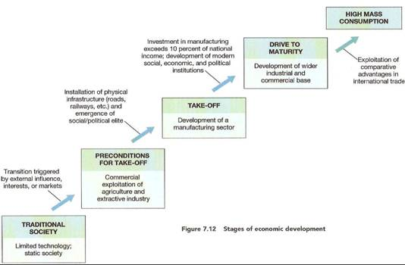
Toward Post-Consumerism?
Both empirical and normative scholarship suggests weakening of that the structural organization of “consumer society.”
???

Slide 34
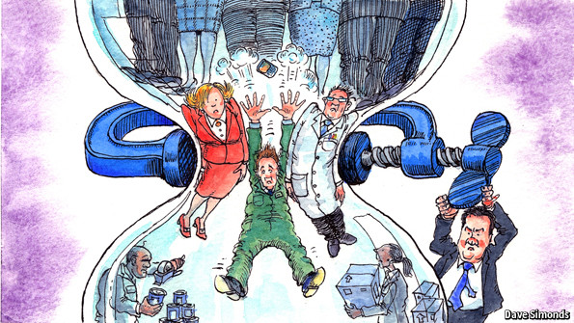
Social Dimensions of Sustainable Consumption
Entrenchment of Inequality/Precarious Lifestyles

Slide 35

Emergence of the “Gig” Economy
Alternatively called “on-demand economy,” “1099 economy,” “zero-hour contract economy”).

Slide 36

Vanishing Middle Class

Slide 37

Future of Employment

Slide 38

Politics of Austerity Amidst Political Paralysis

Slide 39

Demographic Contraction

Slide 40

Migration and Assimilation Crises

Slide 41



Global Environmental Crises

Slide 42

Climate Change and Sustainable Consumption
From the “Annex” to the Paris Agreement: “Also recognizing that sustainable lifestyles and sustainable patterns of consumption and production, with developed country Parties taking the lead, play an important role in addressing climate change.”

Slide 43

Institutional Organization of the Field of Sustainable Consumption Research and Policy (2005‒2008)

Slide 44

http://www.scorai.org
SCORAI is a knowledge network of professionals working at the interface of material consumption, human well-being, and technological and cultural change.

Slide 45
Comprises 800+ academics and policy practitioners around the world
Regional sub-networks operate in North America, Europe, China, and (most recently) Israel
Each regional sub-network organizes conferences, workshops, collaborations with practitioners, publishes books and special journal issues
Operates a dynamic website and active listserv and publishes a monthly newsletter
Provides an audience for dissemination of research and organizational structure for the field (including the recently launched Routledge –SCORAI Book Series on Sustainable Consumption)

Slide 46


Slide 47

Potential Founding Members of a Future Earth Knowledge-Action Network on Sustainable Consumption and Production
SCORAI, SCORAI-Europe, SCORAI-China, SCORAI-Israel
SWITCH Asia, SWITCH Mediterranean
Asia-Pacific Roundtable on Sustainable Production and Consumption
European Roundtable on Sustainable Production and Consumption
Urban Sustainability Directors Network
Others?

