Slide 1
Sustainable Consumption and Economic Democracy: Opportunities for Hybrid Cooperativism
Maurie J. Cohen, Director
Science, Technology, and Society Program
New Jersey Institute of Technology
Newark, NJ 07102 USA
mcohen@njit.edu
and
Associate Fellow
Tellus Institute
Boston, MA 02116 USA
Presentation at the Mistra Center for Sustainable Markets, Stockholm School of Economics, Stockholm, Sweden, 9 March, 2016.

Slide 2
The Future of Consumer Society: Prospects for Sustainability in the New Economy (Oxford University Press, 2016)
1. “Sharing” Economy
2. Maker Movement
3. Economic Localization
4. Effects of Digital Automation Technologies

Slide 3

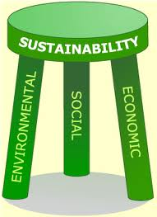

The field of sustainable consumption research and policy practice has for the past two decades been largely about reducing energy and material throughputs, or environmental sustainability.

Slide 4
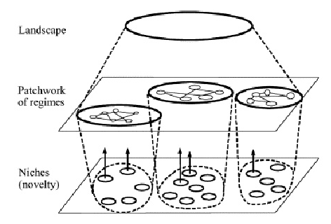
Sustainable System Innovation and the Multi-level Perspective

Slide 5
Predominant Systems of Social Organization
Dominant Systems of Social Organization
Agrarian Society
Industrial Society
Consumer Society

Slide 6
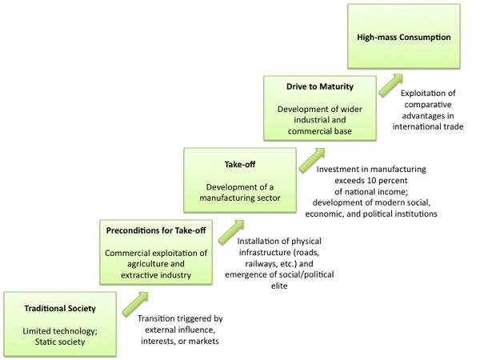
Predominant Systems of Social Organization
Rostow’s Stages of Growth Theory
Industrial Society

Slide 7
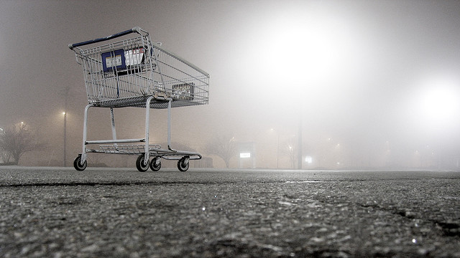
Are We Reaching the End of Consumer Society?
Demographic aging
Increasing income inequality
Decline of wage-based employment
Inadequate public investment
New preferences and cultural values
(especially among Millennials)

Slide 8
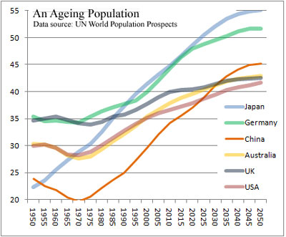
Demographic Aging

Slide 9
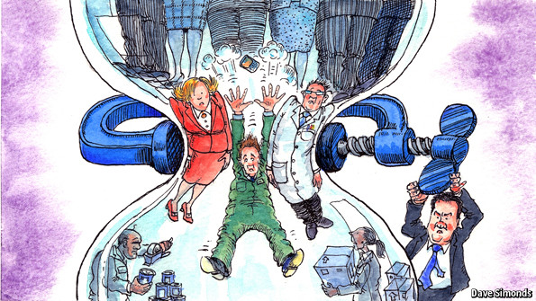
Increasing Income Inequality
We are inexorably moving toward an hourglass society as the gains of economic growth are disproportionately captured by the uppermost income/wealth quintiles.

Slide 10
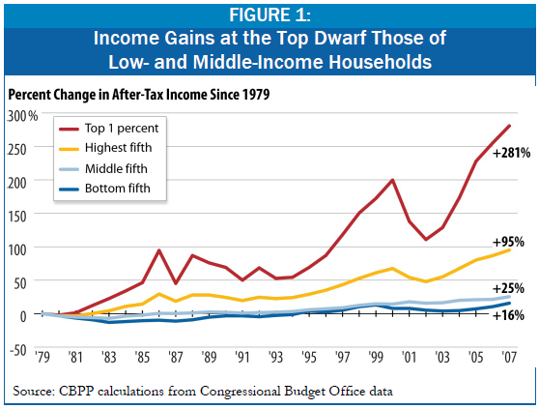
Increasing Income Inequality

Slide 11
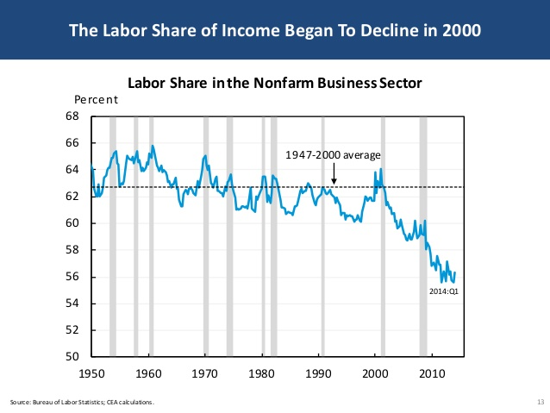
Labor Share of GDP, United States, 1950-2015
https://anticap.wordpress.com/tag/exploitation

Slide 12
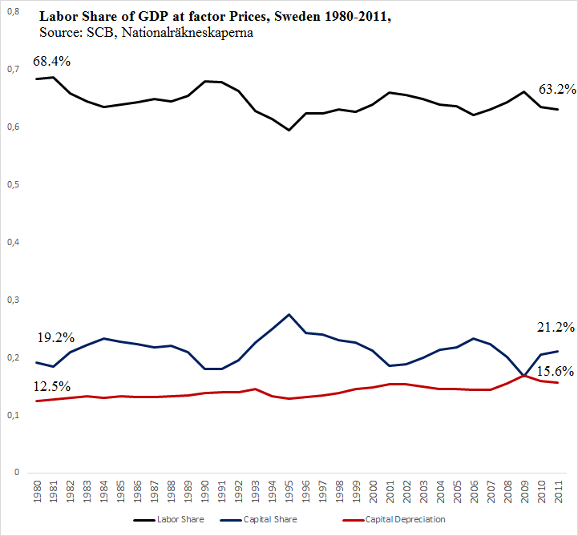
Labor Share of GDP, Sweden 1980–2011

Slide 13
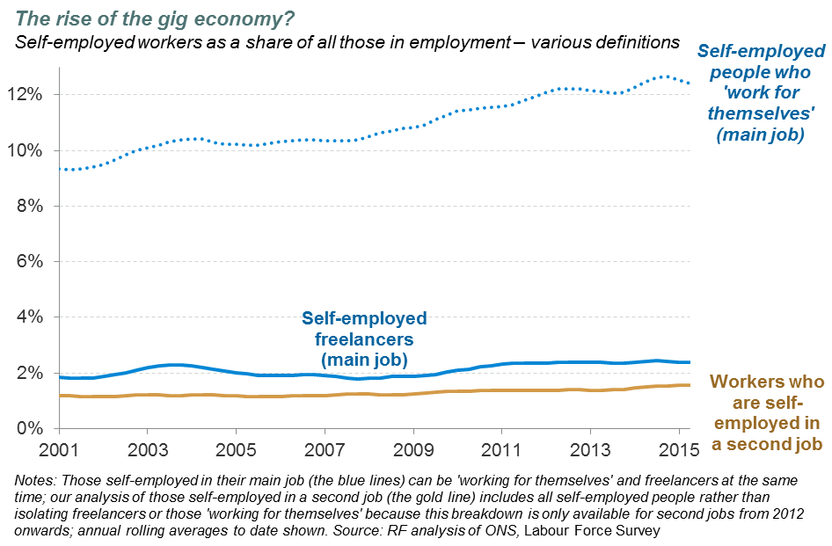
Decline of Wage-Based Employment

Slide 14
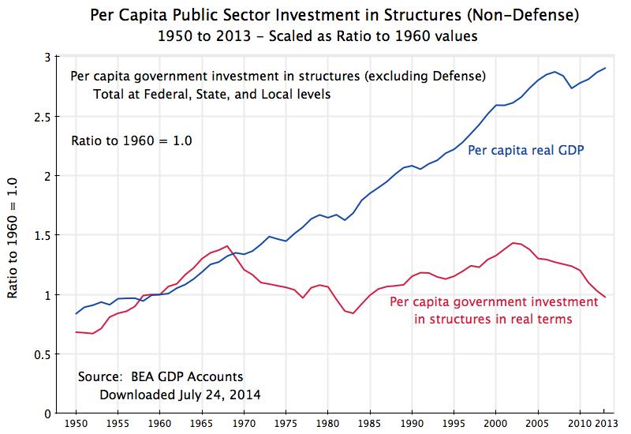
Decline in Public Investment

Slide 15
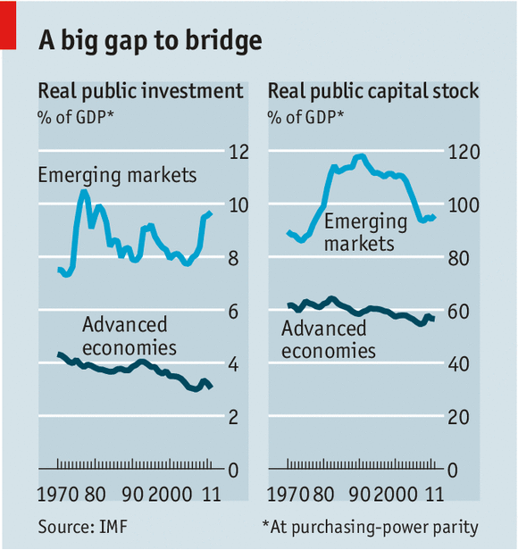
Decline in Public Investment

Slide 16
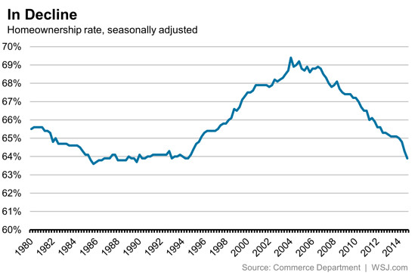
New Consumer Preferences/Capabilities

Slide 17
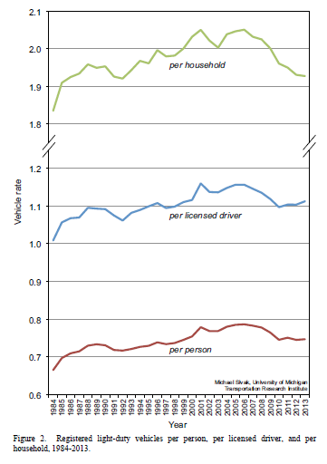
New Consumer Preferences/Capabilities
Vehicles Miles Driven Per Year, United States, 1984‒2013

Slide 18


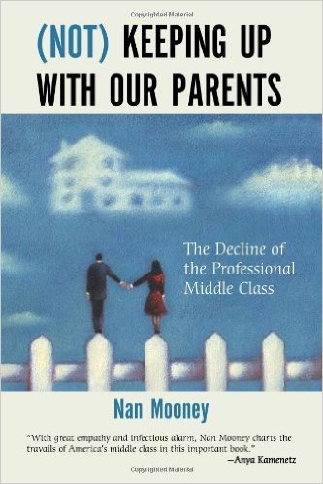

Sample of the Literature on the “New Economy”

Slide 19
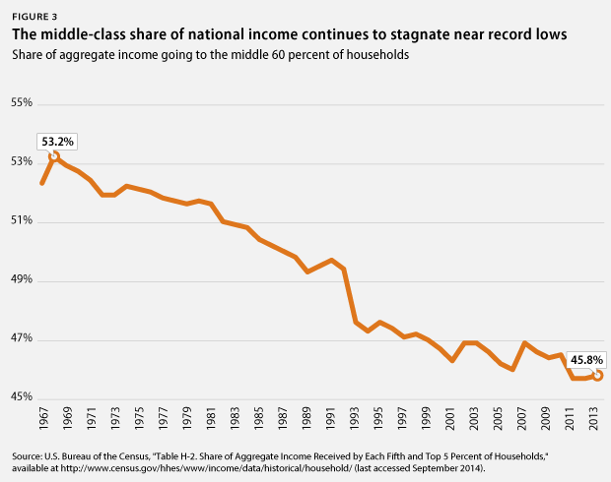
A Marxist Labor-Theory-of-Value Perspective
Can a Consumer Society Persist in the Face of a Shrinking Middle Class?

Slide 20
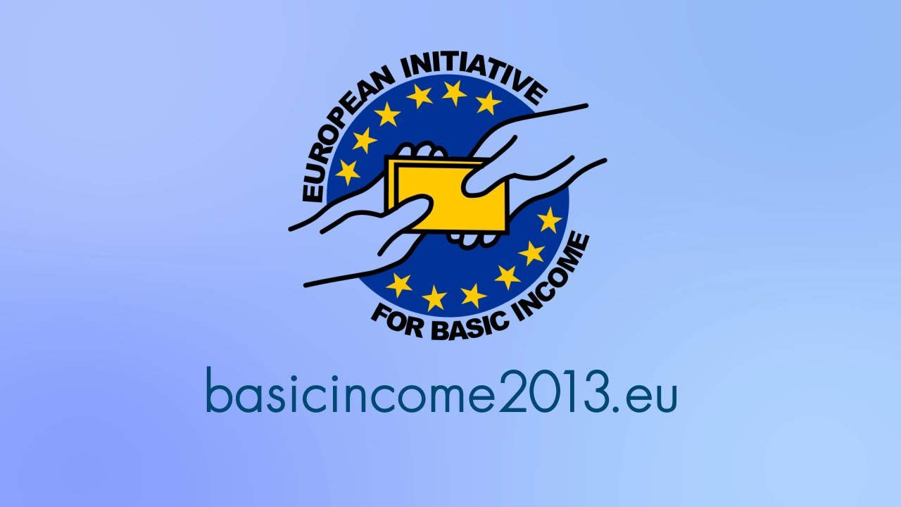
Policy Responses Focused on Increasing Non-labor Income
1. Universal Basic Income

Slide 21
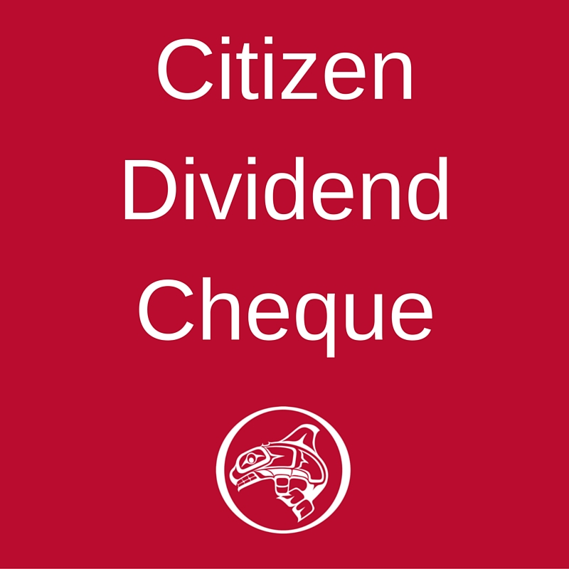
Policy Responses Focused on Increasing Non-labor Income
2. Citizen’s Dividend

Slide 22
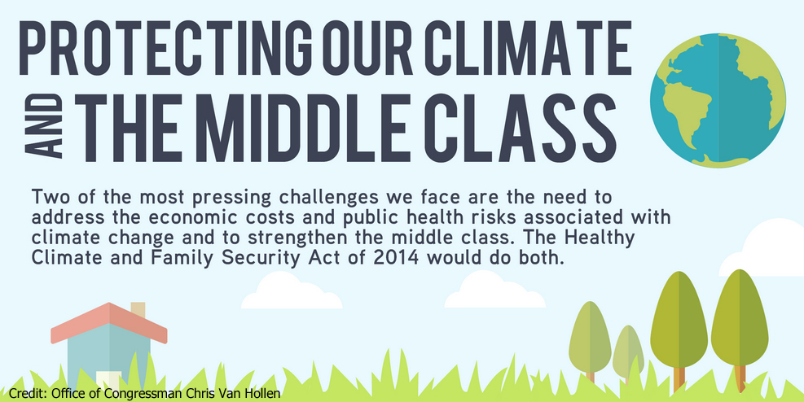

Policy Responses Focused on Increasing Non-labor Income
Cap and Dividend (or Fee and Dividend)

Slide 23

Policy Responses Focused on Increasing Non-labor Income
3. Broad-based Stock Ownership

Slide 24
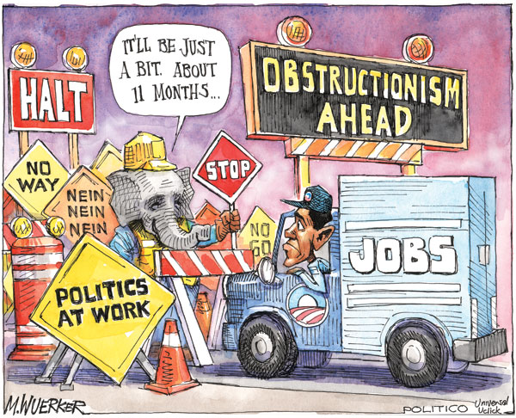

Slide 25

What Is to Be Done to Maintain Adequate Provisioning During an Era of Increasing Social Turbulence and Economic Precarity?

Slide 26
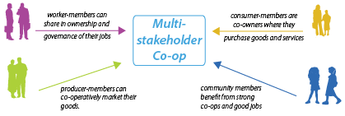
Multi-stakeholder (Hybrid) Cooperativism

Slide 27
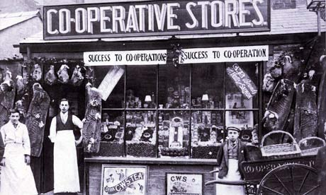
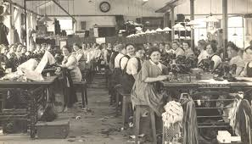

Worker and Consumer Cooperatives
Worker Cooperative
Consumer Cooperative

Slide 28

Worker and Consumer Cooperatives
It is though a figment of our reductionistic imagination to suppose that people are either workers (or producers) or consumers.

Slide 29
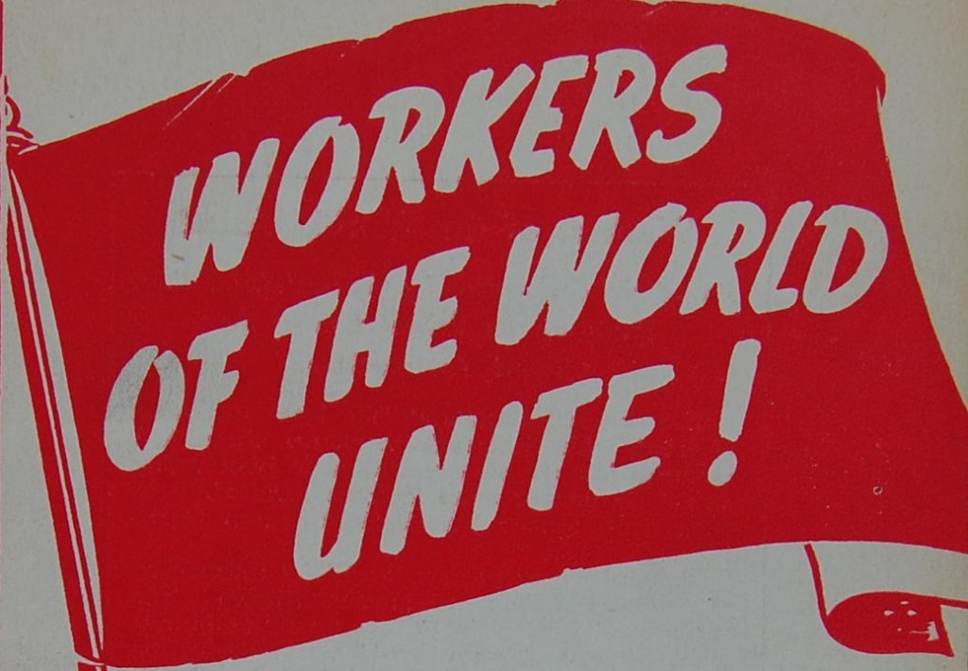
& CONSUMERS

Slide 30
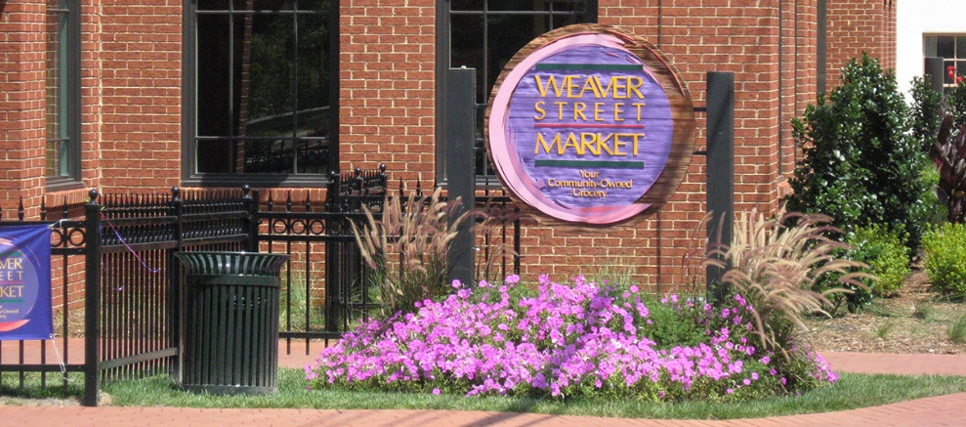

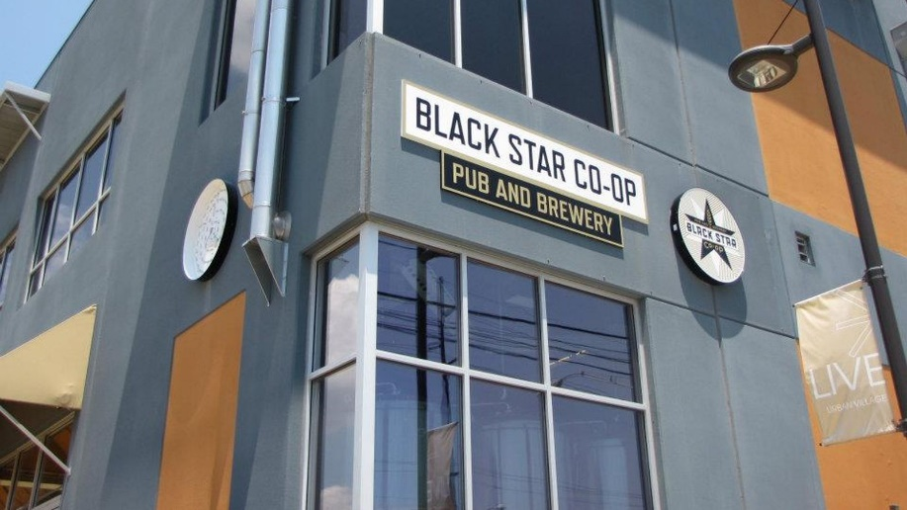
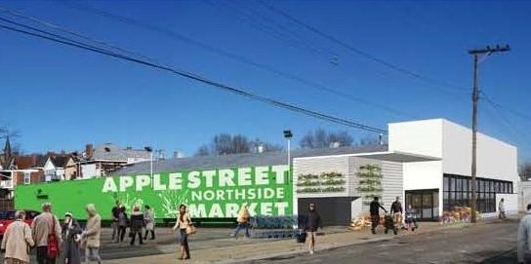
Worker-Consumer Cooperatives

Slide 31
Why Worker-Consumer Cooperatives?
Buffer economic insecurity by giving worker-consumers a financial stake in the provisioning system.
Offset vagaries of market capitalism by enabling worker-consumers to accumulate wealth through dividend disbursements and asset accumulation.
Build institutional bridges between producers and consumers and overcome the artificial divide between production and consumer (while also eliminating costs associated with retail brokerage).
Enhance social solidarity by building economically democratic institutions based on participatory organizational structures.
Modulate the tendency for overconsumption by bringing the logics of production and consumption into closer alignment.

Slide 32


Slide 33


