Slide 1
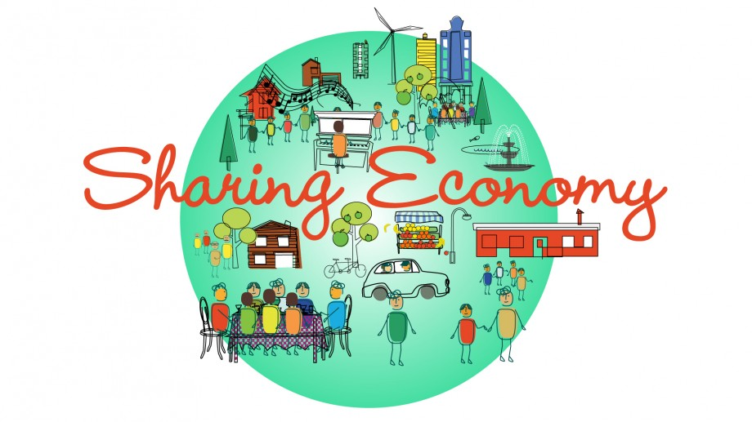
The Illusory Promises of the Sharing Economy
Maurie J. Cohen, Director
Program in Science, Technology, and Society
New Jersey Institute of Technology
Presentation at the Research Seminars and Public Lectures on Ecological Economics, Wirschaftsuniversität Wien, September 29, 2015

Slide 2

http://www.scorai.org
Excerpt from mission statement: The Sustainable Consumption Research and Action Initiative (SCORAI) is an international knowledge network of professionals working at the interface of material consumption, human well-being, and technological and cultural change.

Slide 3
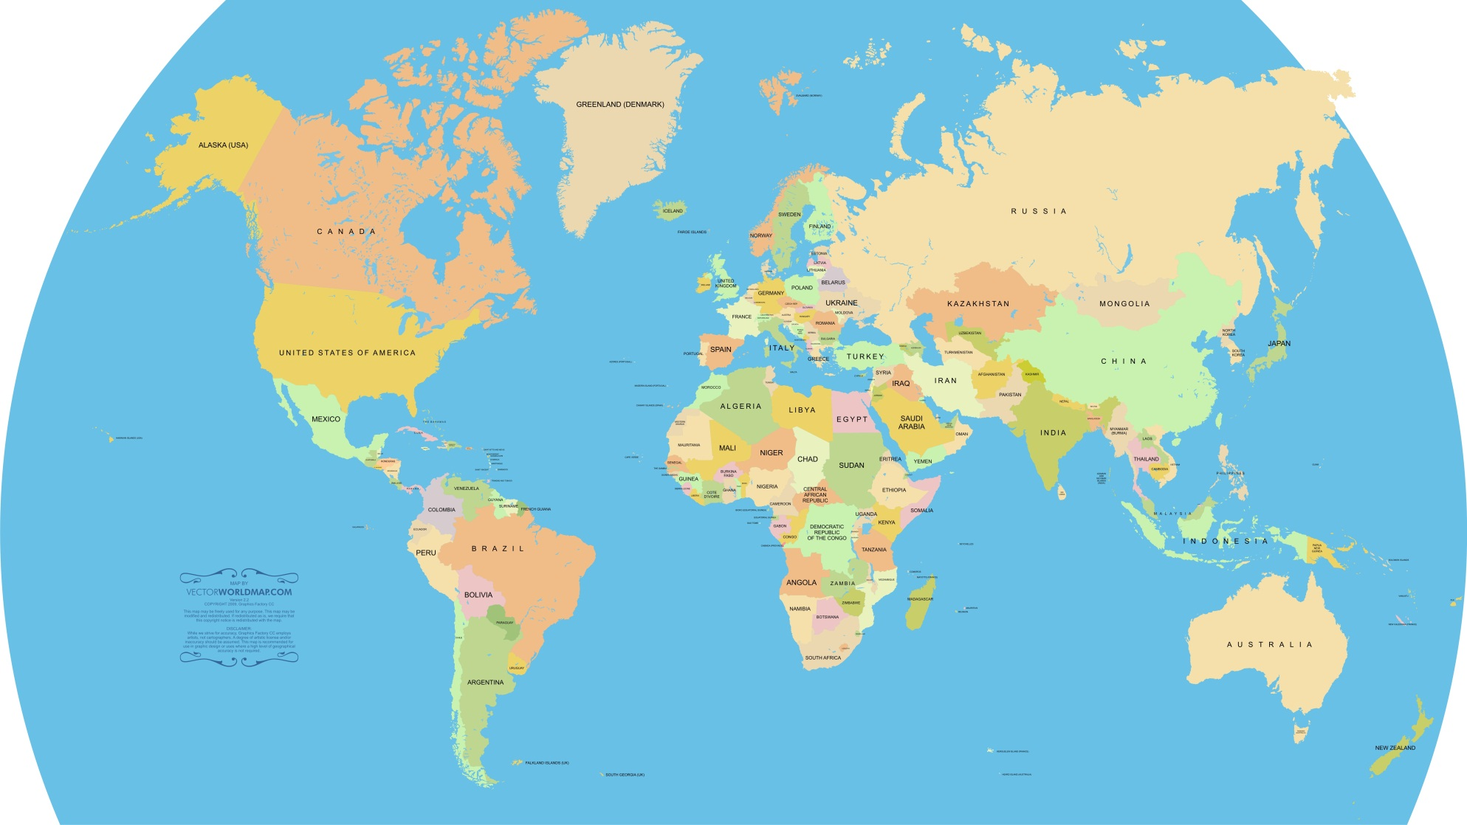
Consortium of SCORAI Networks
SCORAI
Europe
SCORAI
North America
SCORAI
China

Slide 4
Recent/Current SCORAI‒NA Activities
Convened last year a colloquium series on Consumption and Social Change that began in Spring 2014 and concludes next month.
Colloquium series will conclude with a workshop in October 2015 reflecting on the span of presentations and seeking to formulate a “state of the field” on current understanding of opportunities for fostering social change beyond consumerism.
Organizing a workshop on Sustainable Consumption and Cities in collaboration with the Urban Sustainability Directors Association in October 2015.
Holding the Second International SCORAI Conference at the University of Maine in June 2016.
Several publication projects moving toward completion including a co-edited book provisionally entitled Putting Sustainability into Practice: Applications and Advances in Practice Theories. Also launching a new book series with Routledge on Studies in Sustainable Consumption.

Slide 5

http://sspp.proquest.com

Slide 6
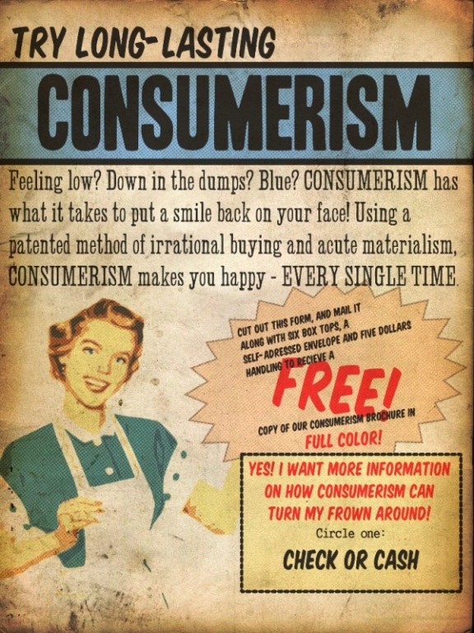
The Challenge of Overcoming Consumerism

Slide 7



Transition to a “New” Economy

Slide 8


Transition to a “New” Economy

Slide 9

The Future of Consumer Society: Prospects for Sustainability in the New Economy

Slide 10
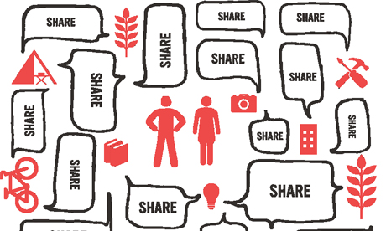
Sharing Economy (Collaborative Consumption)

Slide 11
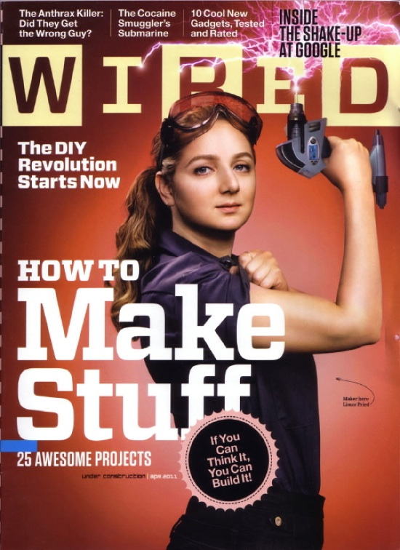
Maker Movement (Prosumption/Artisanal Crafting)

Slide 12
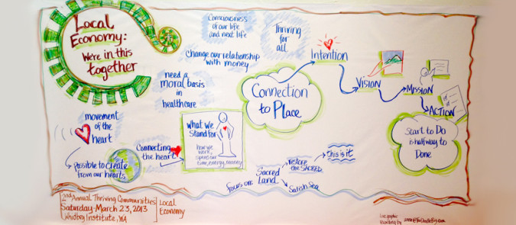
Localization

Slide 13
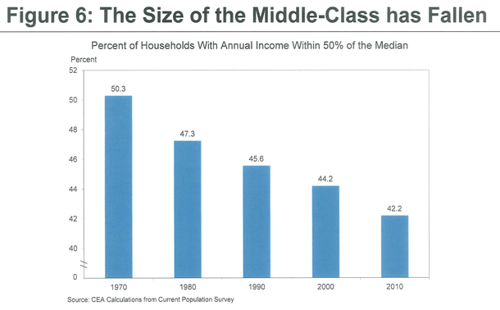
Can a Consumer Society Persist in the United States in the Face of a Shrinking Middle Class…?

Slide 14

…And What Does the Future Hold in Terms of Household Provisioning Practices?

Slide 15
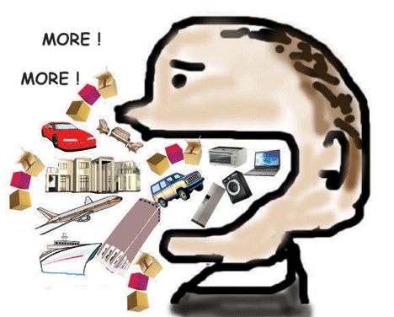

We Really (!) Do Live in a Consumer Society

Slide 16
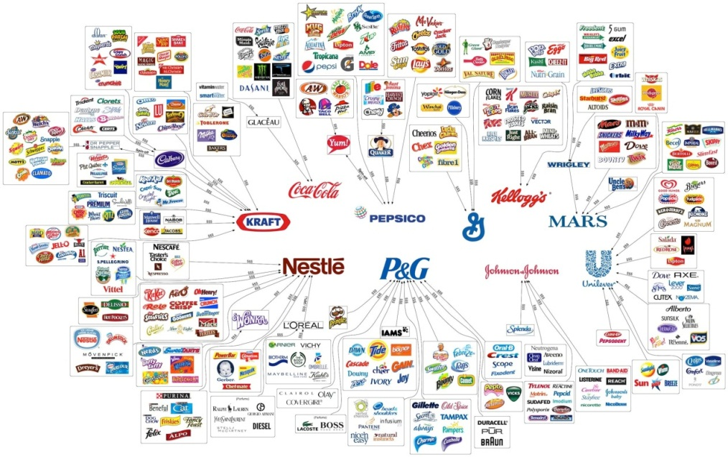
Consumer Society (n): a community in which the buying and selling of mass-produced goods and services is promoted through mass media and is the dominant economic activity.

Slide 17

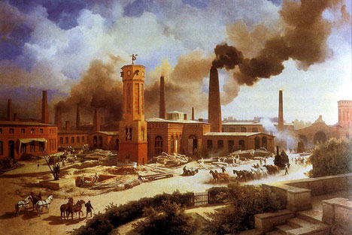

A Longue Durée Perspective on Consumer Society
Industrialism (1800-1945)
Consumerism (1945-??)
Agrarianism (pre-1800)

Slide 18
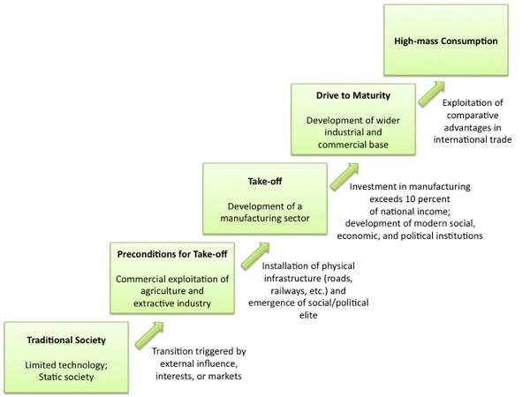
Rostow’s Stages of Growth Theory

Slide 19
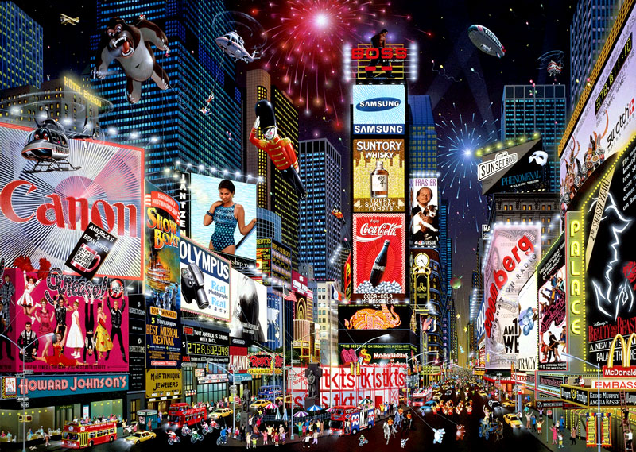
The Conspicuous Tendency to Idealize Consumer Society

Slide 20
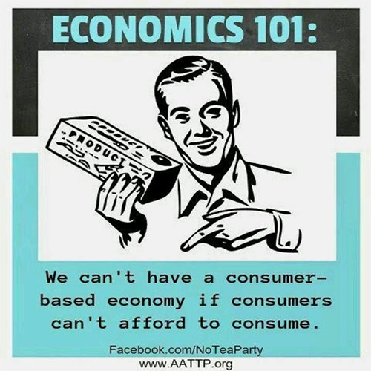
The Pillars of Consumer Society

Slide 21
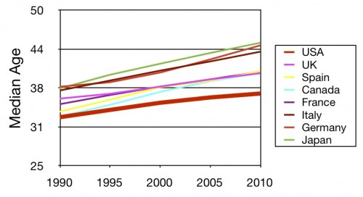
Demographic Aging

Slide 22
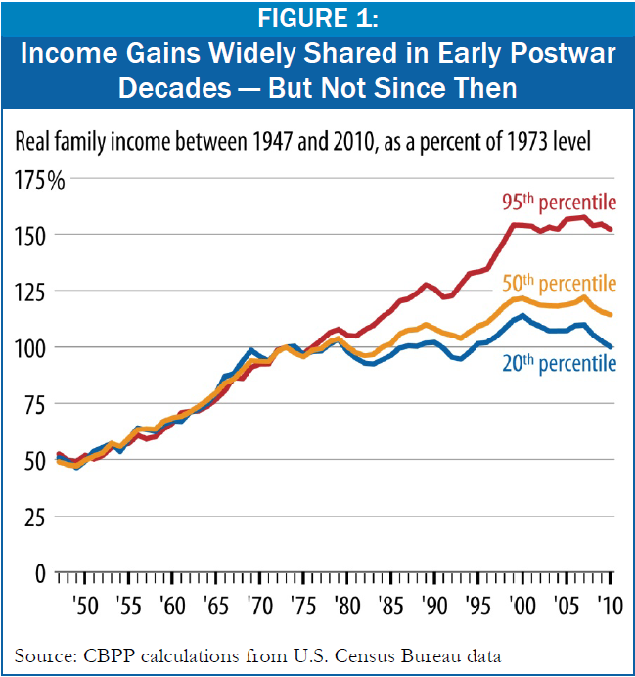
Wage Stagnation

Slide 23
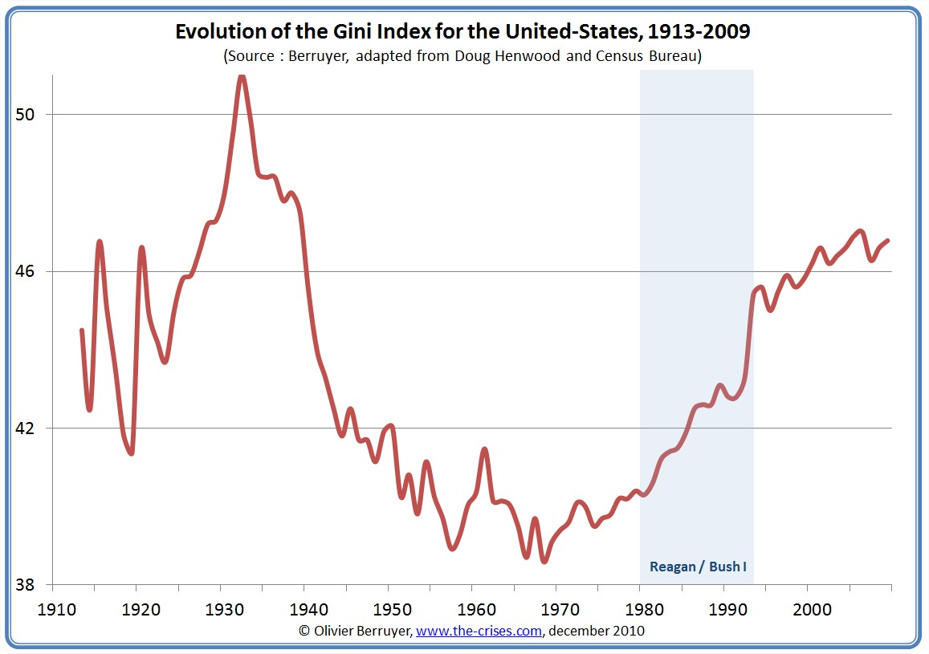
Increasing Income Inequality

Slide 24
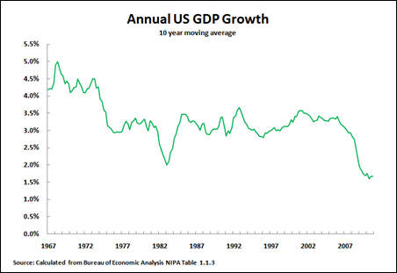
Slowing of Economic Growth

Slide 25
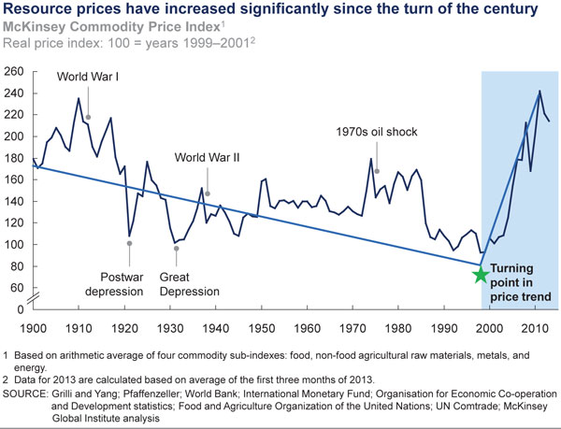
Increasingly Volatile Prices for Critical Natural Resources

Slide 26
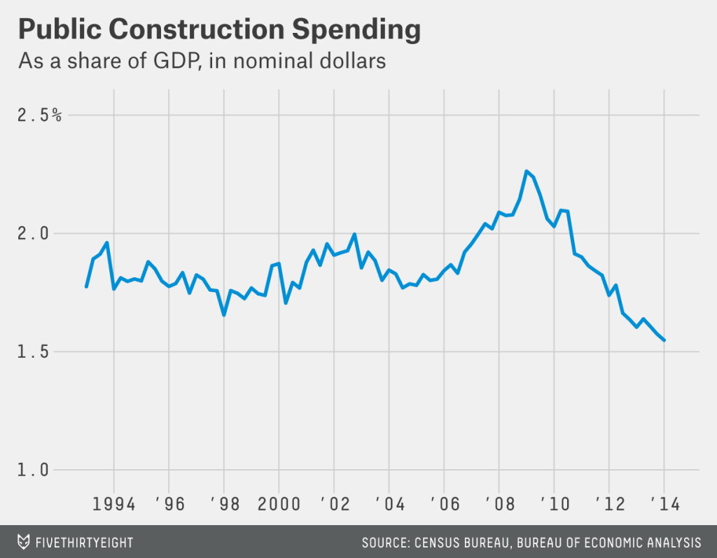
Declining Political Commitment to Mass Consumerism

Slide 27
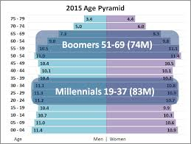
Millennialization-Boomerization of Society

Slide 28
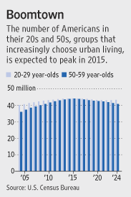
Reurbanization (or Desuburbanization)

Slide 29

Shifting Occupational Opportunity Structures

Slide 30
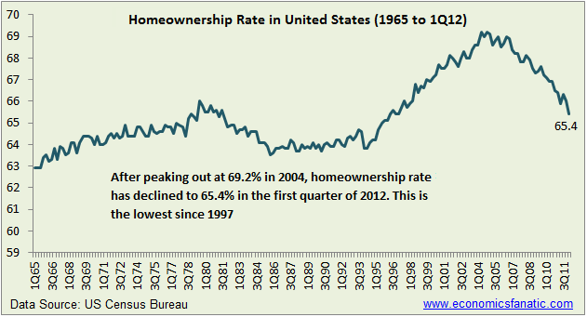
Declining Homeownership Rate

Slide 31
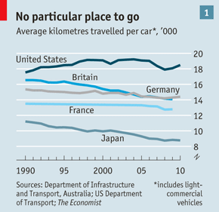
Declining Automobile Ownership/Utilization

Slide 32
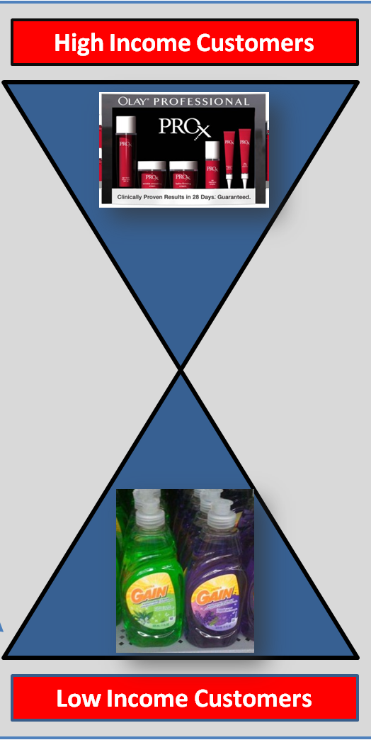
Onset of the Hourglass Society

Slide 33

Sharing Economy

Slide 34
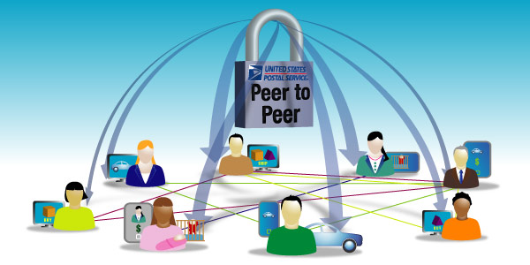
Peer-to-Peer Provisioning

Slide 35

Collaborative Consumption

Slide 36

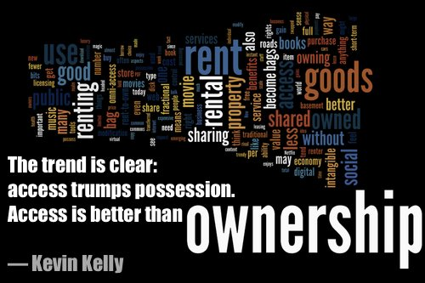
Shift From Ownership to Access (or Usership)

Slide 37
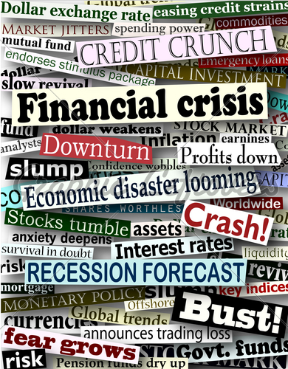
A Brief History of the Sharing Economy

Slide 38

A Brief History of the Sharing Economy

Slide 39
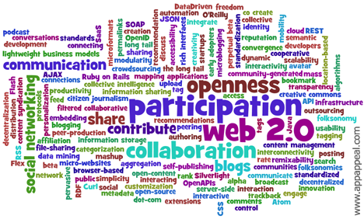
A Brief History of the Sharing Economy

Slide 40
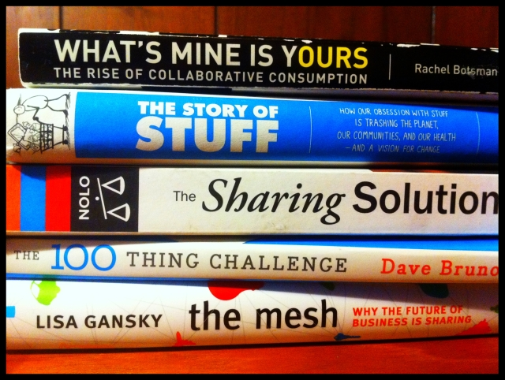
A Brief History of the Sharing Economy

Slide 41
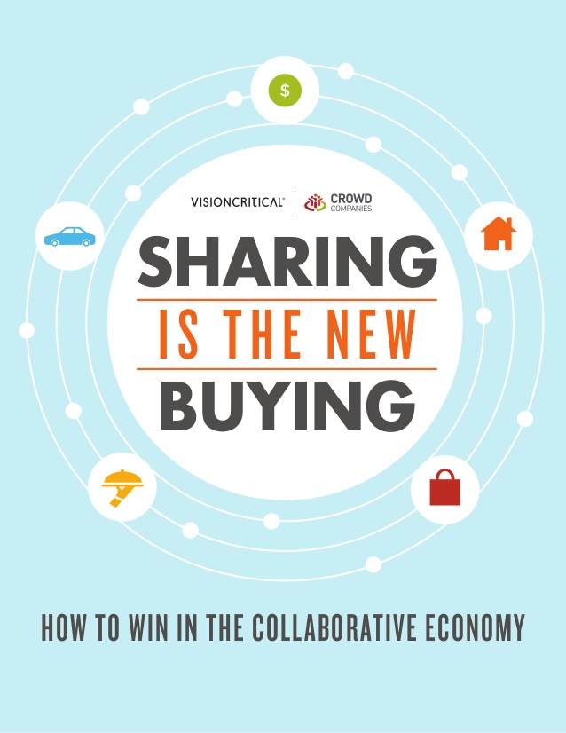
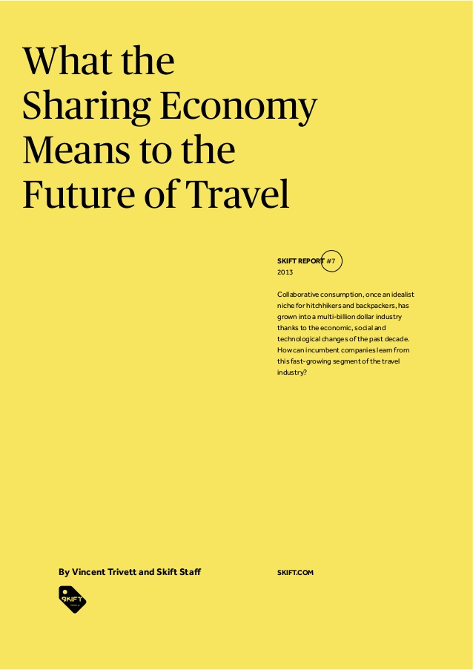
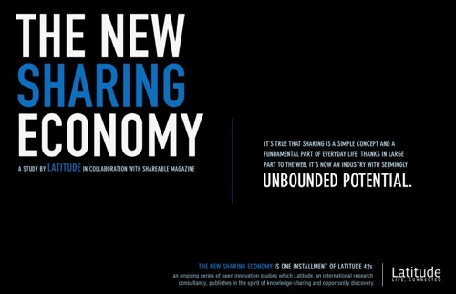
A Brief History of the Sharing Economy

Slide 42
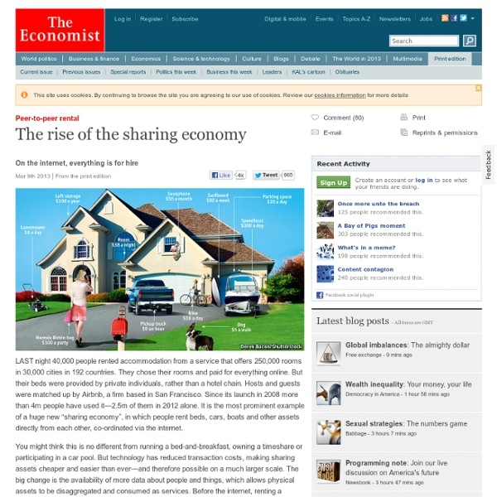
A Brief History of the Sharing Economy

Slide 43
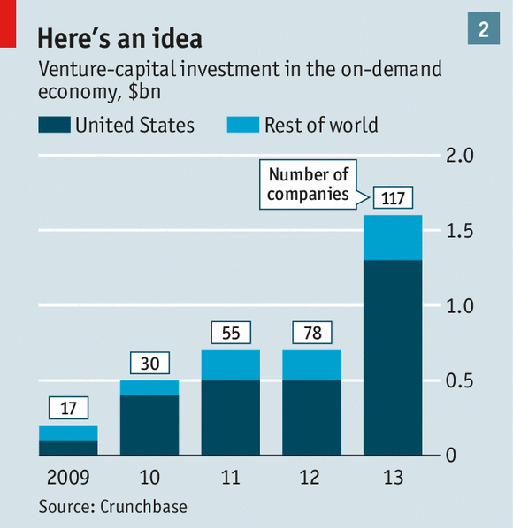
A Brief History of the Sharing Economy

Slide 44



Should Not Overestimate the Novelty of Sharing
Sharing as a provisioning strategy has been around for a long time and encouraged by friendly societies, mutual aid organizations, and fraternal groups.

Slide 45
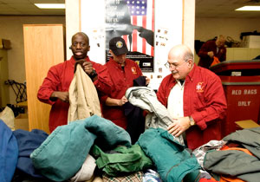
Should Not Overestimate the Novelty of Sharing
And especially among people on the economic margins due to poverty, sharing has been an essential economic survival strategy.

Slide 46
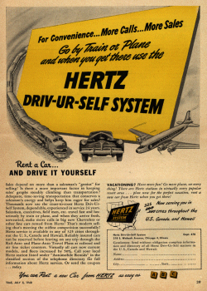
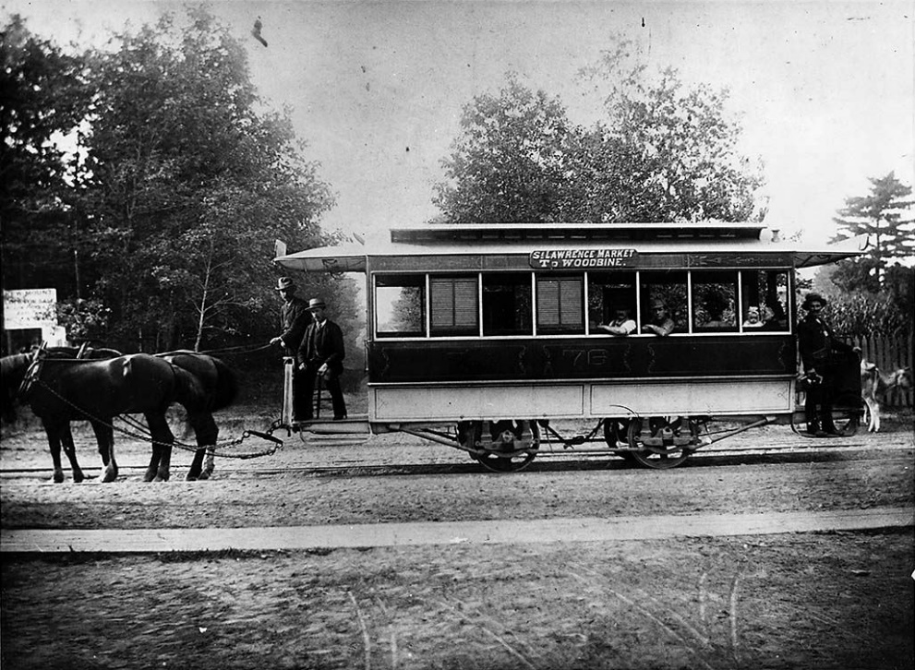
Should Not Overestimate the Novelty of Sharing
“Sharing” both as a public service and a commercial activity has a long history.

Slide 47
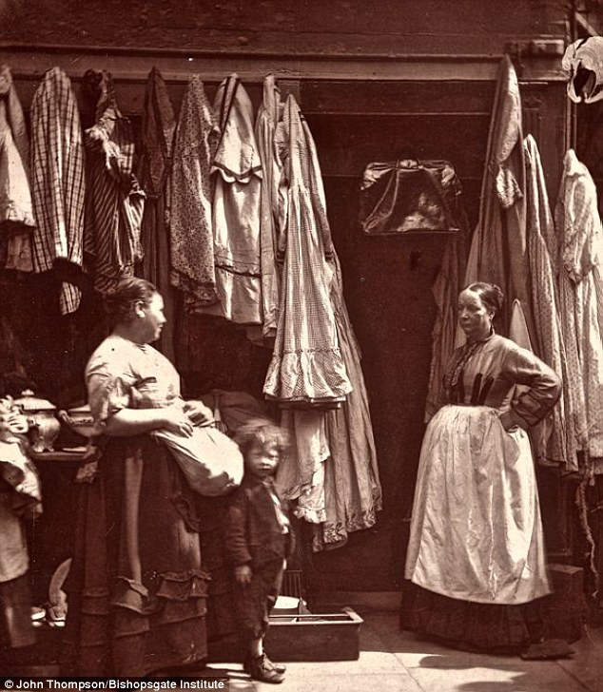
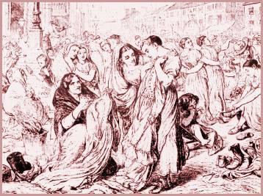
Should Not Overestimate the Novelty of Sharing
The trading of second-hand clothing was common during the 18th and 19th centuries, but lost favor due to public health concerns in the early years of the 20th century.

Slide 48

Should Not Overestimate the Novelty of Sharing
As the consumer society developed during the 20th century, sharing as an institutionalized practice came to be deeply stigmatized.

Slide 49
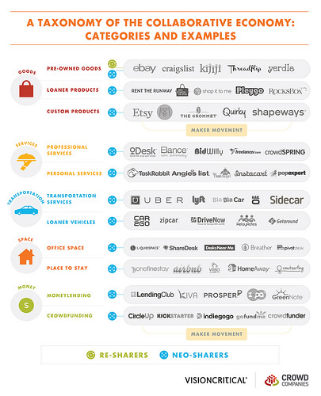
Size of the “Sharing” Economy Has Grown Exponentially

Slide 50

“Big Sharing”

Slide 51

Sharing Has Acquired Appeal as a Sustainability Strategy

Slide 52
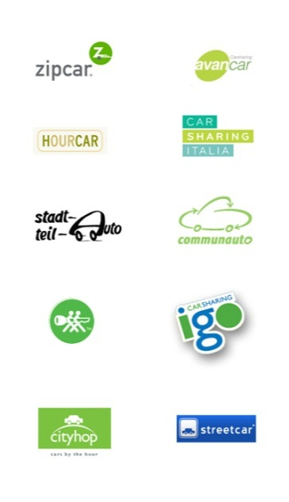



Major Facets of the “Sharing” Economy

Slide 53

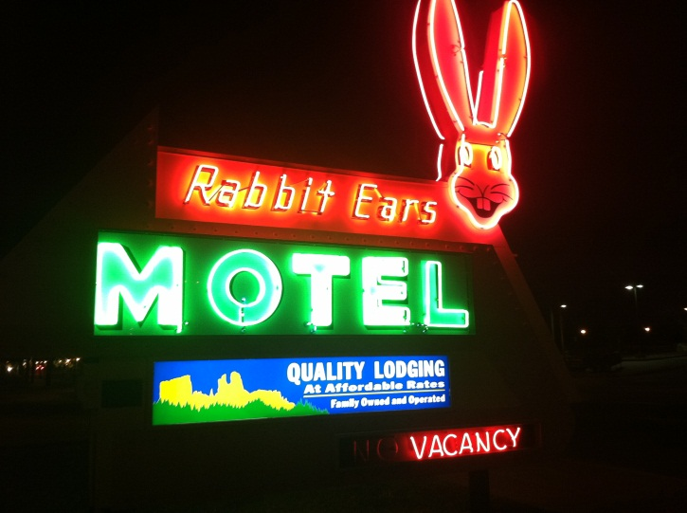
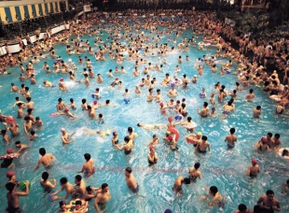
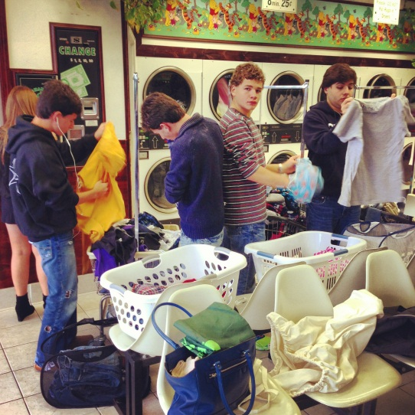
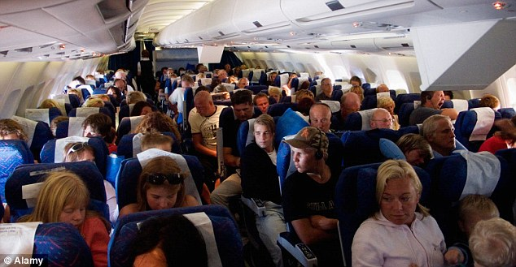
Conceptual Confusion Surrounding Sharing

Slide 54


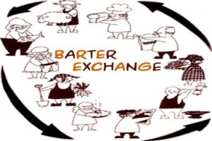
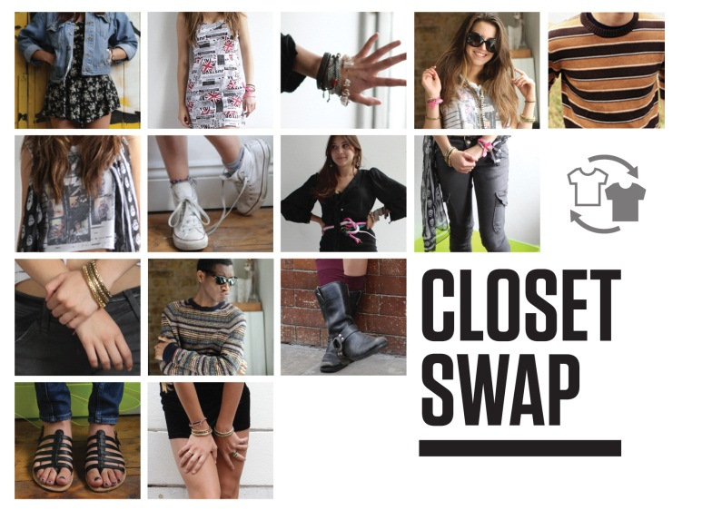
Conceptual Confusion Surrounding Sharing

Slide 55
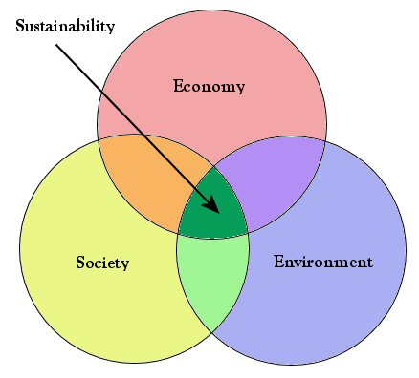
Assessing the Sustainability of the “Sharing” Economy

Slide 56
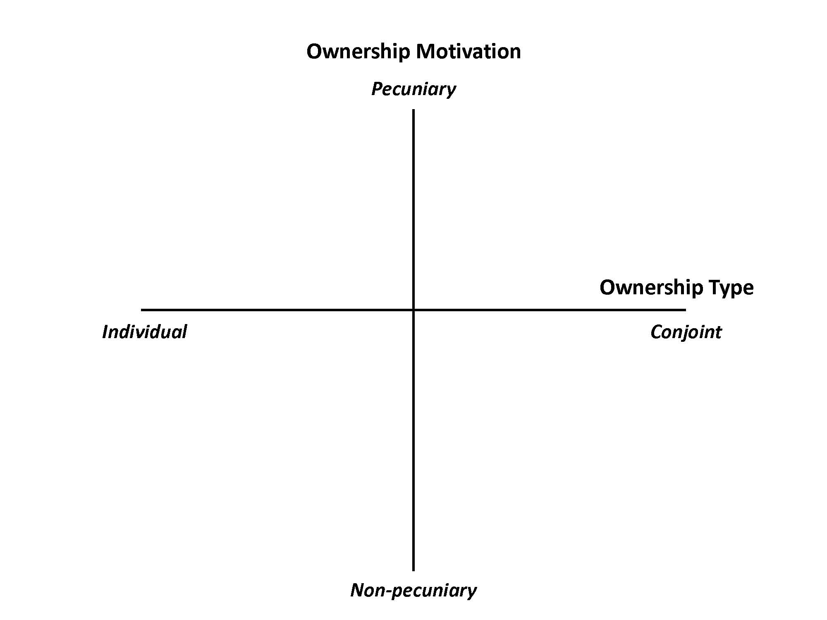
Social Sustainability of the Sharing Economy

Slide 57
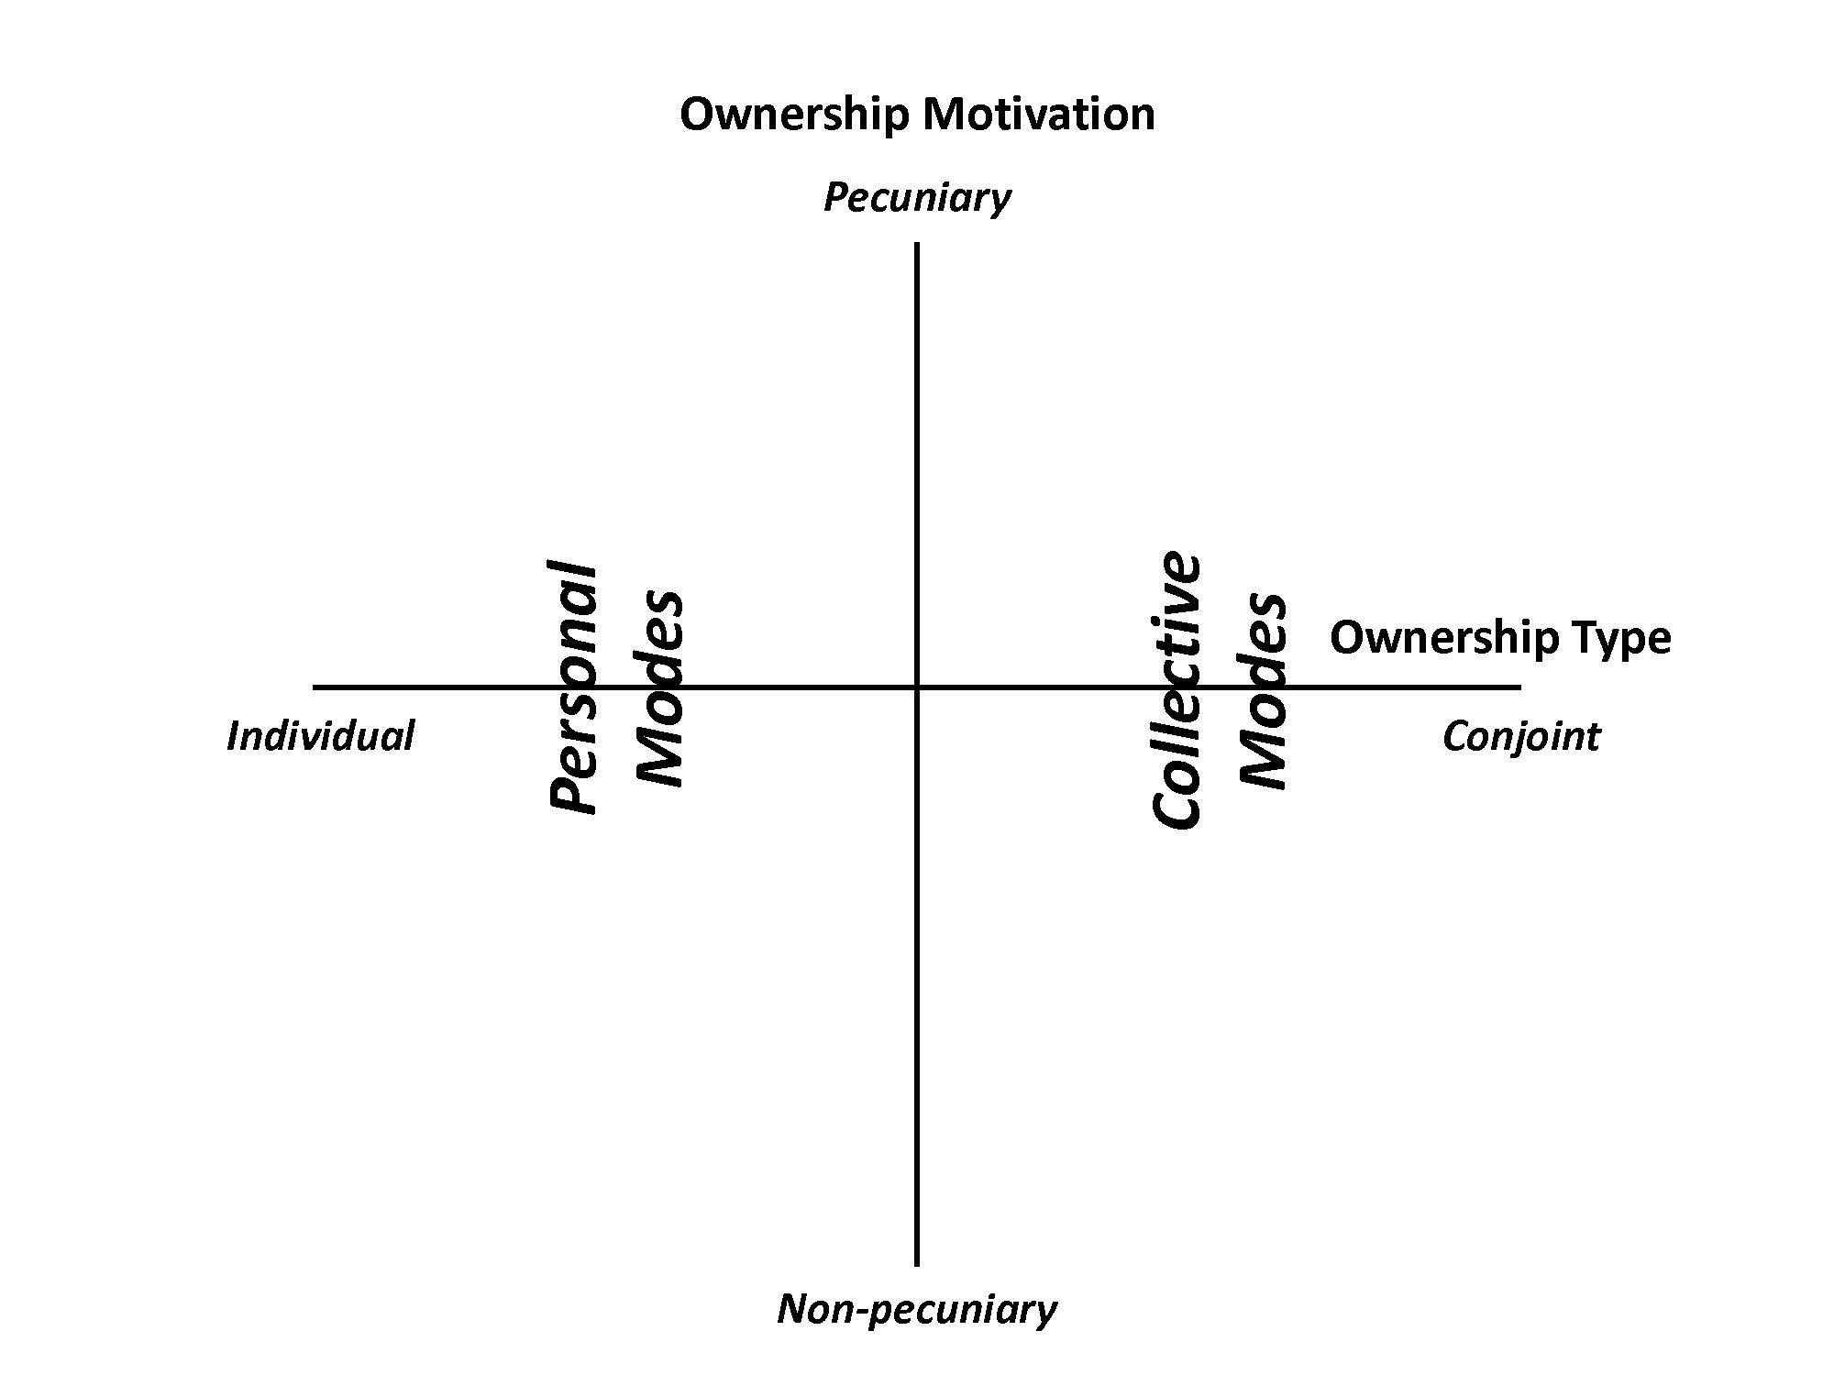
Social Sustainability of the Sharing Economy

Slide 58

Social Sustainability of the Sharing Economy

Slide 59

Social Sustainability of the Sharing Economy

Slide 60

Social Sustainability of the Sharing Economy
Individual
Conjoint

Slide 61
Serialized Rental Model
Nothing innovative about this model. The car rental companies and others have been engaged in this activity for decades.
It is highly debatable whether serialized rental actually reduces resource throughput as opposed to serving a “pump-priming” function by making consumption goods available at reduced cost for short periods of time.
There is a non-negligible risk that the relatively lower cost associated with access to serialized rental goods (especially clothing and accessories) will catalyze new modes of hyperconsumerism.
Seems to be a certain ambivalence on the part of firms engaged in serialized rental as to whether they are in fact part of the “sharing” economy.

Slide 62


Freelancing Model
Service providers are independent contractors rather than employees and receive no benefits or protections in the event of fluctuations in demand.
While the work offers opportunity for some flexibility, freelancers need to provide their own assets (e.g., car, house).
Engagement as a freelancer typically requires being continuously on the lookout for the next “gig.”

Slide 63



Environmental Sustainability of the Sharing Economy
Sharing economy proponents contend that there is widespread inefficiency and slack capacity in the consumer economy.

Slide 64



Improving the Efficiency of Consumption
Moving “efficiency thinking” from the production side of the economy to the consumption side.

Slide 65

Rebound Effects
Sharing proponents fall into the same trap as other advocates of efficiency-led strategies—they fail to acknowledge that more efficient use lowers costs and increases aggregate consumption.

Slide 66



Lower Prices Induce More Activity/Throughput

Slide 67

Sharing Really Is the New Shopping!

Slide 68


Consumer Goods in Micro-Sized Units

Slide 69


Economic Sustainability of the Sharing Economy
Narrative 1: Disruptive innovation of stagnant industries that enjoy regulatory protection.

Slide 70


Economic Sustainability of the Sharing Economy
Workers with employment protections are being displaced by an itinerant labor force of casual service providers.

Slide 71

Economic Sustainability of the Sharing Economy
Narrative 2: Internet-based businesses that are seeking to circumvent regulations (and taxes).

Slide 72


Economic Sustainability of the Sharing Economy
Regulation of public services and accommodation typically exist for good reason.

Slide 73

Economic Sustainability of the Sharing Economy
Narrative 3: A perceived opportunity for comparative economic advantage among cities.

Slide 74

Economic Sustainability of the Sharing Economy
About projecting an image that conveys hipness and technological savviness as a way to recruit millennial migrants and tourists.

Slide 75

Economic Sustainability of the Sharing Economy
Narrative 4: Creating employment opportunities for otherwise marginalized workers.

Slide 76

Economic Sustainability of the Sharing Economy
Are service workers in the sharing economy empowered micro-entrepreneurs or is shared access just “neo-liberal solutionism” with laborers part of a new “precariat”?

Slide 77


Diversionary Reframing and the Sharing Economy

